Slide 1
Guidelines To Juniper Switch Configuration

Slide 2
Contents:-
1.Accessing the Juniper Switch first time
2. Creating Username & Password
3.Upgrading JunOS
4. Create/Delete & Verify VLANs
5.Making Ports Access & Trunks
6.Assigning IP to Vlan Interface & Enabling SSH
7. Configuring Ether-Channels
8.Configuring VRRP & STP
9.Configuring Static-Route
10.Some Imp. Commands
11. Port-Channel Using LACP Protocol

Slide 3
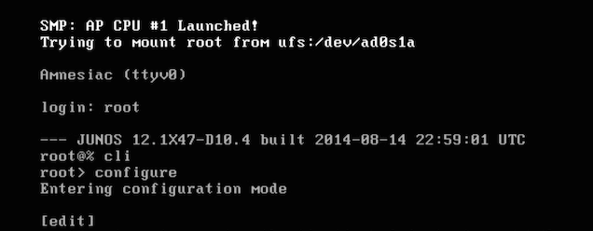
Accessing Juniper Switch First Time with Console
After a few seconds, switch will prompt for login.
We will use root (Default created user on Switch)
Login:root
Then enter command cli & then configure .
Now we are in configuration mode.

Slide 4
Creating Username & Password
Creating User & Password-
Type the following commands
root@switch# edit system login (this command will take us to system login configuration mode)
[edit system login]
Now give the name of user we want to add
root@switch# edit user Admin
The above command will create user with username Admin
root@switch# set authentication plain-text-password
New password:*******
Retype new password: *******

Slide 5
Upgrading JunOS
Using the below commands we can upgrade JunOS on EX(2200,2300,3200,3300,3400,4200,4300,4500,4550) Series Switches.
From FTP Server
Go to cli operation mode & type following commands
Sw1>
Sw1> request system software add ftp://ip-address/path/os-file-name
Here ip-address is of FTP Server .
From Switch
First we need to copy os file from pc to our switch using following commands
sw1> file copy ftp://ip-address/path/os-file-name /var/tmp/os-file-name
The Above command will copy os-file from FTP server to /var/tmp directory on switch
Sw1> request system software add /var/tmp/os-file-name

Slide 6
Upgrading JunOS
Now Reboot to start the new software using command
Sw1>request system reboot
After the reboot has completed, log in and verify that the new version of the software is properly installed
sw1> show version

Slide 7
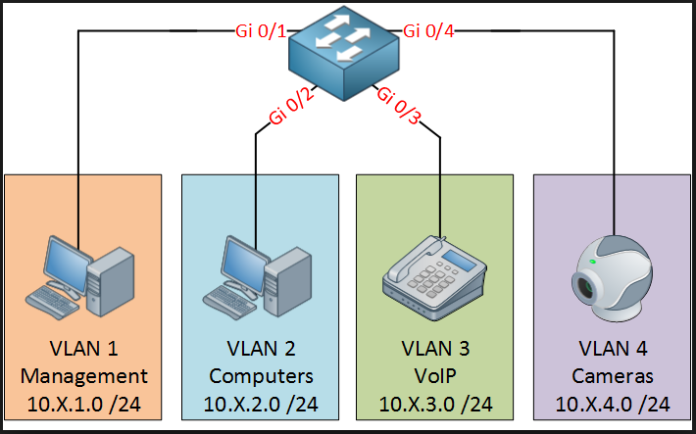
VLAN
A virtual LAN (VLAN) is any broadcast domain that is partitioned and isolated in a computer network at the data link layer (OSI layer 2). LAN is an abbreviation for local area network. To subdivide a network into virtual LANs, one configures network equipment.

Slide 8
Create/Delete & Verify VLANs
Creating Vlans
Type the following command in configuration mode
root@sw1: edit vlans (this command will take us to vlan configuration mode)
root@sw1: set name vlan-id number
root@sw1: set users vlan-id 10
root@sw1: set servers vlan-id 20
root@sw1: set printers vlan-id 30
The above commands will create Vlans named users, servers, printers with vlan-id 10, 20 & 30 respectively.
Deleting Vlans
root@sw1#delete vlans printers
This command will delete the printers vlan
Verifying Vlans
root@sw1# run show vlans

Slide 9
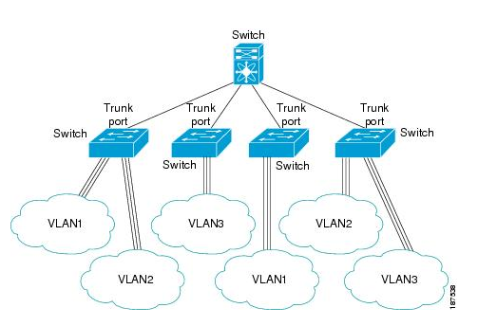
Switchport Mode Access or Trunk
Access Port
An access port can have only one VLAN configured on the interface; it can carry traffic for only one VLAN.
Trunk Port
A trunk port can have two or more VLANs configured on the interface; it can carry traffic for several VLANs simultaneously.

Slide 10
Making port Access/Trunk
Go to the configuration mode & type the following commands
root@sw1# edit interfaces
root@sw1#edit ge-0/0/0 unit 0 family ethernet-switching
root@sw1#set port-mode access
root@sw1#set vlan members users(name of created vlan you want to assign to this port) or
root@sw1: set interface ge-0/0/1 unit 0 family Ethernet-switching interface-mode access
root@sw1: set interface ge-0/0/1 unit 0 family Ethernet-switching vlan members servers
For making trunk port
root@sw1#edit interfaces
root@sw1#edit ge-0/0/1 unit 0 family ethernet-switching
root@sw1#set port-mode trunk
root@sw1#set vlan members users
root@sw1#set vlan members servers (Specify the name of vlans you want to allow on this trunk port)

Slide 11
Assigning IP to Vlan Interface & Enabling SSH
root@sw1#set interface vlan unit 10 family inet address 192.168.1.11/24
root@sw1#set vlans v10 l3-interface vlan.10
root@sw1#show interface terse
root@sw1#show route
The above command will assign IP ADDRESS to interface vlan 10
Enabling SSH/Telnet
root@sw1# set system services ssh
root@sw1# set system services telnet

Slide 12
Configuring Ether-Channels
To configure Ether-Channel following set of commands will be used
First of all we need to create an LAG(Link Aggregation Group) following commands
[edit]
root@sw1# edit chassis
root@sw1# set chassis aggregated-devices ethernet device-count 4
(The above command will create 4 “ae” interfaces, after you commit, you should see ae0 – ae 3 created)
root@sw1#commit (this command is used to save the configuration)
root@sw1# edit interfaces
root@sw1# set ae0 unit 0 family ethernet-switching
root@sw1# set ae0 aggregated-ether-options LACP active
The above commands will put the ae0 interface in LACP active mode
root@sw1# set ge-0/0/1 ether-options 802.3ad ae0
root@sw1# set ge-0/0/2 ether-options 802.3ad ae0 (We have bundled these interfaces with ae0 interface)
root@sw1# commit
root@sw1# run show interface terse | match ae0
(This will show the status of ae0(i.e up or down) & interfaces it includes)

Slide 13
Configuring VRRP on Juniper L3 Switches
sw1# set interfaces vlan unit 30 family inet address 10.1.1.11/24 vrrp-group 1 virtual-address 10.1.1.1
sw1# set interfaces vlan unit 30 family inet address 10.1.1.11/24 vrrp-group 1 priority 200
Commands to be run on Sw2 are
sw2# set interfaces vlan unit 30 family inet address 10.1.1.12/24 vrrp-group 1 virtual-address 10.1.1.1
sw2# set interfaces vlan unit 30 family inet address 10.1.1.12/24 vrrp-group 1 priority 100
In the above commands we have assigned IP Address of same subnet to vlan 30 on both switches & created a vrrp-group 1
With virtual-address for forwarding the traffic to be 10.1.1.1
By default higher priority Switch will be Active in this case Switch1 (Priority 200)
sw1# set interfaces vlan unit 30 family inet address 10.1.1.11/24 vrrp-group 1 preempt
sw2# set interfaces vlan unit 30 family inet address 10.1.1.12/24 vrrp-group 1 preempt (Enabling preempt)

Slide 14
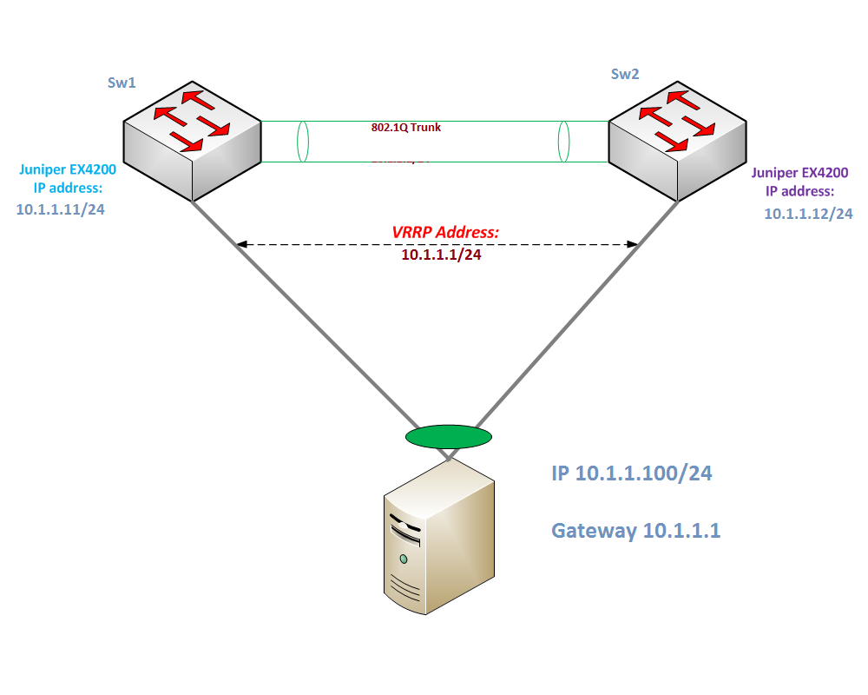
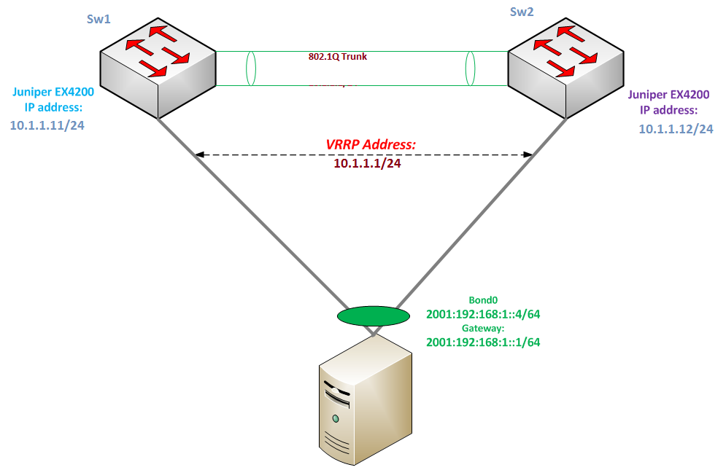
Configuring VRRP on Juniper L3 Switches
Now we need to configure Vlan 30 interface to accept packets destined for the virtual IP address.
sw1# set interfaces vlan unit 30 family inet address 10.1.1.11/24 vrrp-group 1 accept-data
sw2# set interfaces vlan unit 30 family inet address 10.1.1.12/24 vrrp-group 1 accept-data
Checking the configuration
sw1# show interfaces vlan.30
family inet {
address 10.1.1.11/24{
vrrp-group 1 {
virtual-address 10.1.1.1;
priority 200;
preempt;
accept-data;

Slide 15
Configuring STP on Juniper Switch
The default spanning-tree protocol for EX Series switches is Rapid Spanning Tree Protocol (RSTP). RSTP provides faster convergence times than the original Spanning Tree Protocol (STP). However, some legacy networks require the slower convergence times of basic STP that work with 802.1D 1998 bridges.
To configure STP:
Either delete RSTP on the entire switch or disable RSTP on specific interfaces:
To delete RSTP on the entire switch:
Sw1# edit protocols
sw1# delete rstp
To disable RSTP on a specific interface:
Sw1# edit protocols
sw1# set rstp interface interface-name disable
Enable STP either on all interfaces or on a specific interface:
To enable STP on all interfaces:
Sw1# edit protocols
sw1# set stp interface all
To enable STP on a specific interface:
Sw1# edit protocols
sw1# set stp interface interface-name

Slide 16
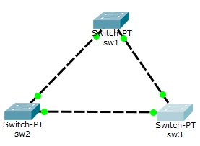
Configuring Vlan STP on Juniper Switch
First we will run Vlan STP(VSTP) for all the vlans using commands
Sw1# set protocols vstp vlan all
Sw2# set protocols vstp vlan all
Sw3# set protocols vstp vlan all
Now let we want to make Sw1 as Root Bridge for vlan1,Sw2 for vlan 2
& Sw3 for vlan 3 then following command will help
Sw1# edit protocols vstp (Now we have entered in VSTP configuration mode)
Sw1# edit vlan 1
Sw1# set bridge-priority 4096 (Lowest priority Switch will become ROOT-Bridge)
The above commands will make our Sw1 as root-bridge for vlan 1
Similarly we will configure Sw2 & Sw3 to be Root-Bridge for vlans 2 & 3 respectively.
Sw1# show spanning-tree bridge (This command will show the spanning tree status)
Sw1# show spanning-tree interface (To check Spanning-tree interfaces states)

Slide 17
Static Route & Inter-Vlan Routing
Static Route
Sw1#set routing-options static route destination-network next-hop ip-address of next-hop
Inter-Vlan Routing
For Inter-Vlan-Routing Each Vlans must be assigned an Ip Address using commands
Sw1#set interface vlan unit number-of-vlan family inet address ip-address/mask
Sw1#set vlan name-of-vlan L3-interface vlan.1
Sw1#set vlan name-of-vlan L3-interface vlan.10
Sw1#set vlan name-of-vlan L3-interface vlan.20
Run this command for all the vlan between which Inter-Vlan-Routing is required.

Slide 18
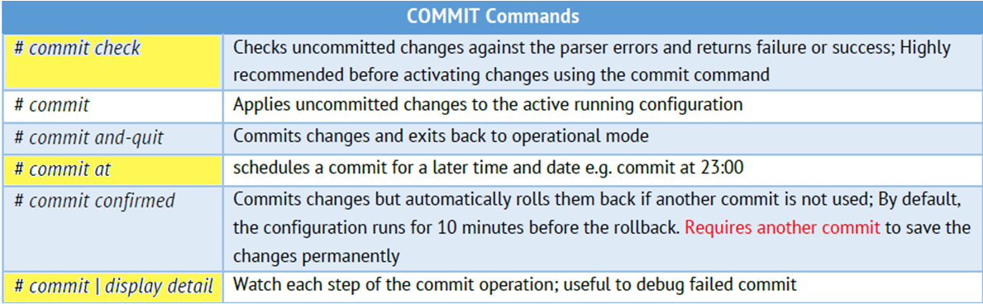
Some Show Commands
sw1> show interface terse Equivalent to show ip interface brief command from the Cisco
sw1> show interface terse | match ge-0/0/1 Equivalent to show run interface | include 0/1 command from the Cisco
Sw1> show interface terse | except ge-0/0/1 Equivalent to show run interface | exclude 0/1 command from the Cisco
sw1> show interface terse | find ge-0/0/1 Equivalent to show run interface | begin 0/1 command from the Cisco
Sw1# run show ether-switching table Equivalent to show mac-address-table

Slide 19
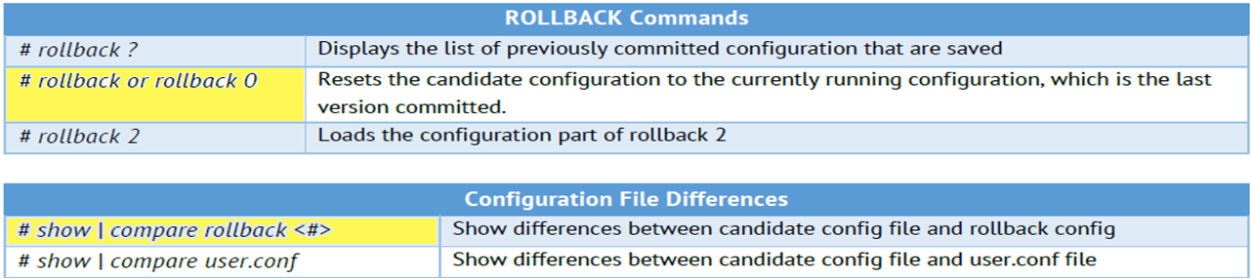
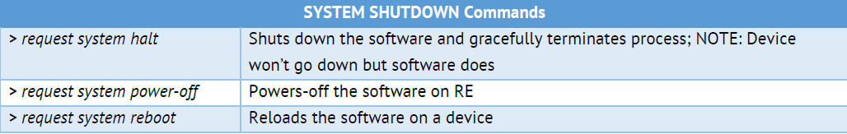

Slide 20
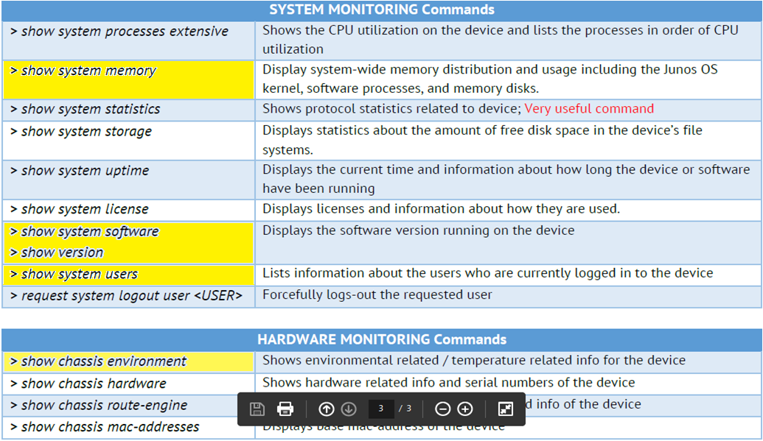

Slide 21
Port-Channel Using LACP Protocol
Step 1-
The first and very important command is to specify number of bundle (aggregated interface) you want to create. Here we will create two bundle links each having two Ethernet from different VC member (switch).
{master:0}[edit]
root@sw# set chassis aggregated-devices ethernet device-count 2
This means that, two bundle interfaces will be created i.e. ae0 and ae1. You can see these interfaces after you commit the configuration changes.
Step 2-
Now you have to delete all the configuration of the interface. This is because, to add interfaces to bundle, the interfaces should not have any configuration like VLANs, MTU, etc.
{master:0}[edit]
root@sw# delete interface ge-0/0/0 unit 0
Step 3-
Now we have to associate physical interface with an aggregated Ethernet interface. To do so hit the following command,
{master:0}[edit]
root@sw# set interface ge-0/0/0 ether-options 802.3ad ae0

Slide 22
Port-Channel Using LACP Protocol
Step 4:-
Configure interface parameters like VLANs, MTU, port-mode, etc. in ae interfaces.
{master:0}[edit]
root@sw# set interfaces ae0 aggregated-ether-options lacp active periodic fast
root@sw# set interface ae0 unit 0 family ethernet-switching vlan members Mail
root@sw# show
Step 5:-
Verify aggregated interfaces is up. If the ae interfaces are down then you have done some mistakes. Re check the configuration and re configure it.
{master:0}[edit]
root@sw# run show interfaces terse | match ae
root@sw# run show interfaces ae0

Slide 23
Thanks

