Slide 1
Guidelines To HP Switch Configuration

Slide 2
Contents-
1.Accessing the Switch through Console
2.Setting Username and Password
3.Upgrading HP Switch Firmware
4.Creating/Deleting Vlans & assigning IP to vlan
5.Assigning Ports to Vlans & making ports Access/Trunk
6.Configuring STP/Rapid pvst
7.Enabling Telnet/SSH on the Switch
8.Configuring Ether-Channels
9.Configuring VRRP
10.Inter-Vlan Routing

Slide 3

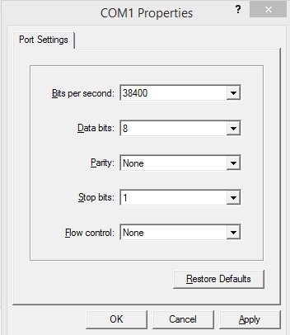
Accessing HP Switch First Time with Console
Connect a console cable to the console port of your switch & serial port of PC. Then make terminal setting as shown

Slide 4
2.Setting Username and Password
After a few seconds, switch will in cli configuration mode
Sw> enable
Sw# conf
Sw(conf)# password ***** user-name admin

Slide 5
Upgrading HP Firmware
First download the new Firmware to be installed. Copy it to TFTP Server. Now run the command
Hpsw# sh flash
Hpsw# copy tftp flash ip-address-of-tftp name-of-file primary (file saved on the primary flash)
the primary os will be deleted, continue [y/n]? y
Hpsw# sh flash
Now reboot switch with new Firmware
HPSW# reload
After reboot check OS version
HPSW# show version

Slide 6
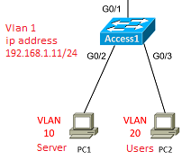
4.Creating/Deleting Vlans & assigning IP to vlan
Creating/Deleting Vlans
Type the following command in configuration mode
HP-SW(conf)# vlan 10 (we will enter in vlan context config. mode)
HP-SW(vlan-10)# name Servers
HP-SW(vlan-10)# vlan 20
HP-SW(vlan-20)# name Users
HP-SW(conf)# no vlan 10 (it will remove vlan 10)
Verifying Vlans
sw# show vlans
Assign IP to Vlan
HP-SW(conf)# vlan 1
HP-SW(conf)# ip address ip-address subnet-mask
HP-SW(conf)# ip address 192.168.1.11 255.255.255.0

Slide 7
Assigning Vlans to Switchport & making port Access/Trunk
Go to the configuration mode & type the following commands
Making Access Ports
On a single port only one vlan can be untagged at most.
HP-SW(conf)# vlan 10
HP-SW(vlan-10)# untagged 1-10 (this command makes ports 1-10 access for vlan 10)
(the above command will assign ports 1-10 untagged for vlan 10)
Making trunk ports
Sw(conf)# vlan 10 tagged 5
Sw(conf)# vlan 20 tagged 5 (it will make port 5 trunk with vlan10, 20 tagged & vlan 1 untagged(BY default))
We need to run vlan tagged command for vlans we want to allow on the trunk

Slide 8
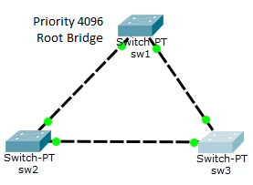
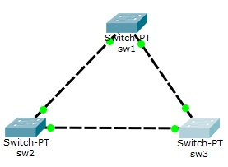
6.Configuring STP/Rapid PVST
Note- By deafult STP is Disabled on HP Procurve Routing Switches.
So we must first enable STP before making the switch live.
sw(conf)# spanning-tree (this will enable MST on switch globally)
sw(conf)# spanning-tree priority 4096 (it makes this switch root)
sw(conf)# write memory
(default is 32768, Lower priority switch will be the root bridge)
Enabling Rapid PVST-
sw1(config)# spanning-tree mode rapid-pvst
sw(config)# spanning-tree priority number
Enabling spanning-tree on a Vlan-
Sw(conf)# vlan 5
Sw(conf)# spanning-tree
Sw(conf)# spanning-tree priority number

Slide 9
7.Enabling Telnet/SSH on the Switch
For enabling Telnet/SSH we must have atleast an IP configured on the switch
sw(conf)# vlan 1
sw(conf)# ip address 192.168.1.100 255.255.255.0
Now give default gateway so that switch can be managed from different subnet.
sw(conf)# ip default-gateway ip-address-next-hop
Enabling SSH
sw(conf)# crypto key generate ssh
sw(conf)# ip ssh (Enable SSH version 1 if version 2 isn’t supported)
sw(conf)# ip ssh version 2 (Enable SSH version 2 if supported)
Enabling/Disabling Telnet-
sw(conf)# telnet-server
sw(conf)# no telnet-server

Slide 10
Enabling/Disabling Web-Management SSL-
Enabling/Disabling Web-Management SSL-
sw(conf)# crypto host-cert generate self-signed
(generate self-signed certificate for host)
sw(conf)# web-management ssl
sw(conf)# no web-management plain-text

Slide 11
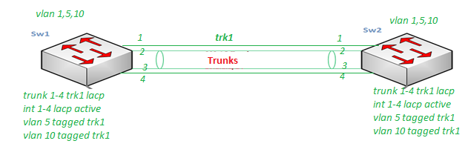
8.Configuring Ether-Channels
First create a trunk group trk1 & assign interfaces to it & use LACP
sw1(conf)# trunk 1-4 trk1 LACP
sw1(conf)# int 1-4 lacp active (configure these interfaces for LACP active)
Now allow VLANs for tagging which we want to allow over this trunk group i.e.
sw1(conf)# vlan 5 tagged trk1 (by default vlan 1 is untagged over trunk)
sw1(conf)# vlan 10 tagged trk1

Slide 12
8.Configuring Ether-Channels
Now configure the sw2
sw2(conf)# trunk 1-4 trk1 LACP
sw2(conf)# int 1-4 lacp (active or passive)
sw2(conf)# vlan 5 tagged trk1
sw2(conf)# vlan 10 tagged trk1
(Note- vlan id tagged trk1 command must be same on both switches)

Slide 13
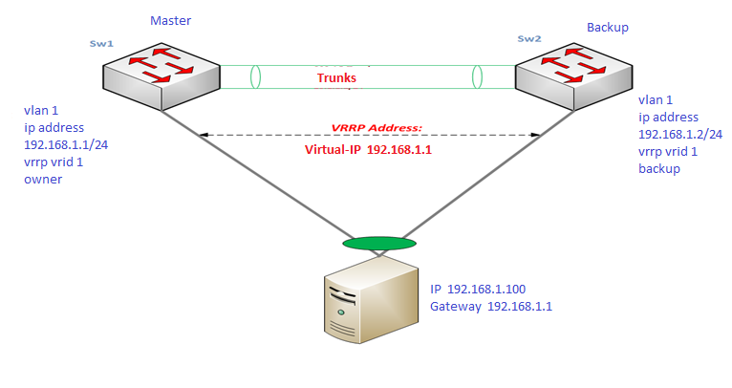
9.Configuring VRRP
sw1(conf)# router vrrp
sw1(conf)# vlan 1
sw1(conf)# ip address 192.168.1.1 255.255.255.0
sw1(conf)# vrrp vrid 1 (vrrp virtual router id 1)
sw1(conf)# owner (to make this Primary )
sw1(conf)# virtual-ip-address 192.168.1.1 255.255.255.0
sw1(conf)# enable (enabling the VR instance)
sw1# show vrrp vlan 1 vrid 1 config
sw1# show vrrp config global
sw1# show vrrp statistics global

Slide 14
9.Configuring VRRP
Now configure on Switch 2
sw2(conf)# router vrrp
sw2(conf)# vlan 1
sw2(conf)# ip address 192.168.1.2 255.255.255.0
sw2(conf)# vrrp vrid 1
sw2(conf)# backup
sw2(conf)# virtual-ip-address 192.168.1.1 255.255.255.0
sw2(conf)# enable

Slide 15
10.Inter-Vlan Routing
Static Route-
sw(conf)# ip routing
sw(conf)# ip route destination-network subnet-mask next-hop-ip
sw(conf)# ip route 10.1.1.0 255.255.255.0 192.168.1.1
Inter-Vlan Routing
first create all the required vlan on L3 switch and assign ip address to
these which will act as gateway for that vlan.
sw(config)# vlan 1
sw(config-vlan-1)# ip address 10.1.1.254 255.255.255.0
sw(config-vlan-1)# vlan 2
sw(config-vlan-2)# ip address 10.1.2.254 255.255.255.0
sw(config-vlan-2)# vlan 3
sw(config-vlan-3)# ip address 10.1.3.254 255.255.255.0
sw(config-vlan-3)# exit

Slide 16
Thanks

