Slide 1
Cisco Switch Configuration document

Slide 2
Accessing Cisco Switch First Time with Console
Basic Configuration
Configure username/password & Enable SSH/Telnet
Create/Delete VLAN
Assign IP & Default Gateway on VLAN for Management Access
Define Access/Trunk Ports
Description on Ports
Save Configuration & Backup Configuration

Slide 3
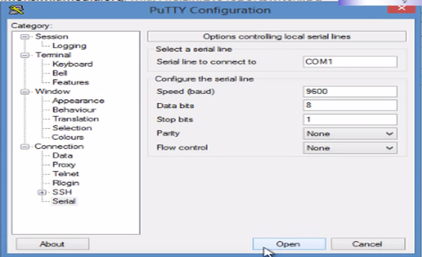
Accessing Cisco Switch First Time with Console
Connect a console terminal to the console interface of your supervisor engine.

Slide 4
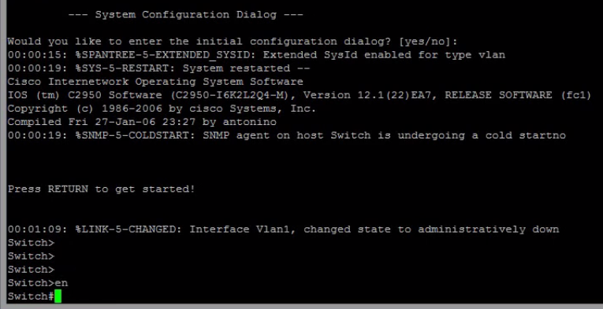
Accessing Cisco Switch First Time with Console
After a few seconds, you see the user EXEC prompt (Switch>).
Now, you may want to enter privileged EXEC mode, also known as enable mode. Type enable to enter enable mode:
Switch> enable

Slide 5

Basic Configuration
Go to Config Mode
Set Hostname
Set username and password
Set Enable Password

Slide 6
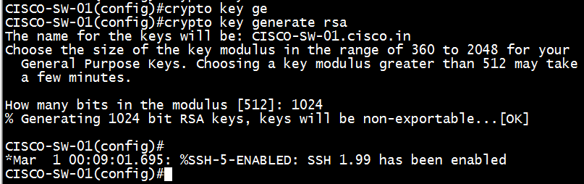

Enable SSH
Set IP Domain Name for SSH key
Generate RSA key
Enable SSH in vty

Slide 7
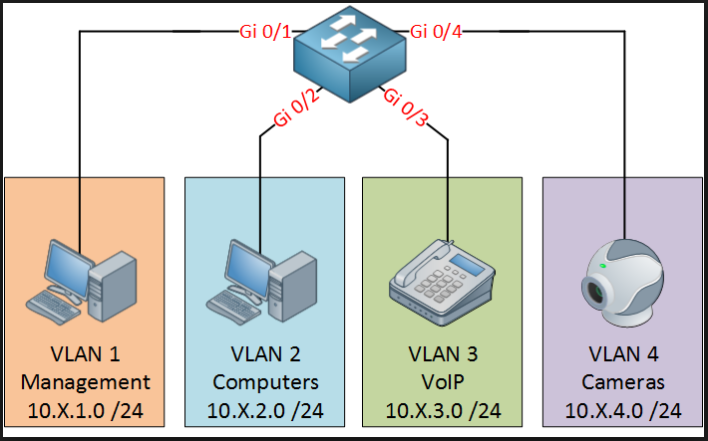
VLAN
A virtual LAN (VLAN) is any broadcast domain that is partitioned and isolated in a computer network at the data link layer (OSI layer 2). LAN is an abbreviation for local area network. To subdivide a network into virtual LANs, one configures network equipment.

Slide 8
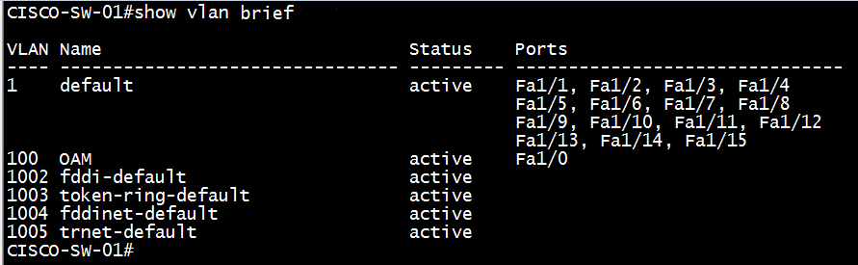
Create or Delete VLAN
Create VLAN
Delete VLAN
Verify created VLAN

Slide 9
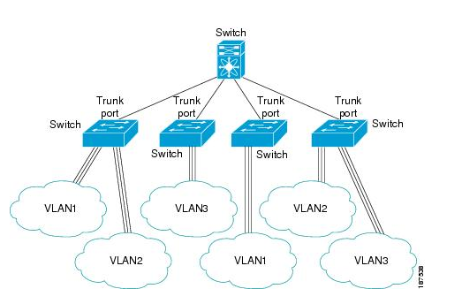
Switchport Mode Access or Trunk
Access Port
An access port can have only one VLAN configured on the interface; it can carry traffic for only one VLAN.
Trunk Port
A trunk port can have two or more VLANs configured on the interface; it can carry traffic for several VLANs simultaneously.

Slide 10


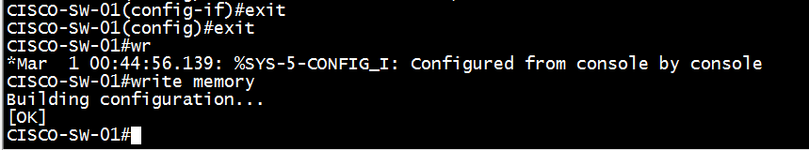
Switchport Configuration Access or Trunk
Access Port
Trunk Port & allowed VLAN
Interface Description
Exit & Save Configuration

Slide 11
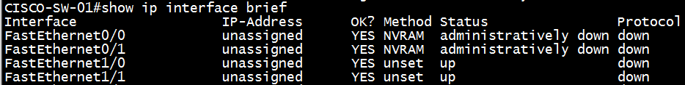
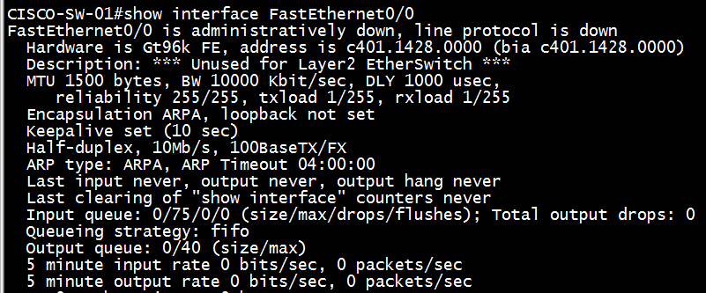
Verify Interfaces Status
Interfaces Status
Interface Details

Slide 12
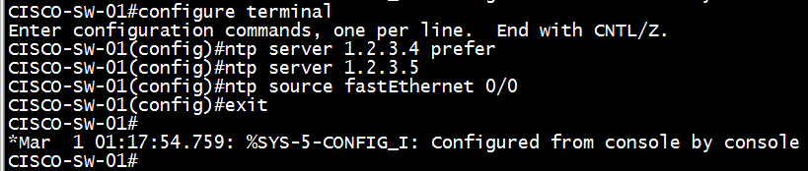
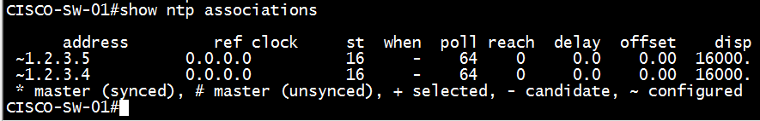
NTP Configuration
NTP Configuration
Verify NTP Configuration

Slide 13

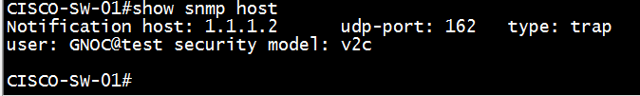
SNMP Configuration
SNMP Configuration
Verify SNMP Configuration

Slide 14
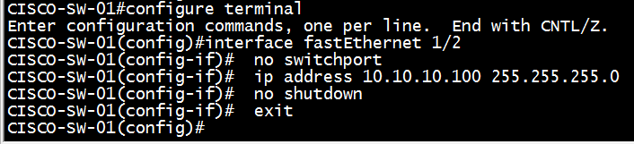
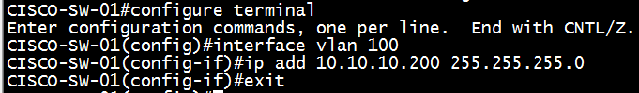

IP & Gateway Configuration
Interface IP Configuration
(Only for Layer3 Switch)
VLAN IP Configuration
IP Gateway Configuration

Slide 15
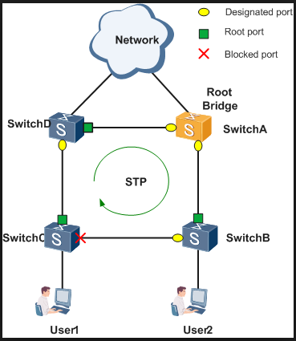
Spanning Tree Protocol
Spanning Tree Protocol (STP) is a Layer 2 protocol that runs on bridges and switches. The specification for STP is IEEE 802.1D. The main purpose of STP is to ensure that you do not create loops when you have redundant paths in your network. Loops are deadly to a network.
By Spanning Tree Protocol is enabled in Cisco Switches.

Slide 16
Spanning Tree Protocol
All decisions in STP are made from the perspective of Root Bridge. Switch with the lowest switch ID is selected as Root Bridge. BPDU contains Switch ID. Switch ID is made from priority of the switch and MAC address of switch itself. Default priority is set to 32768. Switch with the lowest MAC address will be selected as the root switch, if you don’t change the default priority value. You can override root selection process by changing the priority value. If you want one switch to be Root Bridge, change its priority value to less than 32768.
Root Bridge
Root port is a port that is directly connected with the Root Bridge, or has the shortest path to the Root Bridge. Shortest path is path that has lowest path cost value. Remember that switch can go through many other switches to get the root. So it’s not always the shortest path but it is the fastest path that will be used.
Root Port
Designated Port
Designated port is the port that is selected as having the lowest port cost. Designated port would be marked as forwarding port.
Blocking Port
Blocking port remains disable to remove loops.

Slide 17
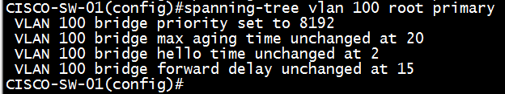

Spanning Tree Protocol Modification
Manual Root-Bridge Selection
Change STP Priority
Change Root Path Cost

Slide 18
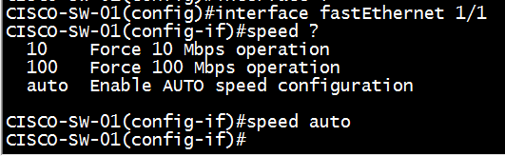
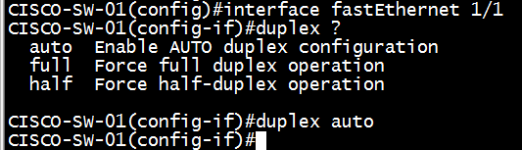
Speed & Duplex
Change Interface Speed Manually
Change Interface Duplex Manually

Slide 19
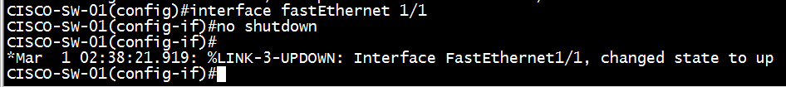
Manually Disable/Enable Interface
Disable/shutdown
Enable/no shutdown

Slide 20
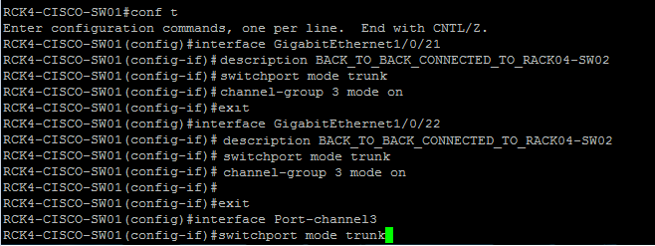
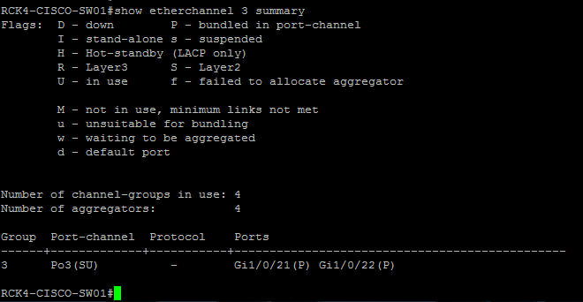
Ether Channel Configuration
Configure Ether Channel
Verify Ether Channel

Slide 21
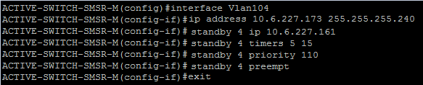
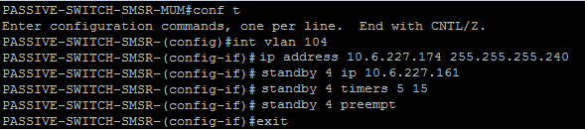

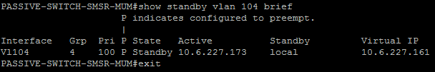
HSRP/VRRP Configuration
Configure HSRP on Switch-01
Configure HSRP on Switch-02
Verification of HSRP on Switch-01
Verification of HSRP on Switch-01

Slide 22



Backup & Restore Configuration
Backup
Restore
Take output of “#show running-config” command
Show running Backup

Slide 23
Switch configuration checklist and HA document

Slide 24
Thanks

