Slide 1
Cisco Switch Configuration document

Slide 2
Function of switches (L2)
Address Resolution Protocol
Function of switches (L3)
VLANs
Trunk and Access port
Spanning Tree Protocol (STP)
STP Port States
STP Enhancements
EtherChannel
EtherChannel (LACP & PAgP)
Switch Port Analyzer (SPAN)
Static Routing
Basic command through CLI
How to configure ports and VLANs
Trunk and Access port configuration
STP Modifications
17. STP Enhancements
18. EtherChannel configuration
19. LACP configuration
20. PAgP configuration
21. EtherChannel misconfiguration guard
22. SPAN configuration
23. Verify Span
24. Static Route configuration
25. Troubleshooting of various issues faced with switches.
26. Sample configuration
27. Backup and Restore

Slide 3
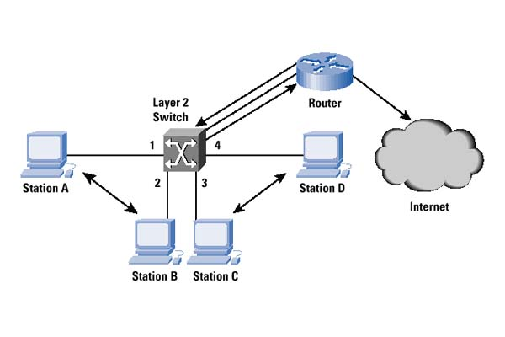
Function of switches (L2)
Function of L2 Switch
Traditional switching operates at layer 2 of the OSI model, where packets are sent to a specific switch port based on destination MAC addresses. Devices in the same layer 2 segment do not need routing to reach local peers. What is needed however is the destination MAC address which can be resolved through the Address Resolution Protocol (ARP)

Slide 4


Address Resolution Protocol
Host C
192.168.1.3
ARP (Address Resolution Protocol) is a network protocol used to find out the hardware (MAC) address of a device from an IP address
ARP request packets are sent to the broadcast addresses (FF:FF:FF:FF:FF:FF for the Ethernet broadcasts and 255.255.255.255 for the IP broadcast).
ARP Request
ARP Request
Host B
Host A
ARP Reply
ARP Request
192.168.1.2
192.168.1.1/24
Source IP
192.168.1.1
Destination IP
192.168.1.2
Source MAC
A
Destination MAC
FF:FF:FF:FF:FF:FF
(Broadcast)
Host D
192.168.1.4

Slide 5
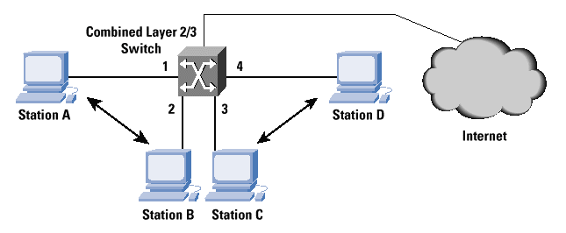
Function of switches (L3)
Function of L3 Switch
The key points are that layer 2 switches forward frames using only layer 2 information (MAC address of destination). Layer 3 switches have the capability of layer 2 switches to forward using destination MAC address but also the capability to forward using layer 3 information (destination IP address)

Slide 6
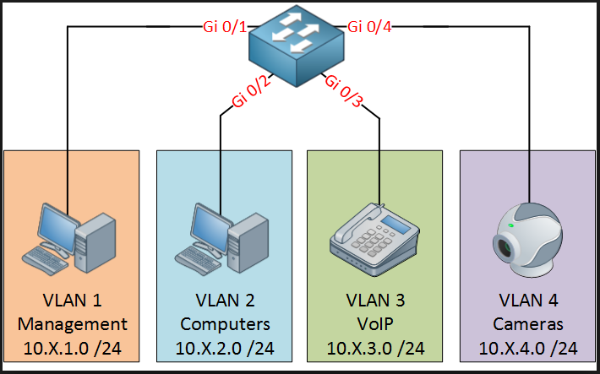
VLANs
VLAN
A virtual LAN (VLAN) is any broadcast domain that is partitioned and isolated in a computer network at the data link layer (OSI layer 2). LAN is an abbreviation for local area network. To subdivide a network into virtual LANs, one configures network equipment.

Slide 7
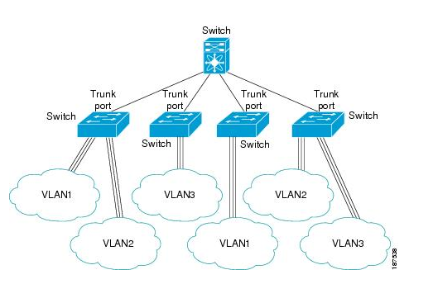
Trunk and access port
Access Port
An access port can have only one VLAN configured on the interface; it can carry traffic for only one VLAN.
Trunk Port
A trunk port can have two or more VLANs configured on the interface; it can carry traffic for several VLANs simultaneously.

Slide 8
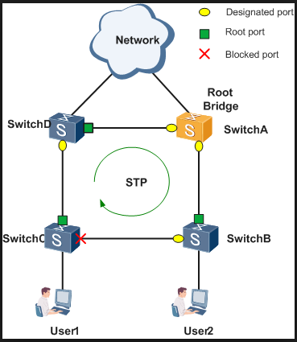
Spanning Tree Protocol
Spanning Tree Protocol (STP) is a Layer 2 protocol that runs on bridges and switches. The specification for STP is IEEE 802.1D. The main purpose of STP is to ensure that you do not create loops when you have redundant paths in your network. Loops are deadly to a network.
By Spanning Tree Protocol is enabled in Cisco Switches.

Slide 9
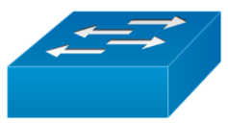
BPDU Exchange
Root Bridge ID
MAC + Bridge Priority
Cost to Root
Sending Bridge ID
32768.02.aa.c1.32.ed.ff
Hello Timer = 2 Sec
Max Age = 20 sec
Port Role
Port State
Cost to root = 0+4
Cost to root = 4
Root Port (Port on the local Switch that provide the least path cost to the switch)
DP
RP
F
F
F
Cost to root = 0
Cost to root 4+4=8
Designated Port (Port on the cable that provide the least path cost to the switch)
B
DP
ND
F
Cost to root 4+ 4= 8
Cost to root =4
B
F
Non-Designated port
DP
RP
F
32768.02.aa.c1.32.a1.f1
Cost to root = 0
Cost to root = 0+4
Elected as Root Bridge
32768.02.aa.c1.32.ff.22
Gig Eth = 04

Slide 10
STP Port State
Disabled
Port that is in the down state
Blocking
Port that is only allowed to receive the BPDU .
Cannot send or receive data or add MAC address on its port
Listening
Port that is allowed to send and receive BPDU.
Can actively participate in the STP
Cannot send and receive data
Allowed to send and receive BPDU
Can learn MAC addresses to add its addresses table
Cannot send and receive data
Learning
Forwarding
Receiving BPDUs, Forwarding data traffic, receiving data traffic, learns MAC addresses

Slide 11
Spanning Tree Protocol
All decisions in STP are made from the perspective of Root Bridge. Switch with the lowest switch ID is selected as Root Bridge. BPDU contains Switch ID. Switch ID is made from priority of the switch and MAC address of switch itself. Default priority is set to 32768. Switch with the lowest MAC address will be selected as the root switch, if you don’t change the default priority value. You can override root selection process by changing the priority value. If you want one switch to be Root Bridge, change its priority value to less than 32768.
Root Bridge
Root port is a port that is directly connected with the Root Bridge, or has the shortest path to the Root Bridge. Shortest path is path that has lowest path cost value. Remember that switch can go through many other switches to get the root. So it’s not always the shortest path but it is the fastest path that will be used.
Root Port
Designated Port
Designated port is the port that is selected as having the lowest port cost. Designated port would be marked as forwarding port.
Blocking Port
Blocking port remains disable to remove loops.

Slide 12
STP Enhancements
Port Fast Excludes ports which are not connected to bridges or switches. Reduces the STP data size.
Ports do not go through blocking, listening, learning and forwarding phases, but go straight to forwarding.
Port Fast
PVST stands for Per Vlan Spanning Tree.
By using PVST we can select any switch as a root bridge for a particular Vlan. By doing so, we achieve the load balancing in a network.
PVST is enabled by-default on cisco switches.
We achieve the PVST by decreasing the priority value of a switch for Vlans/Vlan.
PVST
RSTP stands for rapid-STP.
Convergence time of PVST is high so we use RSTP for less convergence time.
RSTP

Slide 13
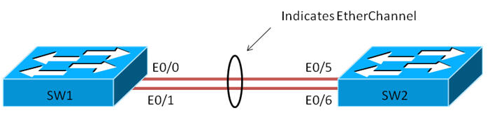
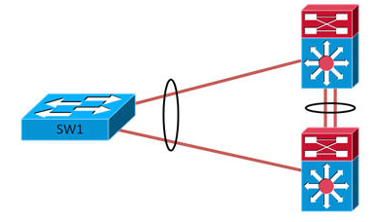
EtherChannel
EtherChannels consist of individual links bundled into a single logical link.
Provides fault tolerant high speed links between switches, routers, and servers.
Can provide full duplex bandwidth up to 800 Mbps.
EtherChannels can consist of up to eight interfaces.
Each Etherchannel has a logical port channel interface numbered from 1-6

Slide 14
EtherChannel
LACP can be configured in either Passive or Active mode. In active mode, the port actively tries to bring up LACP.
In passive mode, it does not initiate the negotiation of LACP.
LACP and PAgP are not compatible – both sides of an EtherChannel must use the same aggregation protocol.
Link Aggregation Control Protocol (LACP)
PAgP is a Cisco-proprietary aggregation protocol
PAgP protocol data units (PDUs) are sent and received on the lowest numbered VLAN of the trunk link.
Auto – This is the passive negotiating state which responds to PAgP packets.
Desirable – Places interface into an active negotiating state.
Port Aggregation Protocol (PAgP)

Slide 15
Static Routing
It is the manual configuration and selection of a network route, usually managed by the network administrator.
Static routes are normally implemented in those situations where the choices in route selection are limited, or there is only a single default route available.
Static routes, which define explicit paths between two routers, cannot be automatically updated.
You must manually reconfigure static routes when network changes occur.
Static routes use less bandwidth than dynamic routes.
No CPU cycles are used to calculate and analyze routing updates.

Slide 16
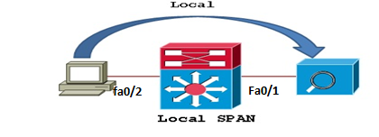
SPAN (Switch port Analyzer)
SPAN works by copying the traffic from one or more source ports. The copy is then sent out a SPAN destination port. The destination port will often be connected to a host running packet analyzing software, such as Wireshark.
Source and destination on the same switch or switch stack.

Slide 17
LAB MANUAL

Slide 18
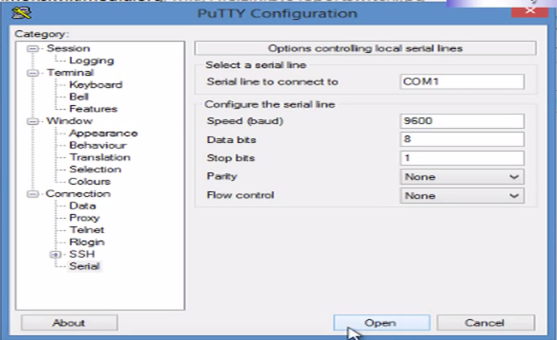
Basic command through CLI
Accessing Cisco Switch First Time with Console
Connect a console terminal to the console interface of your supervisor engine.

Slide 19
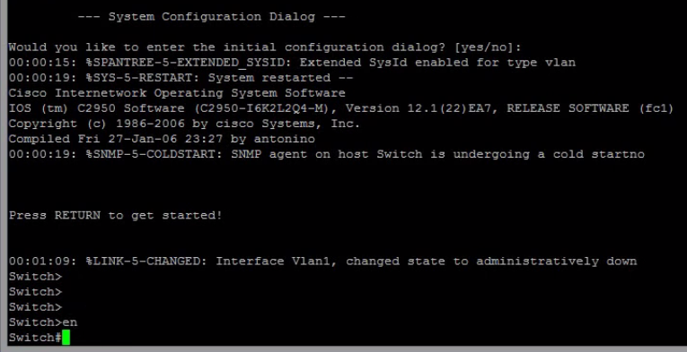
Basic command through CLI
Accessing Cisco Switch First Time with Console
After a few seconds, you see the user EXEC prompt (Switch>).
Now, you may want to enter privileged EXEC mode, also known as enable mode. Type enable to enter enable mode:
Switch> enable

Slide 20

Basic command through CLI
Go to Config Mode
Set Hostname
Set username and password
Set Enable Password

Slide 21
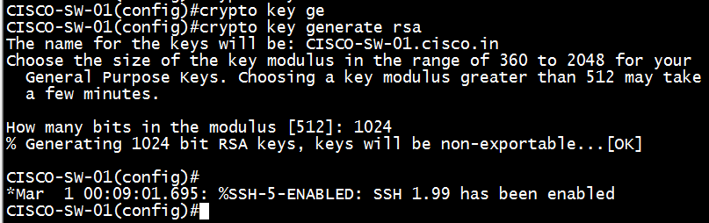

Basic command through CLI
Enable SSH
Set IP Domain Name for SSH key
Generate RSA key
Enable SSH in vty

Slide 22
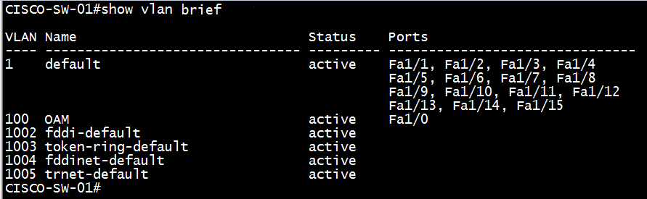
How to configure ports and VLANs
Create VLAN
Delete VLAN
Verify created VLAN

Slide 23
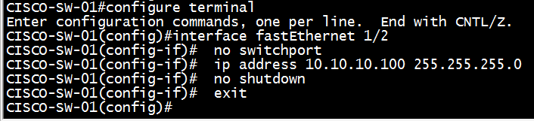
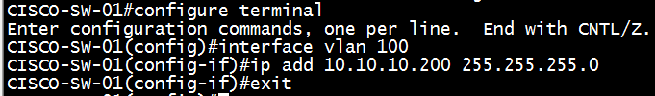

How to configure ports and VLANs
IP & Gateway Configuration
Interface IP Configuration
(Only for Layer3 Switch)
VLAN IP Configuration
IP Gateway Configuration

Slide 24


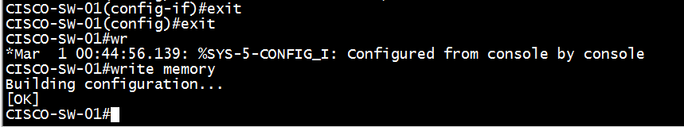
Trunk and access port configuration.
Access Port
Trunk Port & allowed VLAN
Interface Description
Exit & Save Configuration

Slide 25
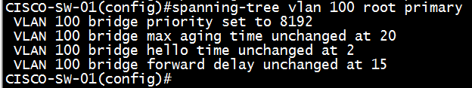

Spanning Tree Protocol Modification
Manual Root-Bridge Selection
Change STP Priority
Change Root Path Cost

Slide 26
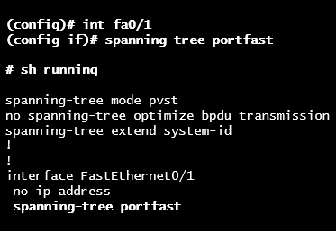
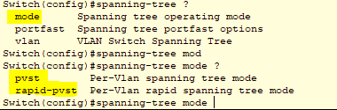
STP Enhancements
Port Fast Excludes ports which are not connected to bridges or switches. Reduces the STP data size. Ports do not go through blocking, listening, learning and forwarding phases, but go straight to forwarding.
PVST & RSTP Mode

Slide 27
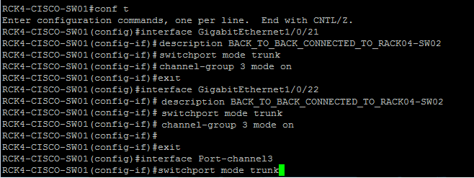
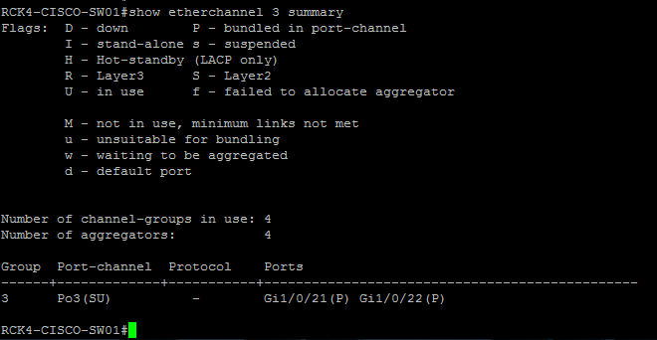
Ether Channel Configuration
Configure Ether Channel
Verify Ether Channel

Slide 28
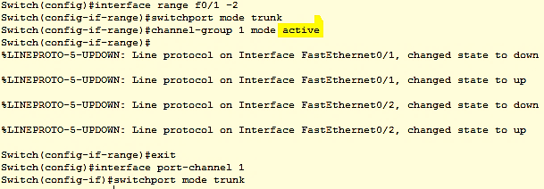

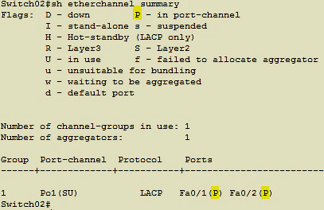
LACP Configuration
Configure LACP
Verify LACP

Slide 29
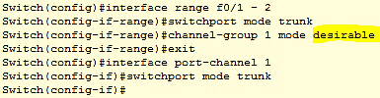

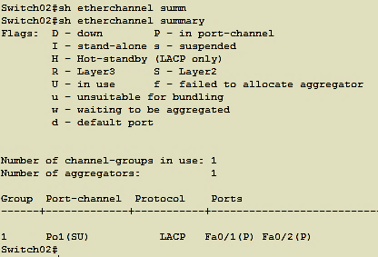
(PAgP) Configuration
Configure PAgP
Verify PAgP

Slide 30
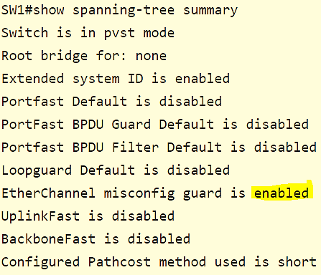
Ether-Channel misconfiguration guard
Ether-Channel Guard is a way of finding out if one end of the Ether-Channel is not configured properly. When there is a misconfiguration found, the switch will place the interfaces in error-disabled state and an error will be displayed.
Enable Ether-Channel Guard
Verify Ether-Channel Guard

Slide 31
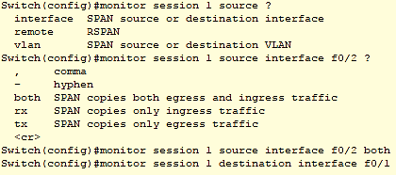
SPAN (Switch port Analyzer) Configuration
TCP traces using port mirroring/monitor feature
SPAN Configuration

Slide 32
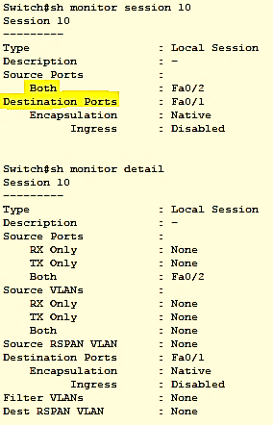
Verify SPAN (Switch port Analyzer)
Verify SPAN

Slide 33

Static Route Configuration
172.16.1.0/24
Switch01
Switch01(config)# ip route 172.16.3.0 255.255.255.0 172.16.2.1
Switch01(config)# ip route 192.168.2.0 255.255.255.0 192.168.1.1
Switch 01
192.168.1.0/24
Switch02
Switch02(config)# ip route 172.16.1.0 255.255.255.0 172.16.2.2
Switch02(config)# ip route 192.168.1.0 255.255.255.0 172.16.2.2
Switch02(config)# ip route 192.168.2.0 255.255.255.0 172.16.2.2
172.16.2.0/24
Switch03
Switch03(config)# ip route 172.16.1.0 255.255.255.0 192.168.1.2
Switch03(config)# ip route 172.16.2.0 255.255.255.0 192.168.1.2
Switch03(config)# ip route 172.16.3.0 255.255.255.0 192.168.1.2
Switch 02
Switch 03
172.16.3.0/24
192.168.2.0/24

Slide 34
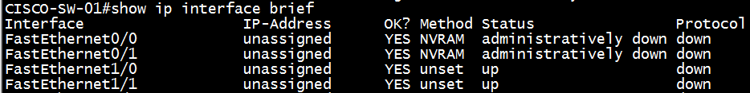
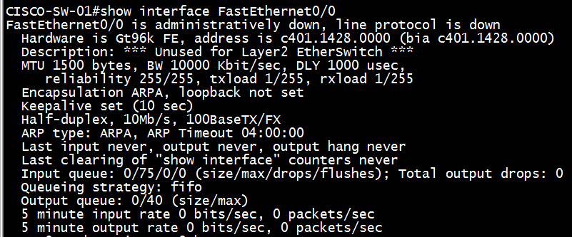
Troubleshooting of various issues faced with switches.
Interfaces Status
Interface Details

Slide 35
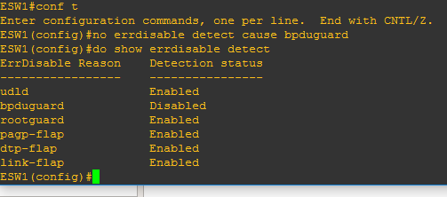

Troubleshoot Err-disable recovery
Troubleshooting of various issues faced with switches.
Disable err-disabled cause
To manually enabled a err-disabled port
Shutdown the port and issue a no shut

Slide 36

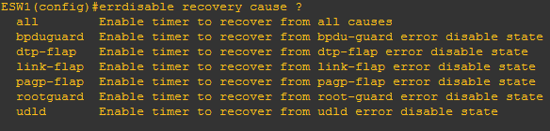
Troubleshoot Err-disable recovery
Troubleshooting of various issues faced with switches.
Show the current setting of Err-Disable
Display the Err-Disable reason
Display any interface currently in Err-Disable State
To automatically recover err-disabled port time in Sec
To enable Auto recovery cause

Slide 37
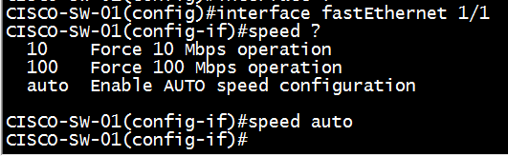
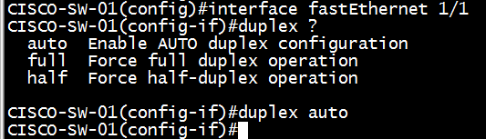
Troubleshooting of various issues faced with switches.
Speed & Duplex
Change Interface Speed Manually
Change Interface Duplex Manually

Slide 38
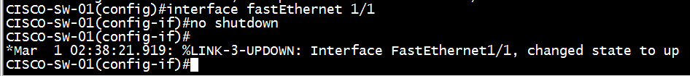
Troubleshooting of various issues faced with switches.
Manually Disable/Enable Interface
Disable/shutdown
Enable/no shutdown

Slide 39



Backup and restoration of switch configuration.
Backup
Restore
Take output of “#show running-config” command
Show running Backup

Slide 40

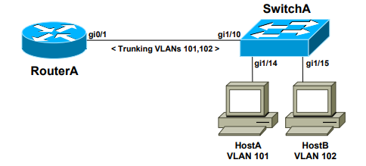
Sample configuration
The first method involves using an Switch with a separate physical interface in each VLAN. This is the least scalable solution, and impractical for environments with a large number of VLANs
The second method involves using an Switch with a single trunk link to the switch, over which all VLANs can be routed.

Slide 41
THANK YOU

