Slide 1
Network Training

Slide 2
Contents
Basic Networking
Switching
Routing
Network Basics
Types of network
HUB
Switch
Bridge
Router
Cloud
Topology
Cables and connectors
OSI Model
TCP/IP Model
IP Addressing
Classification of IPs
Subnet Mask
DHCP
Gateway
DNS
Subnetting
STP
Ether-Channel
SPAN
VTP
Static Routing
Routing Basics
Comparison between routing protocols
OSPF
EIGRP

Slide 3
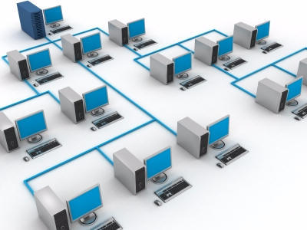
Networking
Interconnection of devices for sharing data or for communication is computer networking

Slide 4
Benefits of Networking
Resource Sharing- Hardware Resources (sharing devices like printer, scanner, etc.) and Software Resources (sharing data between a network or file sharing. E.g.- email.)
Communication- Communication between two pcs. E.g.- email, chatting, video chatting, etc.
Critical Storage- Storage of data from one machine to another in case of damage of the main machine.

Slide 5
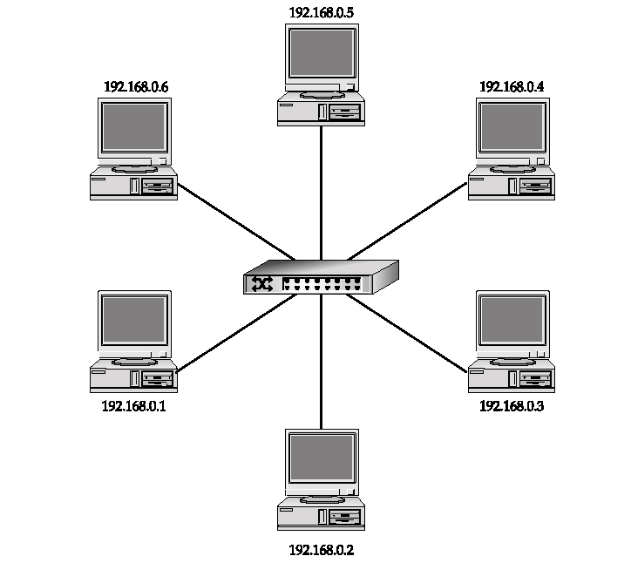
Types of Network
LAN (Local Area Network)
Interconnection of machines in a small geographical area is called LAN
E.g.- Connection of machines in an office or a building
Wireless LAN- Wifi

Slide 6
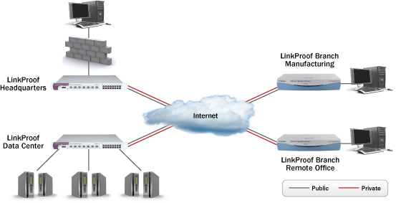
WAN (Wide Area Network)
Interconnection of machines in a wide geographical area is WAN
E.g.- home internet, two LANs connected with a router and a service provider is connected between two routers
Wireless WAN- 2G, 3G, 4G

Slide 7
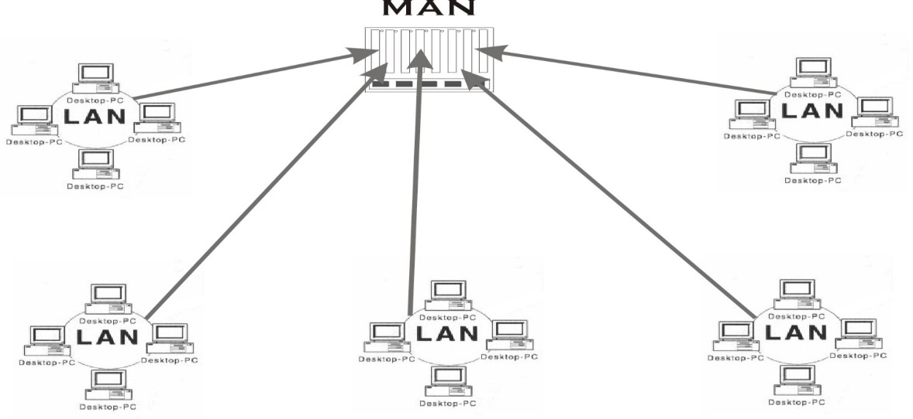
MAN (Metropolitan Area Network)
Administration of one or more network by a central authority in between an area of 50 km is called MAN or small WAN
Wireless MAN- WiMax

Slide 8
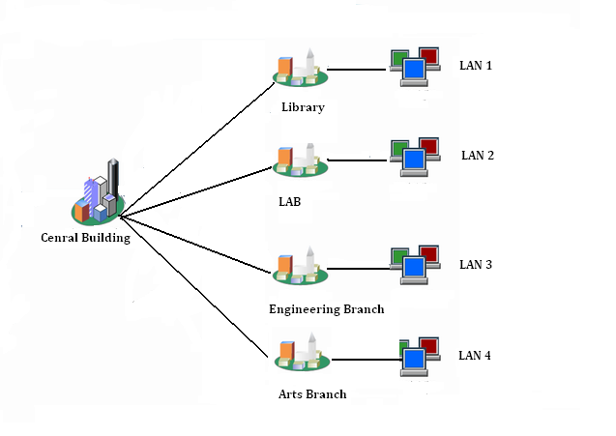
CAN (Campus Area Network)
Multiple LAN connection in campus is called CAN

Slide 9
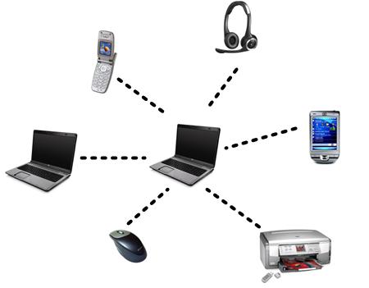
PAN (Personal Area Network)
A type of LAN for data communication between one or more personal devices such as Laptops, Palmtops is PAN
Bluetooth networking through mobile is called Piconet

Slide 10
Minimum requirements of LAN configuration
Two PCs
Network Operating System
NIC (Network Interface Card)
Drivers
Cables and Connectors
Protocols

Slide 11
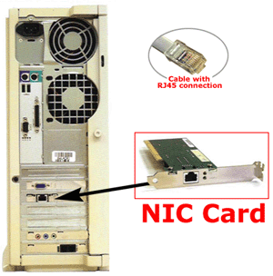
NIC (Network Interface Card)
Ethernet Card or Network Card
NIC is one which converts network signals into computer language signals
Add-on Cards
Integrated built in Motherboards

Slide 12
MAC (Media Access Control)
It is a unique address stored in NICs
Hardware address or Physical address
48 bit hexadecimal address
Eg- 00-0c-76-5e-c3-06
To find MAC address-
start- run- cmd- getmac
or
start- run- cmd- ipconfig /all

Slide 13
Hub
Hub is used to connect multiple devices
Each port broadcast to find its device every time for communication. Due to this heavy traffic occurs. All time this process is repeated to find MAC address.
Slow communication
Also known as multiport repeater
Multiple communication is not possible at a time.
Other wise collision occurs.
Normally works only on 10 mbps.

Slide 14
Switch
It is also used to connect multiple devices
There is a MAC address table in switch, in that it will save MAC addresses of all connected devices and its corresponding ports. These information are saved on the first time of broadcasting from a port. This process is not repeated for the next time of communication.
More faster
Also known as Multiport Repeater or Intelligent Hub.
Multiple communication is possible at a time.
Therefore reduces collision.
Normally works on 10/100/100/10000 .. mbps

Slide 15
Bridge
Provide connections between LANs.
Not only do bridges connect LANs, but they also perform a check on the data to determine whether it should cross the bridge or not.
This makes each part of the network more efficient.

Slide 16
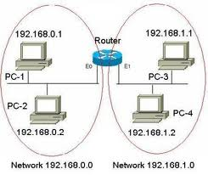
Router
Routers are used to connect multiple networks.
Router is first found by CISCO in 1984.
Further more companies like Enframe, Checkpoint, Juniper, Huawei, etc. started manufacturing routers.

Slide 17
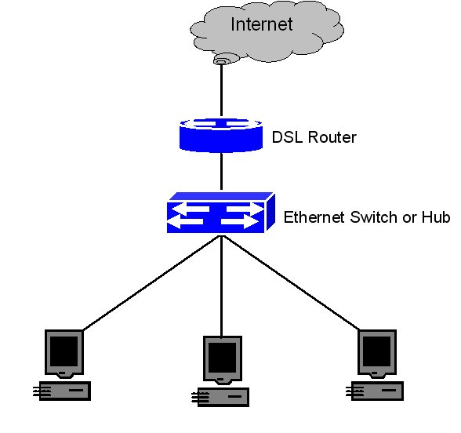
Cloud
The cloud is used in diagrams to represent where the connection to the internet is.
It also represents all of the devices on the internet.

Slide 18
Topology
Bus
Topology in which coaxial cable network is used
Configuration is very easy
High cost for implementation
Less speed
Entire network will be down if any damage occurs in the back bone of the cable
Network will be down if additional node is added.

Slide 19
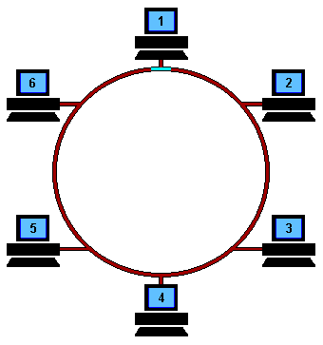
Ring
A network type called Arcnet implemented by IBM is used in Ring topology.
A token which acts as data carrier in the cable passes information clockwise direction through the network.
It transfers data from a device to another according to device priority base.
MSAU (Multi station access unit) connects all devices into it.
If individual device is down the whole network will be down

Slide 20
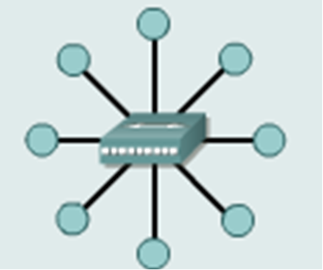
Star or Ethernet
Multiple machines connected into a Hub or Switch is Star topology.
Most commonly used topology
Implementation is easy
Additional nodes are added without interfering other devices or whole network.
If a Hub or Switch is down the entire network is down.
Devices are connected through patch panel.

Slide 21
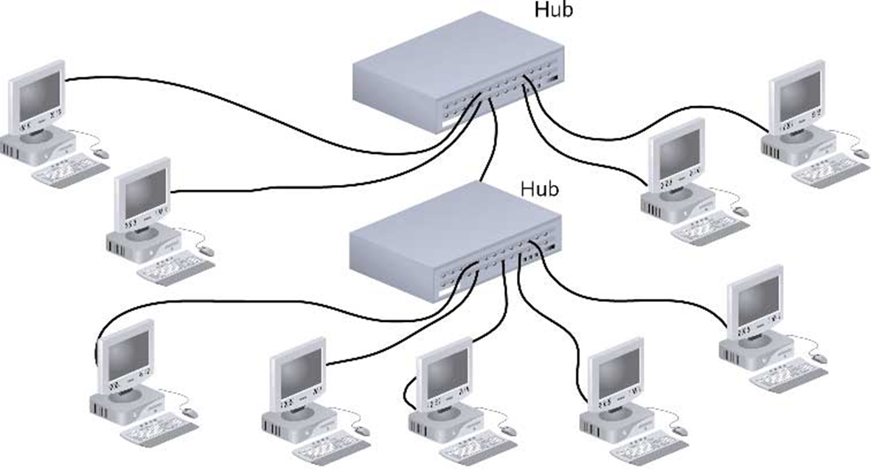
Hybrid
The combined Star and Bus topology is called Hybrid topology

Slide 22
Mesh
Most commonly used topology.
It consist of multiple links.
If any one of them gets down, the router finds another link to communicate.
High expensive.
Difficult to implement

Slide 23
Cables and Connectors
Coaxial Cable

Slide 24
OFC (Optical Fiber Cable)
Network signals are converted into light signals in this cable.
It works under ‘Total Internal Reflection’ principle.
Used for under sea connection.
Transmits at a speed of 3 X 10^8 m/s

Slide 25
Twisted Pair Cables
Contains 8 colored wires
Each twisted as 4 pairs
Two types:-
Shielded Twisted Pair
Unshielded twisted pair

Slide 26
STP (Shielded twisted pair)
Each pair of cables are shielded.
It is used in high level industries or machineries.
High expensive.
It is shielded due to protect from external signals

Slide 28
Unshielded Twisted Pair
Contains of 8 twisted wires
Theses wires are twisted as pairs to reduce EMI (Electromagnetic Interference)
Connectors of UTP are called RJ45 (Registered Jack)
Connectors used in telephone cable is called RJ11
8 contact legs for RJ45
4 contact legs for RJ11

Slide 30
Categories of UTP
Cat 1 | 10 MBps
Cat 2 | 10 mbps
Cat 3 | 16 mbps
Cat 4 | 100 mbps
Cat 5 | 1000 mbps
Cat 5e | 1000 mbps
Cat 6 | 10000 mbps
Used for voice communication
Used for networking

Slide 31
Cable Specifications
10BASE-T
The T stands for twisted pair.
10BASE5
The 5 represents the fact that a signal can travel for approximately 500 meters 10BASE5 is often referred to as Thicknet.
10BASE2
The 2 represents the fact that a signal can travel for approximately 200 meters 10BASE2 is often referred to as Thinnet.
Thinnet and Thicknet are actually a type of networks, while 10BASE2 & 10BASE5 are the types of cabling used in these networks.

Slide 32
Types of UTP cables
Straight through
Crossover cables
Rollover or Console
Straight through cables are used to connect dissimilar devices such as PC-Switch, PC- Hub, Router-Switch, etc.
Crossover cables are used to connect similar devices such as PC-PC, Switch-Switch, Hub- Hub, PC- Router
Rollover or Console cables are used to configure Router and Switch

Slide 33
Remember..
A straight-thru cable has Class B on both ends. A crossover able has Class B on one end and Class A on the other. A console cable had Class B on one end and reverse Class B on the other, which is why it is also called a rollover cable.
A NIC transmits signals on pins 1 & 2, and it receives signals on pins 3 & 6. Other for ground support.
Class A
Class B

Slide 34
OSI Model
To address the problem of networks increasing in size and in number, the International Organization for Standardization (ISO) researched many network schemes and recognized that there was a need to create a network model
This would help network builders implement networks that could communicate and work together
ISO therefore, released the OSI reference model in 1984.

Slide 35
Open System Interconnect (OSI)
7 Application
6 Presentation
5 Session
4 Transport
3 Network
2 Data Link
1 Physical

Slide 36
Layer 7- Application layer
7 Application
User Interaction Layer
Opens applications such as MS –word, excel, PowerPoint, etc. and networking applications.
PDU (Protocol Data Unit) is in the form of Data
6 Presentation
5 Session
4 Transport
3 Network
2 Data Link
1 Physical

Slide 37
Layer 6- Presentation Layer
7 Application
This layer gives file extension.
E.g.- .ppt, .doc, .docx
Encryption, decryption, compression, decompression are done in this layer
PDU is in Formatted data
6 Presentation
5 Session
4 Transport
3 Network
2 Data Link
1 Physical

Slide 38
Layer- 5 Session Layer
7 Application
This layer establishes, manages, and terminates sessions between two communicating hosts.
Offers three modes of communication
Simplex
Half duplex
Full duplex
PDU is in Formatted Data
6 Presentation
5 Session
4 Transport
3 Network
2 Data Link
1 Physical

Slide 39
Layer- 4 Transport Layer
7 Application
This layer breaks up the data from the sending host and then reassembles it in the receiver.
It also is used to insure reliable data transport across the network.
Can be reliable or unreliable
Sequencing
Acknowledgment
Retransmission
Flow Control
PDU is in Data segments
6 Presentation
5 Session
4 Transport
3 Network
2 Data Link
1 Physical

Slide 40
Layer- 3 Network Layer
7 Application
Sometimes referred to as the “Cisco Layer”.
Provide logical addressing that routers use for path determination
Segments are encapsulated
Error Correction
Packet forwarding
Packet Filtering
Makes “Best Path Determination”
Fragmentation
PDU is in Data Packets
6 Presentation
5 Session
4 Transport
3 Network
2 Data Link
1 Physical

Slide 41
Layer- 2 Data Link Layer
7 Application
Performs Physical Addressing
This layer provides reliable transit of data across a physical link.
Combines bits into bytes and
bytes into frames
Access to media using MAC address
Error detection, not correction
LLC and MAC
Logical Link Control performs Link establishment
MAC Performs Access method
PDU is in Data Frames
6 Presentation
5 Session
4 Transport
3 Network
2 Data Link
1 Physical

Slide 42
Layer- 1 Physical Layer
7 Application
6 Presentation
5 Session
4 Transport
This is the physical media through which the data, represented as electronic signals, is sent from the source host to the destination host.
Move bits between devices
Encoding
3 Network
2 Data Link
1 Physical

Slide 43
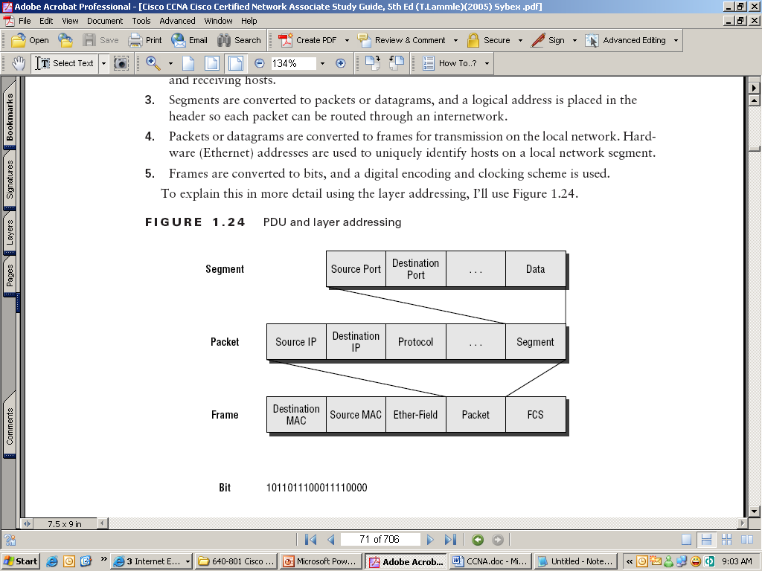
Data Encapsulation & Decapsulation
The process of converting Data into Bits and Bytes is called Encapsulation
The process of converting Bits and Bytes into Data is called Decapsulation

Slide 44
Layer 1 Devices- Cables and Connectors
Layer 2 Devices- Hub, Switch, NIC, Bridge
Layer 3 Devices- Router (Also known as CISCO layers)

Slide 45
Collision Domain
Collision Domain is the place where collision occurs.
Hub is a single Collision Domain.
In the case of a Switch each port in a switch is a single Collision Domain

Slide 46
Broadcast Domain
The maximum area in which the broadcast travels is called Broadcast Domain
Hub and Switch are single Broadcast Domains.
Router will not forward either Collision domains or Broadcast Domains.

Slide 47
DOD Model or TCP/IP Model
Although the OSI reference model is universally recognized, the historical and technical open standard of the Internet is Transmission Control Protocol / Internet Protocol (TCP/IP).
The TCP/IP reference model and the TCP/IP protocol stack make data communication possible between any two computers, anywhere in the world, at nearly the speed of light.
The U.S. Department of Defense (DoD) created the TCP/IP reference model because it wanted a network that could survive any conditions, even a nuclear war.

Slide 48
5 Layers
Application
Presentation
Session
Application
Transport
Transport
Network
Internet
Data-Link
Data-Link
Physical
Physical

Slide 49
Application Layer
File Transfer
- TFTP*
- FTP*
- NFS
E-Mail
- SMTP
Remote Login
- Telnet*
- rlogin*
Network Management
- SNMP*
Name Management
- DNS*
Application
Transport
Internet
Data-Link
*Used by the Router
Physical

Slide 50
Transport Layer
Transmission Control
Protocol (TCP)
User Datagram
Protocol (UDP)
Connection-Oriented
Connectionless
Application
Transport
Internet
Data-Link
Physical

Slide 51
TCP Port Numbers
Exit or entry layer from one application
to another are called port numbers.
1- 64711 are well known port numbers
64712- 65535 are unknown
F
T
P
T
E
L
N
E
T
S
M
T
P
D
N
S
T
F
T
P
S
N
M
P
R
I
P
21
23
25
53
69
161
520
TCP
UDP

Slide 52
TCP Three way Hand Shake
Host A
Host B
1
Send SYN
(seq = 100 ctl = SYN)
SYN Received
2
SYN Received
3
Established
(seq = 101 ack = 301
ctl = ack)

Slide 53
UDP (User Datagram Protocol)
User Datagram Protocol (UDP) is the connectionless transport protocol in the TCP/IP protocol stack.
UDP is a simple protocol that exchanges datagrams, without acknowledgments or guaranteed delivery. Error processing and retransmission must be handled by higher layer protocols.
UDP is designed for applications that do not need to put sequences of segments together.
The protocols that use UDP include:
TFTP (Trivial File Transfer Protocol)
SNMP (Simple Network Management Protocol)
DHCP (Dynamic Host Control Protocol)
DNS (Domain Name System)

Slide 54
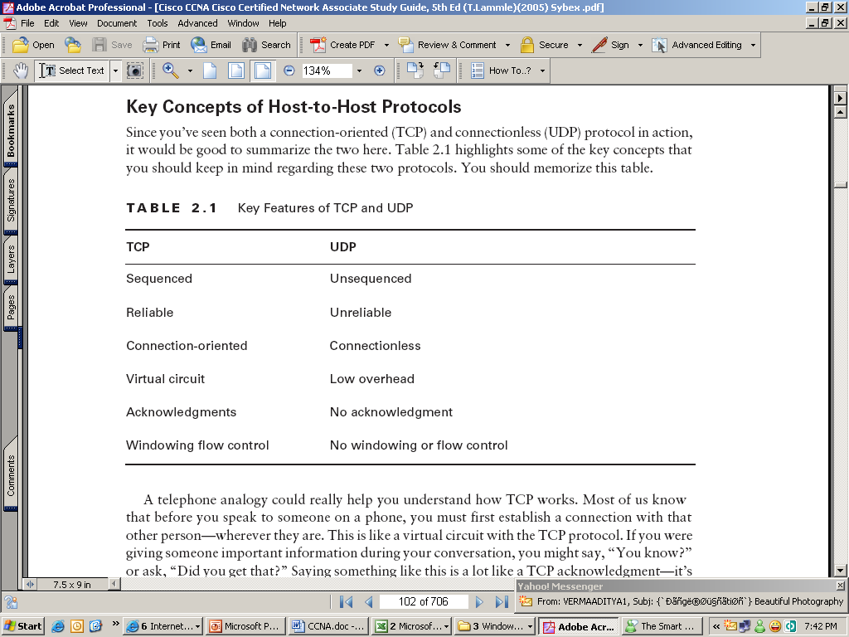
TCP vs. UDP

Slide 55
Internet Layer
Internet Protocol (IP)
Internet Control Message
Protocol (ICMP)
Address Resolution
Protocol (ARP)
Reverse Address
Resolution Protocol (RARP)
Application
Transport
Internet
Data-Link
Physical

Slide 56
Connectivity Protocols
IP- Used for IP addressing
ICMP- Used to check internet connectivity
ARP- Resolves MAC address from IP
RARP- Resolves IP from MAC address

Slide 57
IP Addressing
Using the IP address of the destination network, a router can deliver a packet to the correct network.
When the packet arrives at a router connected to the destination network, the router uses the IP address to locate the particular computer connected to that network.
It has two versions:-
IPv4- 32 bit decimal address
IPv6- 128 bit hexadecimal address

Slide 58
IPv4 Address
IPv4 is 32 bit decimal address divided into 4 groups.
Each group contains 8 bit.
Each group is also called an Octet
Contains addresses between 0.0.0.0 to 255.255.255.255
We don’t use these two address for communication
Since 0.0.0.0 is an invalid IP and 255.255.255.255 is a Global Broadcast address

Slide 59
Classification of IP’s
IANA (Internet Assigned Numbering Authority) classified IP addresses into 5 classes, they are:-
X.X.X.X
Cass A (1-126)
Class B (128-191)
Class C (192-223)
Class D (224-239)
Class E (240-255)
Class A, B, C are used for communication
Class D are Multicast addresses
Class E are used for IP Research

Slide 60
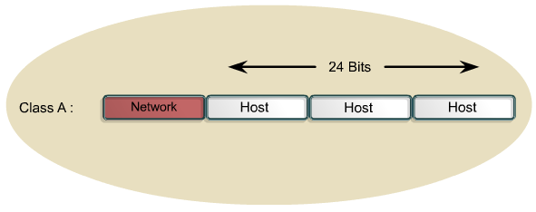
Network Portion & Host Portion
In Class A 1st octet is in Network portion and rest of them are in Host portion

Slide 61
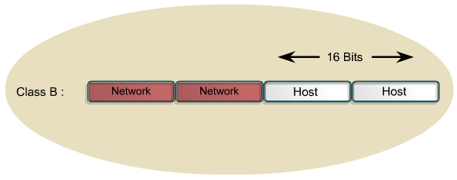
In Class B 1st two octet are in Network and last two are in Host portion

Slide 62
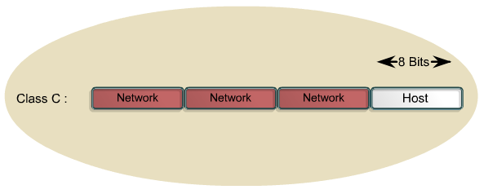
In Class C 1st three Octets are in Network and last octet is in Host portion
Two Host in a Network wont communicate when the Network portion of the IP address is not same.

Slide 63
Public IP & Private IP
Public IP are purchasable
Used for WAN
Private IP are non purchasable
Used for LAN
Private Range:-
Class A- 10.0.0.0 to 10.255.255.255
Class B- 172.16.0.0 to 172.31.255.255
Class C- 192.168.0.0 to 192.168.255.255
Others are in Public range

Slide 64
Subnet Mask
To identify Network Portion and Host Portion we give an additional information.
This information is called Subnet Mask.
Predefined Subnet Mask for each class are:-
Class A- 255.0.0.0
Class B- 255.255.0.0
Class C- 255.255.255.0
When all the Network bits are 1 and Host bits are 0, we will get the Subnet Mask.

Slide 65
DHCP (Dynamic Host Configuration Protocol)
              172.16.0.1- Start
              172.16.0.100- End
DHCP Server
Client 1
Client 2

Slide 66
Default Gateway
It is an IP address given to exit from one network to another.
The interface from Private Network to Public Network is a Default gateway.
NAT (Network Address Translation) service is provided inside the modem which translates Private address to Public address for communication.
ICS (Internet Connection Sharing) range will be 192.168.0.0 to 192.168.255.255 (Class C)
This will be the default gateway for all other devices.

Slide 67
DNS (Domain Name Server)
DNS is one which resolves IP from name or name from IP
This Server contains name of the websites and its corresponding IPs
Also called Preferred DNS server
Alternate DNS Server- If preferred DNS is down then the nest contacted DNS server is called Alternate DNS Server
Open DNS Server- It is a Third Party DNS Server
208.67.222.222 (Preferred DNS)
208.67.220.220 (Alternate DNS)

Slide 68
Sub netting
Making subnets from a Parent Network is called Sub netting
It is used to implement security in a network rather than implementing more networks in a company, office, etc.
For that we create Sub networks under one parent network.
Avoids IP wastage.
Implements network security.
Avoids network traffic.
Simplified administration through network

Slide 69
SWITCHING

Slide 70
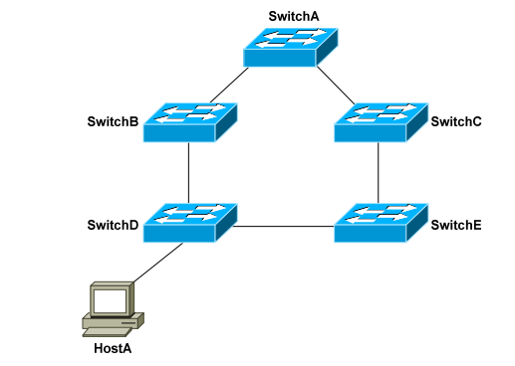
STP (Spanning Tree Protocol)
Switching Loops A Layer-2 switch belongs to only one broadcast domain, and will forward both broadcasts and multicasts out every port but the originating port. When a switching loop is introduced into the network, a destructive broadcast storm will develop within seconds. A storm occurs when broadcasts are endlessly forwarded through the loop. Eventually, the storm will choke off all other network traffic.
Consider the following example:
If HostA sends out a broadcast, SwitchD will forward the broadcast out all ports in the same VLAN, including the trunk ports connecting to SwitchB and SwitchE. In turn, those two switches will forward that broadcast out all ports, including the trunks to the neighboring SwitchA and SwitchC. The broadcast will loop around the switches infinitely. In fact, there will be two separate broadcast storms cycling in opposite directions through the switching loop. Only powering off the switches or physically removing the loop will stop the storm.

Slide 71
Spanning Tree Protocol (STP) was developed to prevent the broadcast storms caused by switching loops. STP was originally defined in IEEE 802.1D.
Switches running STP will build a map or topology of the entire switching network. STP will identify if there are any loops, and then disable or block as many ports as necessary to eliminate all loops in the topology.
A blocked port can be reactivated if another port goes down. This allows STP to maintain redundancy and fault-tolerance.
STP switches exchange Bridge Protocol Data Units (BPDU’s) to build the topology database. BPDU’s are forwarded out all ports every two seconds, to a dedicated MAC multicast address of 0180.c200.0000.

Slide 72
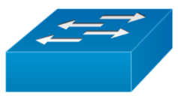
BPDU Exchange
Root Bridge ID
MAC + Bridge Priority
Cost to Root
Sending Bridge ID
32768.02.aa.c1.32.ed.ff
Hello Timer = 2 Sec
Max Age = 20 sec
Port Role
Port State
Cost to root = 0+4
Cost to root = 4
Root Port (Port on the local Switch that provide the least path cost to the switch)
DP
RP
F
F
F
Cost to root = 0
Cost to root 4+4=8
Designated Port (Port on the cable that provide the least path cost to the switch)
B
DP
ND
F
Cost to root 4+ 4= 8
Cost to root =4
B
F
Non-Designated port
DP
RP
F
Cost to root = 0
Cost to root = 0+4
32768.02.aa.c1.32.a1.f1
32768.02.aa.c1.32.ff.22
Elected as Root Bridge
Gig Eth = 04

Slide 73
STP Port State
Disabled
  Port that is in the down state
Blocking
  Port that is only allowed to receive the BPDU .
  Cannot send or receive data or add MAC address on its port
Listening
  Port that is allowed to send and receive BPDU.
  Can actively participate in the STP
  Cannot send and receive data
  Allowed to send and receive BPDU
  Can learn MAC addresses to add its addresses table
  Cannot send and receive data
Learning
Forwarding
  Receiving BPDUs, Forwarding data traffic, receiving data traffic, learns MAC addresses

Slide 74
Spanning Tree Protocol
All decisions in STP are made from the perspective of Root Bridge. Switch with the lowest switch ID is selected as Root Bridge. BPDU contains Switch ID. Switch ID is made from priority of the switch and MAC address of switch itself. Default priority is set to 32768. Switch with the lowest MAC address will be selected as the root switch, if you don’t change the default priority value. You can override root selection process by changing the priority value. If you want one switch to be Root Bridge, change its priority value to less than 32768.
Root Bridge
Root port is a port that is directly connected with the Root Bridge, or has the shortest path to the Root Bridge. Shortest path is path that has lowest path cost value. Remember that switch can go through many other switches to get the root. So it’s not always the shortest path but it is the fastest path that will be used.
Root Port
Designated Port
Designated port is the port that is selected as having the lowest port cost. Designated port would be marked as forwarding port.
Blocking Port
Blocking port remains disable to remove loops.

Slide 75
STP Enhancements
Port Fast Excludes ports which are not connected to bridges or switches. Reduces the STP data size.
Ports do not go through blocking, listening, learning and forwarding phases, but go straight to forwarding.
Port Fast
PVST stands for Per Vlan Spanning Tree.
By using PVST we can select any switch as a root bridge for a particular Vlan. By doing so, we achieve the load balancing in a network.
PVST is enabled by-default on cisco switches.
We achieve the PVST by decreasing the priority value of a switch for Vlans/Vlan.
PVST
RSTP stands for rapid-STP.
Convergence time of PVST is high so we use RSTP for less convergence time.
RSTP

Slide 76
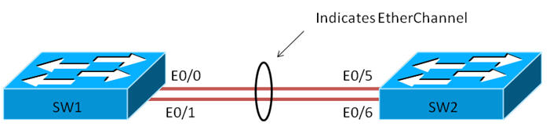
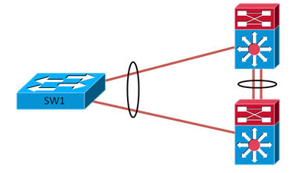
EtherChannel
EtherChannels consist of individual links bundled into a single logical link.
Provides fault tolerant high speed links between switches, routers, and servers.
Can provide full duplex bandwidth up to 800 Mbps.
EtherChannels can consist of up to eight interfaces.
Each Etherchannel has a logical port channel interface numbered from 1-6

Slide 77
EtherChannel
LACP can be configured in either Passive or Active mode. In active mode, the port actively tries to bring up LACP.
In passive mode, it does not initiate the negotiation of LACP.
LACP and PAgP are not compatible – both sides of an EtherChannel must use the same aggregation protocol.
Link Aggregation Control Protocol (LACP)
PAgP is a Cisco-proprietary aggregation protocol
PAgP protocol data units (PDUs) are sent and received on the lowest numbered VLAN of the trunk link.
Auto – This is the passive negotiating state which responds to PAgP packets.
Desirable – Places interface into an active negotiating state.
Port Aggregation Protocol (PAgP)

Slide 78
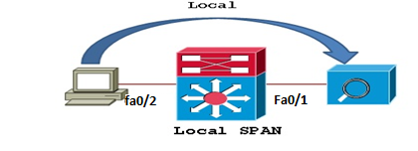
SPAN (Switch port Analyzer)
  SPAN works by copying the traffic from one or more source ports. The copy is then sent out a SPAN destination port. The destination port will often be connected to a host running packet analyzing software, such as Wireshark.
  Source and destination on the same switch or switch stack.

Slide 79
VTP(Virtual Trunking Port)
VTP is used to create domain environment in a switching network
VTP modes:-
  Server
  Client
  Transparent

Slide 80
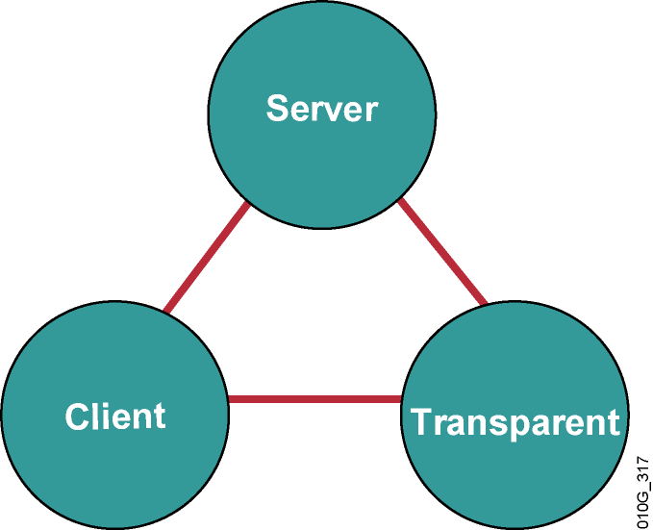
Creates, modifies, and deletes VLANs
Sends and forwards
advertisements
Synchronizes VLAN configurations
Saves configuration in NVRAM
Creates, modifies, and deletes VLANs locally only
Forwards
advertisements
Does not
synchronize VLAN configurations
Saves configuration in NVRAM
Cannot create, change, or delete VLANs
Forwards advertisements
Synchronizes VLAN configurations
Does not save in
NVRAM

Slide 81
VTP Domain
VTP updates will not be received in switch which is having different domain name.
It receives when domain name is same
Switch(config)#vtp domain NS (To create domain)
Switch(config)#vtp mode ? (To change the VTP mode)
VTP Pruning Mode
This mode controls transferring unwanted updates from server to un manual switch.

Slide 82
Static Routing
It is the manual configuration and selection of a network route, usually managed by the network administrator.
Static routes are normally implemented in those situations where the choices in route selection are limited, or there is only a single default route available.
Static routes, which define explicit paths between two routers, cannot be automatically updated.
You must manually reconfigure static routes when network changes occur.
Static routes use less bandwidth than dynamic routes.
No CPU cycles are used to calculate and analyze routing updates.

Slide 83
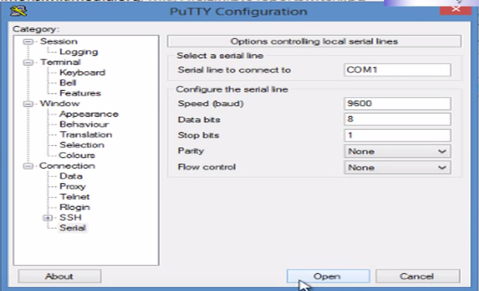
Basic command through CLI
Accessing Cisco Switch First Time with Console
Connect a console terminal to the console interface of your supervisor engine.

Slide 84
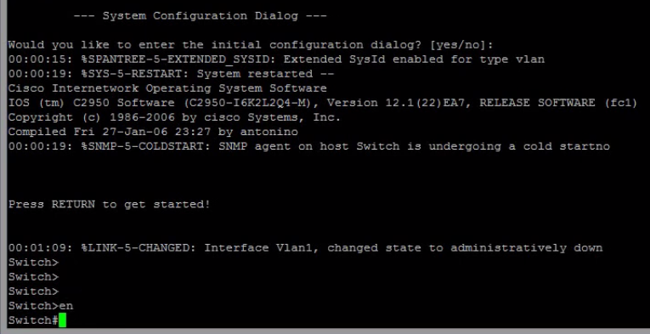
Basic command through CLI
Accessing Cisco Switch First Time with Console
After a few seconds, you see the user EXEC prompt (Switch>).
Now, you may want to enter privileged EXEC mode, also known as enable mode. Type enable to enter enable mode:
Switch> enable

Slide 85

Basic command through CLI
Go to Config Mode
Set Hostname
Set username and password
Set Enable Password

Slide 86
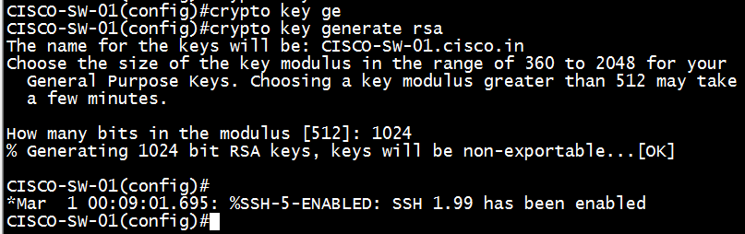

Basic command through CLI
Enable SSH
Set IP Domain Name for SSH key
Generate RSA key
Enable SSH in vty

Slide 87
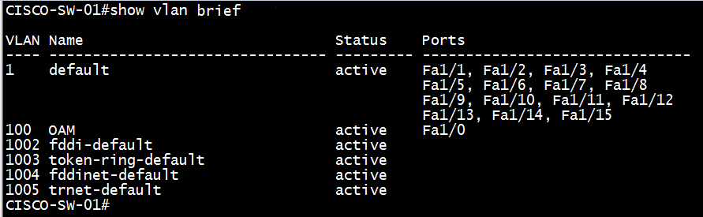
How to configure ports and VLANs
Create VLAN
Delete VLAN
Verify created VLAN

Slide 88
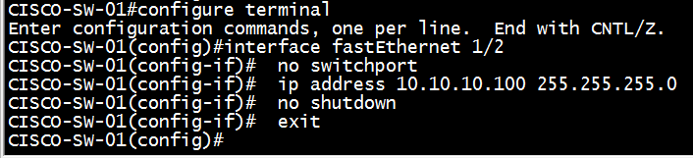
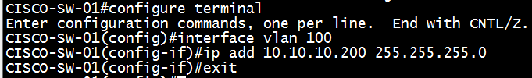

How to configure ports and VLANs
IP & Gateway Configuration
Interface IP Configuration
(Only for Layer3 Switch)
VLAN IP Configuration
IP Gateway Configuration

Slide 89


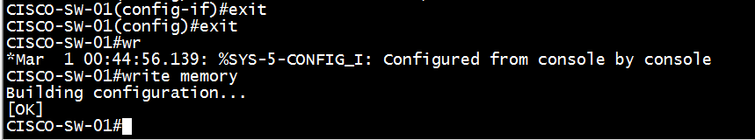
Trunk and access port configuration.
Access Port
Trunk Port & allowed VLAN
Interface Description
Exit & Save Configuration

Slide 90
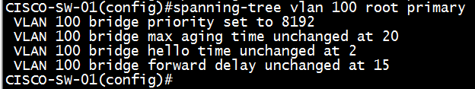

Spanning Tree Protocol Modification
Manual Root-Bridge Selection
Change STP Priority
Change Root Path Cost

Slide 91
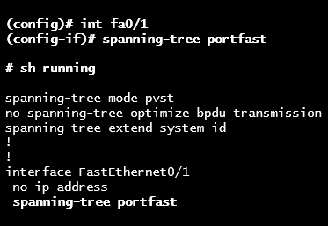
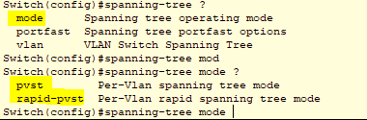
STP Enhancements
Port Fast Excludes ports which are not connected to bridges or switches. Reduces the STP data size. Ports do not go through blocking, listening, learning and forwarding phases, but go straight to forwarding.
PVST & RSTP Mode

Slide 92
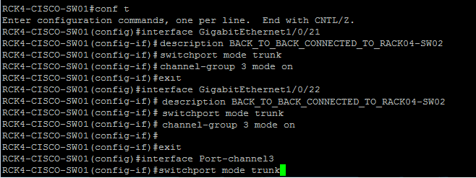
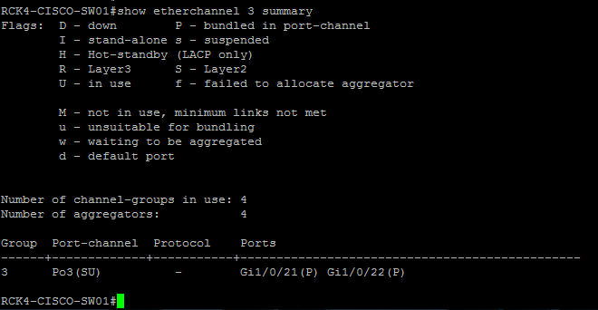
Ether Channel Configuration
Configure Ether Channel
Verify Ether Channel

Slide 93
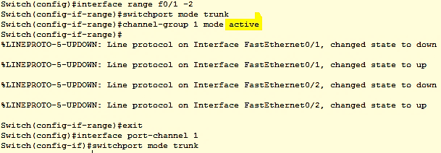

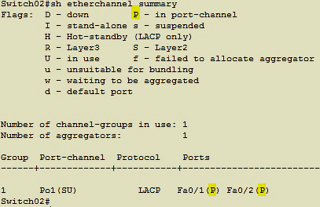
LACP Configuration
Configure LACP
Verify LACP

Slide 94
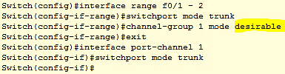

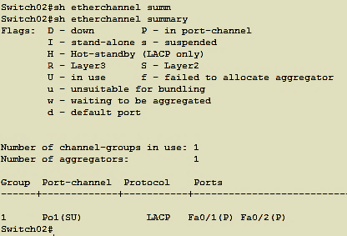
(PAgP) Configuration
Configure PAgP
Verify PAgP

Slide 95
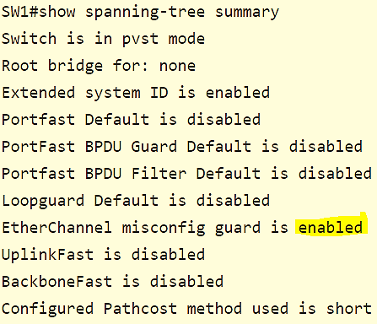
Ether-Channel misconfiguration guard
Ether-Channel Guard is a way of finding out if one end of the Ether-Channel is not configured properly. When there is a misconfiguration found, the switch will place the interfaces in error-disabled state and an error will be displayed.
Enable Ether-Channel Guard
Verify Ether-Channel Guard

Slide 96
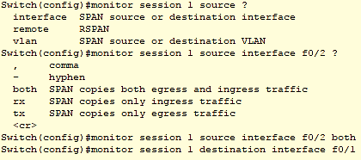
SPAN (Switch port Analyzer) Configuration
TCP traces using port mirroring/monitor feature
SPAN Configuration

Slide 97
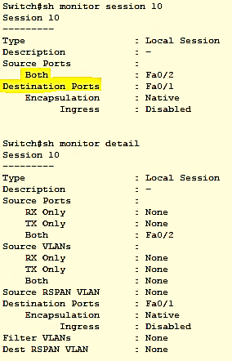
Verify SPAN (Switch port Analyzer)
Verify SPAN

Slide 98

Static Route Configuration
172.16.1.0/24
Switch01
Switch01(config)# ip route 172.16.3.0 255.255.255.0 172.16.2.1
Switch01(config)# ip route 192.168.2.0 255.255.255.0 192.168.1.1
Switch 01
192.168.1.0/24
Switch02
Switch02(config)# ip route 172.16.1.0 255.255.255.0 172.16.2.2
Switch02(config)# ip route 192.168.1.0 255.255.255.0 172.16.2.2
Switch02(config)# ip route 192.168.2.0 255.255.255.0 172.16.2.2
172.16.2.0/24
Switch03
Switch03(config)# ip route 172.16.1.0 255.255.255.0 192.168.1.2
Switch03(config)# ip route 172.16.2.0 255.255.255.0 192.168.1.2
Switch03(config)# ip route 172.16.3.0 255.255.255.0 192.168.1.2
Switch 02
Switch 03
172.16.3.0/24
192.168.2.0/24

Slide 99
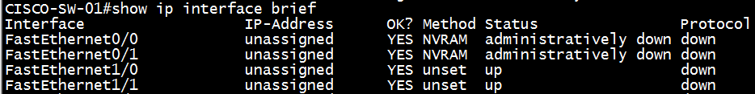
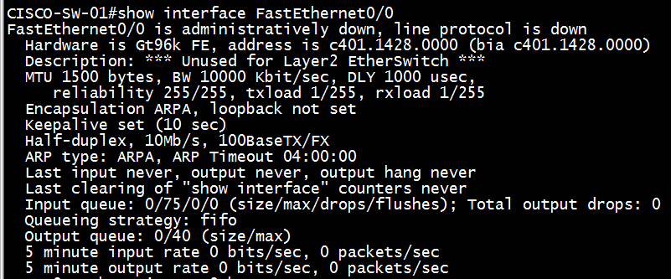
Troubleshooting of various issues faced with switches.
Interfaces Status
Interface Details

Slide 100

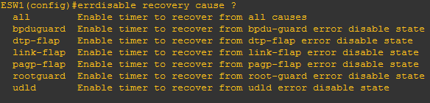
Troubleshoot Err-disable recovery
Troubleshooting of various issues faced with switches.
Show the current setting of Err-Disable
Display the Err-Disable reason
Display any interface currently in Err-Disable State
To automatically recover err-disabled port time in Sec
To enable Auto recovery cause

Slide 101
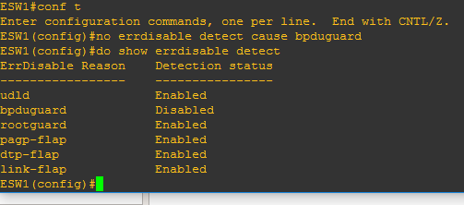

Troubleshoot Err-disable recovery
Troubleshooting of various issues faced with switches.
Disable err-disabled cause
To manually enabled a err-disabled port
Shutdown the port and issue a no shut

Slide 102
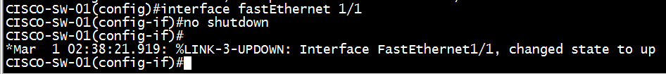
Troubleshooting of various issues faced with switches.
Manually Disable/Enable Interface
Disable/shutdown
Enable/no shutdown

Slide 103
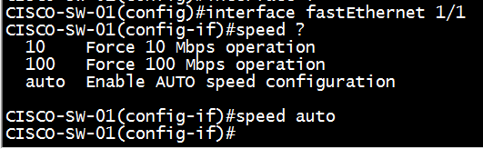
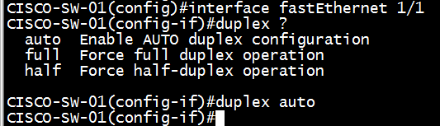
Troubleshooting of various issues faced with switches.
Speed & Duplex
Change Interface Speed Manually
Change Interface Duplex Manually

Slide 104

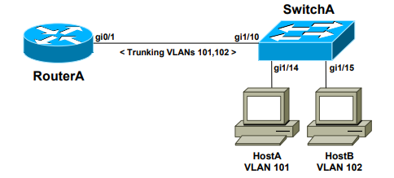
Sample configuration
  The first method involves using an Switch with a separate physical interface in each VLAN. This is the least scalable solution, and impractical for environments with a large number of VLANs
The second method involves using an Switch with a single trunk link to the switch, over which all VLANs can be routed.

Slide 105



Backup and restoration of switch configuration.
Backup
Restore
Take output of “#show running-config” command
Show running Backup

Slide 106
ROUTING

Slide 107
Routing protocols
It specifies how routers communicate with each other,
It enables them to select routes between any two nodes on a network.
Routing algorithms determine the specific choice of route. Each router has a prior knowledge of networks attached to it directly.
The preference is assigned in terms of :
a) Lowest prefix match- More specific the BIDR, subnet mask is more preferred
b)Administrative Distance: measure of the trustworthiness of the source of
routing information.
c) Metrics such as hop count, cost, bandwidth, reliability , etc.
Notes:
Specifies how data packet is transferred between two devices

Slide 108
Routing Protocols
Static Routing
Dynamic Routing
Interior gateway protocol(IGP)
Exterior gateway Protocol(EGP)
Distance vector routing Protocols
Link-state Routing Protocols
RIPv1
IGRP
Open Shortest Path First(OSPF)
RIPv2
EIGRP
Notes:
Static Routing: configured on every router for full connectivity.
AD is 1 so it is preferred over dynamic
Ip route [Dest] [Mask][Next hop]
Default route is a type of static route in which 0.0.0.0 is used,i.e, for any IP
Network and subnet are all zeroes
Dynamic Routing: allows client to select path according to the real-time changes.
The routing table is created and maintained.. Table contains directly connected n/w, remote n/s, next hop, destination, next hop
IGP: data transferred b/w same AS
EGP
DVR: determines best path for packets based on distance. The routers between the path to destination is calculated as Hop count. Routing table is exchanged
LSR: three routing tables are maintained. Cost is used as the metric. Only updates are sent

Slide 109
 | RIP | RIPv2 | IGRP | EIGRP | OSPF
Interior/Exterior | Interior | Interior | Interior | Interior | Interior
Type | Distance vector | Distance vector | Distance vector | Hybrid | Link-state
Default metric | Hop count | Hop count | BW | BW | Cost
AD | 120 | 120 | 100 | 90(internal) 170(external) | 110
Hop count limit | 15 | 15 | 255(100 default) | 224(100 default) | None
Convergence | Slow | Slow | Slow | Very Fast | Fast
Update Address | Broadcast | 224.0.0.9 | 224.0.0.10 | 224.0.0.10 | 224.0.0.5 (All SPFs) 224.0.0.6 (DR & BDR)
Updates | Full Table | Full Table | Full Table | Only changes | Only changes
Classless | No | Yes | No | Yes | Yes
Algorithm | Bellman Ford | Bellman Ford | Bellman Ford | DUAL | Dijkstra’s
Protocol and Port | UDP Port 520 | - | IP Protocol 9 | IP Protocol 88 | IP Protocol 89

Slide 110
Comparison between Distance Vector and Link State Routing
Distance Vector Routing | Link State Routing
BW required is less due to local sharing, no flooding. | 1. BW required is more due to flooding and sending of large link state packets.
2. Makes use of Bellman Ford algorithm | 2. Makes use of Dijikastra’s algorithm
3. Slow convergence as topology table not identical | 3. Convergence faster as all the router share the identical topology table
4. Count to infinity problem | 4. No count to infinity problem
5. Example includes RIP, RIPv2, IGRP | 5. Example includes OSPF

Slide 111

OSPF (Open Shortest Path First)

Slide 112
OSPF:
Link-State routing protocol
OSPF employs a hierarchical network design using Areas.
Advertises the status of directly connected links using Link-State Advertisements (LSAs).
OSPF sends updates (LSAs) when there is a change to one of its links,
and will only send the change in the update. LSAs are additionally
refreshed every 30 minutes.
OSPF traffic is multicast either to address 224.0.0.5 (all OSPF
routers) or 224.0.0.6 (all Designated Routers).

Slide 113
Other characteristics of OSPF include:
OSPF supports only IP routing.
OSPF routes have an administrative distance is 110.
OSPF uses cost as its metric, which is computed based on the
bandwidth of the link. OSPF has no hop-count limit.

Slide 114
The OSPF process builds and maintains three separate tables:
A neighbor table – contains a list of all neighboring routers.
A topology table – contains a list of all possible routes to all known networks within an area.
A routing table – contains the best route for each known network.

Slide 115
OSPF Neighbors:
Exchanging Hello packets to multicast address 224.0.0.5.
Each OSPF router is identified by a unique Router ID.
By default, the dead interval timer is four times the
Hello interval.
Hello packets are sent out OSPF-enabled interfaces every 10
seconds for broadcast and point-to-point interfaces, and 30 seconds for nonbroadcast and point-to-multipoint interfaces.
Dead Interval, which indicates how long a router will wait
without hearing any hellos before announcing a neighbor as “down.” Default for the Dead Interval is 40 seconds for broadcast and point-to-point interfaces, and 120 seconds for non-broadcast and point-to-multipoint interfaces.

Slide 116
OSPF Neighbors (continued)
OSPF routers will only become neighbors if the following parameters within a Hello packet are identical on each router:
• Area ID
• Area Type (stub, NSSA, etc.)
• Prefix
• Subnet Mask
• Hello Interval
• Dead Interval
• Network Type (broadcast, point-to-point, etc.)
• Authentication

Slide 117
A neighbor table is constructed from the OSPF Hello packets, which includes the following information:
• The Router ID of each neighboring router
• The current “state” of each neighboring router
• The interface directly connecting to each neighbor
• The IP address of the remote interface of each neighbor

Slide 118
OSPF Designated Routers:
OSPF will elect a Designated Router (DR) for each multi access
networks, accessed via multicast address 224.0.0.6. For redundancy
purposes, a Backup Designated Router (BDR) is also elected.
OSPF routers will form adjacencies with the DR and BDR. If a change
occurs to a link, the update is forwarded only to the DR, which then
forwards it to all other routers. This greatly reduces the flooding of LSAs.
DR and BDR elections are determined by a router’s OSPF priority, which
is configured on a per-interface basis (a router can have interfaces in
multiple multi-access networks). The router with the highest priority
becomes the DR; second highest becomes the BDR. If there is a tie in
priority, whichever router has the highest Router ID will become the DR.
To change the priority on an interface:
Router(config-if)# ip ospf priority 125

Slide 119
OSPF Neighbor States
Neighbor adjacencies will progress through several states, including:
Down -- no Hellos
Init -- Hello packet has been heard
2-Way –Designated and Backup Designated Routers are elected at this stage.
ExStart -- Master/slave relationships
Exchange -- Database Descriptors (DBDs).
Loading -- exchanging Link State Advertisements
Full : Fully synchronized
• Full/DR – indicating that the neighbor is a Designated Router (DR)
• Full/BDR – indicating that the neighbor is a Backup Designated
Router (BDR)
• Full/DROther – indicating that the neighbor is neither the DR or BDR

Slide 120
LSAs and the OSPF Topology Database
OSPF routers keep track of the status of links within their respective
areas. A link is simply a router interface. From these lists of links and their
respective statuses, the topology database is created. OSPF routers forward
link-state advertisements (LSAs) to ensure the topology database is
consistent on each router within an area.
Several LSA types exist:
• Router LSA (Type 1) – Contains a list of all links local to the router, and
the status and “cost” of those links. Type 1 LSAs are generated by all
routers in OSPF, and are flooded to all other routers within the local area.
• Network LSA (Type 2) – Generated by all Designated Routers in OSPF,
and contains a list of all routers attached to the Designated Router.
• Network Summary LSA (Type 3) – Generated by all ABRs in OSPF,
and contains a list of all destination networks within an area. Type 3
LSAs are sent between areas to allow inter-area communication to occur.

Slide 121
• ASBR Summary LSA (Type 4) – Generated by ABRs in OSPF, and
contains a route to any ASBRs in the OSPF system. Type 4 LSAs are
sent from an ABR into its local area, so that Internal routers know how to exit the Autonomous System.
• External LSA (Type 5) – Generated by ASBRs in OSPF, and contain
routes to destination networks outside the local Autonomous System.
Type 5 LSAs can also take the form of a default route to all networks
outside the local AS. Type 5 LSAs are flooded to all areas in the OSPF
system.

Slide 122
OSPF defines two “types” of external routes:
• Type 2 (E2) – Includes only the external cost to the destination
network. External cost is the metric being advertised from outside the
OSPF domain. This is the default type assigned to external routes.
• Type 1 (E1) – Includes both the external cost, and the internal cost to
reach the ASBR, to determine the total metric to reach the destination
network. Type 1 routes are always preferred over Type 2 routes to the
same destination.
Four separate OSPF router types are as follows:
• Internal Routers – all router interfaces belong to only one Area.
• Area Border Routers (ABRs) – contains interfaces in at least two
separate areas
• Backbone Routers – contain at least one interface in Area 0
• Autonomous System Border Routers (ASBRs) – contain a
connection to a separate Autonomous System

Slide 123
The OSPF Metric
OSPF determines the best (or shortest) path to a destination network using a
cost metric, which is based on the bandwidth of interfaces. The total cost of
a route is the sum of all outgoing interface costs. Lowest cost is preferred.
Cisco applies default costs to specific interface types:
Type Cost
Serial (56K) 1785
Serial (64K) 1562
T1 (1.544Mbps) 64
Token Ring (4Mbps) 25
Ethernet (10 Mbps) 10
Token Ring (16 Mbps) 6
Fast Ethernet 1

Slide 124

Configuring Basic OSPF
Routing protocol configuration occurs in Global Configuration mode. On Router A, to configure OSPF:
RouterA(config)# router ospf 1
RouterA(config-router)# router-id 1.1.1.1
RouterA(config-router)# network 172.16.0.0 0.0.255.255 area 1
RouterA(config-router)# network 172.17.0.0 0.0.255.255 area 0

Slide 125

OSPF Passive-Interfaces
RouterC(config)# router ospf 1
RouterC(config-router)# network 10.4.0.0 0.0.255.255 area 0
RouterC(config-router)# network 10.2.0.0 0.0.255.255 area 0
RouterC(config-router)# passive-interface s0
OR
RouterC(config-router)# passive-interface default
RouterC(config-router)# no passive-interface e0

Slide 126

OSPF Authentication
Two forms of OSPF authentication exist, using either clear-text or an MD5 hash. To configure clear-text authentication, the first step is to enable authentication for the area, under the OSPF routing process:
RouterA(config)# router ospf 1
RouterA(config-router)# network 172.17.0.0 0.0.255.255 area 0
RouterA(config-router)# area 0 authentication
Then, the authentication key must be configured on the interface:
RouterA(config)# interface s0
RouterA(config-if)# ip ospf authentication
RouterA(config-if)# ip ospf authentication-key MYKEY

Slide 127
To configure MD5-hashed authentication, the first step is also to enable authentication for the area under the OSPF process:
RouterA(config)# router ospf 1
RouterA(config-router)# network 172.17.0.0 0.0.255.255 area 0
RouterA(config-router)# area 0 authentication message-digest
Notice the additional parameter message-digest included with the area 0
authentication command. Next, the hashed authentication key must be
configured on the interface:
RouterA(config)# interface s0
RouterA(config-router)# ip ospf message-digest-key 10 md5 MYKEY

Slide 128

OSPF Virtual Links
RouterB(config)# router ospf 1
RouterB(config-router)# router-id 2.2.2.2
RouterB(config-router)# area 1 virtual-link 3.3.3.3
RouterC(config)# router ospf 1
RouterC(config-router)# router-id 3.3.3.3
RouterC(config-router)# area 1 virtual-link 2.2.2.2

Slide 129
OSPF Area Types
Standard Area – A “normal” OSPF area.
Routers within a standard area will share Router (Type 1) and
Network (Type 2) LSAs to build their topology tables. Once fully
synchronized, routers within an area will all have identical
topology tables.
Standard areas will accept Network Summary (Type 3) LSAs,
which contain the routes to reach networks in all other areas.
Standard areas will accept ASBR Summary (Type 4) and External
(Type 5) LSAs, which contain the route to the ASBR and routes to
external networks, respectively.

Slide 130
Stub Area – Prevents external routes from flooding into an area.
• Like Standard areas, Stub area routers will share Type 1 and Type
2 LSAs to build their topology tables.
• Stub areas will also accept Type 3 LSAs to reach other areas.
• Stub areas will not accept Type 4 or Type 5 LSAs, detailing routes
to external networks.
The purpose of Stub areas is to limit the number of LSAs flooded into the
area, to conserve bandwidth and router CPUs. The Stub’s ABR will
automatically inject a default route into the Stub area, so that those routers
can reach the external networks. The ABR will be the next-hop for the
default route.
Configuration of stub areas is relatively simple:
Router(config)# router ospf 1
Router(config-router)# network 10.1.0.0 0.0.7.255 area 1
Router(config-router)# area 1 stub
The area 1 stub command must be configured on all routers in the Stub area.
No ASBRs are allowed in a Stub area.

Slide 131
Totally Stubby Area – Prevents both inter-area and external routes from flooding into an area.
• Like Standard and Stub areas, Totally Stubby area routers will
share Type 1 and Type 2 LSAs to build their topology tables.
• Totally Stubby areas will not accept Type 3 LSAs to other areas.
• Totally Stubby areas will also not accept Type 4 or Type 5 LSAs,
detailing routes to external networks.
Again, the purpose of Totally Stubby areas is to limit the number of LSAs flooded into the area, to conserve bandwidth and router CPUs. The Stub’s ABR will instead automatically inject a default route into the Totally Stubby area, so that those routers can reach both inter-area networks and external networks. The ABR will be the next-hop for the default route.
Configuration of totally stubby areas is relatively simple:
Router(config)# router ospf 1
Router(config-router)# network 10.1.0.0 0.0.7.255 area 1
Router(config-router)# area 1 stub no-summary
The area 1 stub no-summary command is configured only on the ABR of
the Totally Stubby area; other routers within the area are configured with the
area 1 stub command. No ASBRs are allowed in a Totally Stubby area.

Slide 132
Not So Stubby Area (NSSA) – Similar to a Stub area; prevents external
routes from flooding into an area, unless those external routes originated
from an ASBR within the NSSA area.
• Like Standard and Stub areas, NSSA area routers will share Type 1
and Type 2 LSAs to build their topology tables.
• NSSA areas will also accept Network Summary (Type 3) LSAs,
which contain the routes to reach networks in all other areas.
• NSSA areas will not accept Type 4 or Type 5 LSAs, detailing
routes to external networks.
• If an ASBR exists within the NSSA area, that ASBR will generate
Type 7 LSAs.

Slide 133
Again, NSSA areas are almost identical to Stub areas. If Area 1 was
configured as an NSSA, it would not accept any external routes originating
from Router G (an ASBR outside Area 1).
However, Area 1 also has an ASBR within the area (Router A). Those
external routes will be flooded into Area 1 as Type 7 LSAs. These external
routes will not be forwarded to other areas as Type 7 LSAs; instead, they
will be converted into Type 5 LSAs by Area 1’s ABR (Router C).
Configuration of NSSA areas is relatively simple:
Router(config)# router ospf 1
Router(config-router)# network 10.1.0.0 0.0.7.255 area 1
Router(config-router)# area 1 nssa
The area 1 nssa command must be applied to all routers in the NSSA area

Slide 134
Totally Not So Stubby Area (TNSSA) – Similar to a Totally Stubby area; prevents both inter-area and external routes from flooding into an area, unless those external routes originated from an ASBR within the NSSA area.
• Like Standard and Stub areas, TNSSA area routers will share Type 1 and Type 2 LSAs to build their topology tables.
• TNSSA areas will not accept Type 3 LSAs to other areas.
• TNSSA areas will not accept Type 4 or Type 5 LSAs, detailing routes to external networks.
• If an ASBR exists within the TNSSA area, that ASBR will generate Type 7 LSAs.
With the exception of not accepting inter-area routes, TNSSA areas are identical in function to NSSA areas.
Configuration of TNSSA areas is relatively simple:
Router(config)# router ospf 1
Router(config-router)# network 10.1.0.0 0.0.7.255 area 1
Router(config-router)# area 1 nssa no-summary
The area 1 nssa no-summary command is configured only on the ABR of
the TNSSA area; other routers within the area are configured with the area 1
nssa command.

Slide 135
Troubleshooting OSPF
To view the OSPF Neighbor Table:
Router# show ip ospf neighbor
To view the OSPF topology table:
Router# show ip ospf database
To view the specific information about an OSPF process:
Router# show ip ospf 1
To view OSPF-specific information on an interface:
Router# show ip ospf interface s0
To view routing protocol specific information for OSPF:
Router# show ip protocols

Slide 136
To reset an OSPF process, including neighbor adjacencies:
Router# clear ip ospf process
To display information about OSPF virtual-links:
Router# show ip ospf virtual-links
To display routes to both ABRs and ASBRs:
Router# show ip ospf border-routers
To debug OSPF in realtime:
Router# debug ip ospf adj
Router# debug ip ospf events
Router# debug ip ospf hello

Slide 137
EIGRP

Slide 138
EIGRP
EIGRP stands for Extended Interior Gateway Routing Protocol.
EIGRP is a Dynamic Routing Protocol.
EIGRP uses Diffusing Update Algorithm (DUAL) to determine the best path among all “feasible” paths. DUAL also helps ensure a loopfree routing environment.
EIGRP will form neighbor relationships with adjacent routers in the same Autonomous System (AS).
EIGRP traffic is either sent as unicasts, or as multicasts on address 224.0.0.10, depending on the EIGRP packet type.
EIGRP uses Bandwidth and Delay of the Line, by default, to calculate its metric.
EIGRP forms neighbor relationships, called adjacencies, with other routers in the same AS by exchanging Hello packets.
Only after an adjacency is formed can routers share routing information. Hello packets are sent as multicasts to address 224.0.0.10.

Slide 139

Here we will share the routing tables of routers among the routers using EIGRP.
To make use of EIGRP, routers must be in same autonomous system.
So, here in this scenario we will create the autonomous system 1 and then routers will share their routing tables in this same autonomous system.
Topology

Slide 140
Command:-
Router(conf ig)#router eigrp 1
(Here 1 is the autonomous system no.)
So for routers to share their tables they must have same AS number.
After this, routers will multicast the network information present in their routing table.
Router(router-config)#network [subnet ip] [wildmask]
Here subnet ip is the network ip which router wants to share with other routers.Wildmask is the opposite of subnet mask.
If subnet mask is 255.255.255.0 then wildmask will be 0.0.0.255
Router(router-config)#no auto summary
By default, EIGRP is classfull protocol so we use this command to make it classless protocol.

Slide 141


Router#sh ip route eigrp
This command shows the information about all the networks which are learned through eigrp.

Slide 142


Slide 143



Slide 144


Slide 145
THANKYOU

