Slide 1
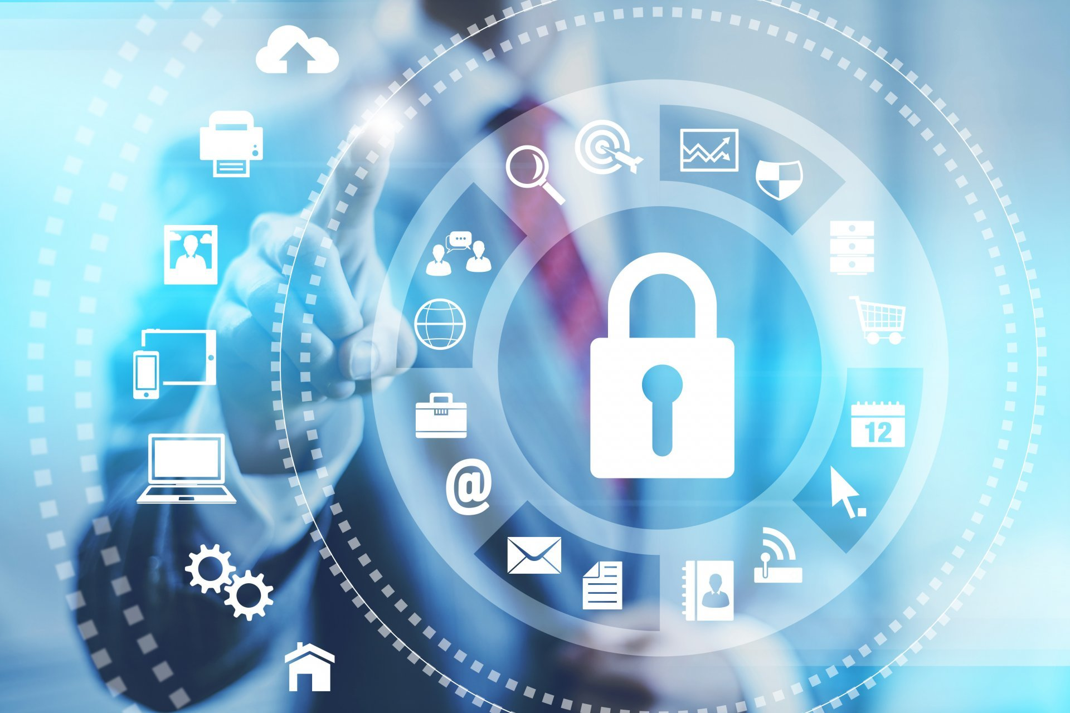
Information Security services
Planning & Roadmap
Ramanuj Prasad Singh

Slide 2
ISS Practice Structure
Ramanuj Prasad Singh
Marketing
Pre-Sales
Deployment Resource

Slide 3





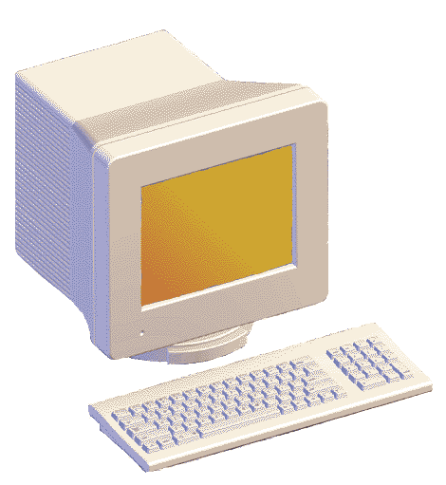
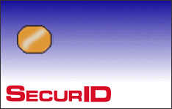



Current Enterprise Scenario – Beyond Boundaries..
Business to Stake Holders
Business to Employees
Stake Holders
Employees
Distributors
Business to Distributors
Business to Customers
Application
Servers
Business to Suppliers
Customers
Suppliers
Notes:
Today’s enterprise environment is not limited to one site or location. The business partners, vendors, distributors, customers, employees spread across geographical locations. Data is exchanged with all these stake holders in and out of corporate environment. When data is getting exchanged we need to have effective security controls at multiple levels to have “Defense in Depth” strategy to protect the corporate data.

Slide 4
The Age of the Hyperextended Enterprise
BUSINESS ISSUES
IMPACT
Innovation
Collaboration
Exploding
Information
Supply Chain
Expanding
Identities
Hyperextended
Enterprise
Customer
Services
Evolving
Infrastructure
IT Consumerization
Increasing
Regulations
Complex
Risk, Security and Compliance Environment
Virtualization and
Cloud Computing
Notes:
As part of a “Hyperextended Enterprise,” you are most likely exchanging information with more constituencies in more ways and more places than ever.
You are innovating and collaborating -- identifying new markets, developing new products and finding new ways to reach customers -- across a vast array of partners.
Your supply chains are becoming more complex and far reaching with outsourcing being aggressively pursued.
If you are like most of our customers, you’re looking for new ways to serve your customers and assimilating new web and communications technologies in the process. And, in doing so, your customers require access to your systems, and you may be storing increasing amounts of sensitive information about your customers within these systems.
Consumer technology is taking hold within organizations. End users are now dictating what devices they want to use to do business. How many of you or your users are using iPads in a business situation? And, certainly virtualization and cloud computing are taking the enterprise by storm, as they very may well be in your organization today.
Click: What does all this mean for you sitting here today? It means that the landscape that you operate within every day has changed with more information to manage and protect than ever before. As a matter of fact, during the last couple of years during the Great Recession when virtually every economic indicator went down – housing prices, jobs, wealth, corporate revenue, IT budgets – information grew by 62 percent. We’re now measuring it in zettabytes. You have more identities to manage – not just your employees, but partners, customers, and consultants and many identities are not even people. Physical as well virtual infrastructure to secure and maintain compliance. And with the growth in information, identities and infrastructure, we have increasing regulations.
Click: All of this is taking place against a backdrop of increasingly sophisticated cybercriminals, which means that you are responsible for managing an extremely complex risk, security and compliance environment.

Slide 5


Companies are Opening Up
Tele-Working
Email
on PDAs
IP
Telephony
Application Sharing
Instant Messaging
Extranets
Connecting
branch
offices
Mobile Workers
Web Applications
Email with Outsiders
5
Notes:
5
5
Companies are increasingly opening up their networks for access to improve business processes, increase operational efficiency, and to attract and retain new customers, business partners, and employees.
For example:
-mobile devices with remote network access enable flexible work options for employees, increasing productivity;
-extranet applications provide business partners and customers with online access to critical business processes, such placing or querying orders;
-additionally, Voice over IP enables organizations to leverage their existing network infrastructure to dramatically reduce telephony costs.
But as companies open up new access to their network and applications, they face serious questions on how to enable the right balance between flexible and ubiquitous access and implementing the right level of security policy enforcement to appropriately manage risks.

Slide 6





















































The Customer Environment…
Can such complexity deliver a high level of security?
Authorization,
Authentication
Manageability
Complicated
Complex
Data security
Identity,
Access Management
Network security
Threat
management
Endpoint security
Security
management
Notes:
6
A new and very important dynamic has developed as companies deploy new security technologies in their environment to support new applications, provide new and more flexible levels of access to their users or respond to new threats: security complexity.
As security needs have continued to increase, companies have typically deployed new security technologies as a “layer” or “point solution” to solve a very specific need. For example, if a company was rolling out a new Web-based portal to provide account access to its business partners, they probably also deployed a new security silo to protect that application, which included a separate firewall to control access, new authentication mechanisms, an intrusion detection and prevention system that could recognize unwanted traffic over Web-based protocols such as HTTP, and perhaps even a separate device to encrypt traffic between end user machines and the Web server.
Taking this point solution approach to security over time as resulted in an environment that is complicated, complex, and comprised of too many vendors, therefore making it impossible to manage. It is not uncommon to see large enterprise organizations with deployed security technology from over 30 different IT security vendors. I can cite the example of a specific Fortune 100 customer who today uses over 40 security vendors and is faced with the issues of management and cost of ownership but also with the inability to answer how well their corporation is secured.
With the fundamental fact that security is only as strong as the weakest link, customers today are facing the question “Can such complexity deliver a high level of security?”

Slide 7
Key Operational Challenges
Cost of Failure, Downtime
Growing Complexity
of Threats
Compliance and Regulatory Mandates

Slide 8

Managing Risk and Threats
No clear visibility to threats and exposures
Inability to adequately address exposures
Slow to respond
Notes:
Quickly introduce Before Scenario that our customers are facing:
Many of our customers come to us facing significant challenges around managing risk and threats within their organizations. They lack clear visibility to threats and exposures, some are unable to adequately address these exposures and many cannot response quickly enough to both internal and external threats, such as theft and fraud.

Slide 9
IT and Security Challenges
Security
IT
Governance, Risk and Compliance
Information Access Control
Application Security
Data Protection and Data Loss Prevention
Users
Application Availability
Application Performance
Safeguarding Data
Information Security
Applications
Application Services
Data
System and End point Security
Security Log Handling
Mobile Security
Business Continuity
Systems
Infrastructure Availability and Performance
Reduce total cost of ownership IT
Green IT
Infrastructure Security
Network
Infrastructure Services
Facilities
Notes:
This slide explains the Technology framework for an extended enterprise and the challenges in the areas of Security and IT. In an enterprise environment the operations are divided into six layers.
Facilities
Network
Systems
Data
Applications
Users
The main pillars of the framework are:
Infrastructure Security
Infrastructure Services
Information Security
Applications Services
Infrastructure Services and Security are primarily dealing with the infrastructure related where facilities, network and systems are involved. Typical challenges faced are mentioned against each pillar.
Information Security and Application Services are primarily dealing with Information related where data is getting exchanged between various users/ stake holders using different applications. Typical challenges faced are mentioned against each pillar.

Slide 10
Security Solutions
Security
IT
Security Incident and Event Management
Identity and Access Management
Governance, Risk and Compliance
Enterprise Service Desk
Multi Factor Authentication
Users
Application Infrastructure Design
PKI & Enterprise Encryption
Application Performance Monitoring
Web Application Firewall
Information Security
Applications
Application Services
Web and Mail Security
Server Load Balancers
SSL-VPN
Global Load Balancers
Data Leakage Prevention, DRM
Data
Web Application Acceleration
Backup, Restore and Archiving
Enterprise FW, VPN, IPS
Systems
Storage –SAN, NAS
Email and Web Security
Disaster Recovery and BCP
Storage Security
Infrastructure Security
Infrastructure Services
Server and Desktop Virtualization
Network
Network Access Control
Bandwidth Optimization
Patch Management
Network Monitoring System
Endpoint FW, AV
Facilities
Data Center Consolidation
Biometrics
Infrastructure Consulting
Professional Services
Notes:
The technology framework remains same. AGC-ISS offers end to end solutions for any enterprise. The various solutions offered by AGC-ISS is mentioned against:
Security Solutions:
Infrastructure Security
Information Security
IT Solutions:
Infrastructure Services
Application Services

Slide 11
Targeted OEM
S. No. | Technology | OEM
1 | Antivirus, HIPS, Antispam | Symantec, Trend Micro, Mcafee
2 | Load Balance (Link & Servers) | F5 Networks, Array Networks, A10, Radware
3 | SIEM (Security Incident & Event Management) | Arcsight, RSA, Symantec
4 | Two Factor Authentication | RSA, Nexus, Vasco
5 | Proxy & Caching Solution | Websense & Bluecoat
6 | WAN Optimisation | Riverbed, Silver peak
7 | DLP | Websense, RSA, Symantec
8 | Web Application Firewall | F5, Palo Alto, Imperva
9 | Encryption | Symantec, IBM
10 | VA/PT | Nessus, Burp suit

Slide 12





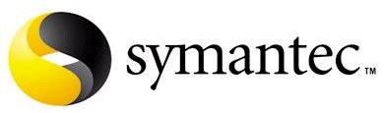









Key Alliances Targeted
Information Security Solutions
12

Slide 13
Our Strength- ISS Training & Certification Pool
Security Training/Certifications
IT Training/Certifications
Microsoft Certified System Administrator
Microsoft Certified System Engineer
Sun Certified System Administrator
Sun Certified Network Administrator
Sun Certified System Administrator for Cluster
Linux Certified System Administrator
Linux Certified Network Administrator
VERITAS Storage Foundation Administrator
EMC Certified Storage Consultants
VMware Certified Professionals
NetApp Certified Data Management Administrator
NetApp Accredited Storage Architect Professionals
NetApp Accredited Sales Professionals
CISSP
CISM
ITIL V3
ISO 27001
PMI
Checkpoint
Fortinet
Symantec
McAfee
Juniper
RSA
Arc Sight
Websense
Bluecoat
F5
Radware
Cisco
13
Notes:
We have large pool certified consultants, engineers who are best of the industry. Typical average experience of our consultant is 5 Years. We have industry specific certifications like CISSP, CISM etc and OEM specific certifications like Checkpoint, F5 Networks etc.

Slide 14
Few Important Technologies
Two Factor
SIEM
WAF

Slide 15
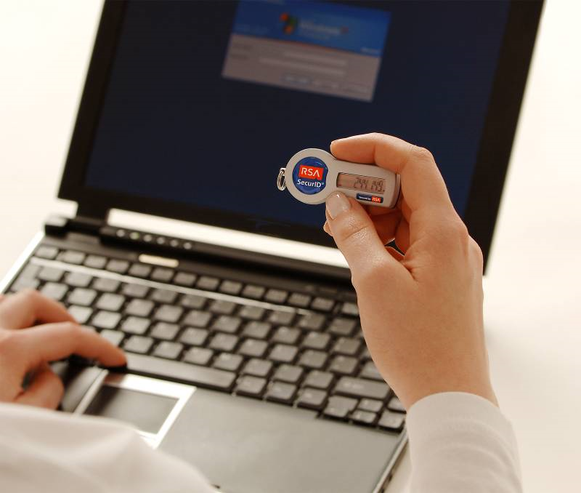
What is Two-Factor Authentication?
Two-Factor Authentication:
“The act of identifying an individual by using any
combination of something they know, something
they have or something they are.”
“Something you know” = PIN, password, life question
“Something you have” = Token, Smartcard, Trusted Device
“Something you are” = Biometrics (fingerprint, retinal scan, etc)
Notes:
15
Note to Presenter: If your customer is well versed in user authentication you can skip this slide.
One of the most widely used for of authentication is two-factor authentication. Two-factor authentication is defined as being able to identify an individual through a combination of something they know (like a PIN or password); something they have (a token) and something they are (a fingerprint or biometric device.). M
It is similar to something you already use – an ATM banking card where the user must present something they have – the card – in combination with something they know – a PIN. Either the card or PIN is insufficient alone, but when combined the users identity is strongly validated.
Organizations are using two-factor authentication to better secure their network resources, as compliance regulations and the high cost of fraud and data loss drive companies for more secure ways to ensure identities than passwords.

Slide 16
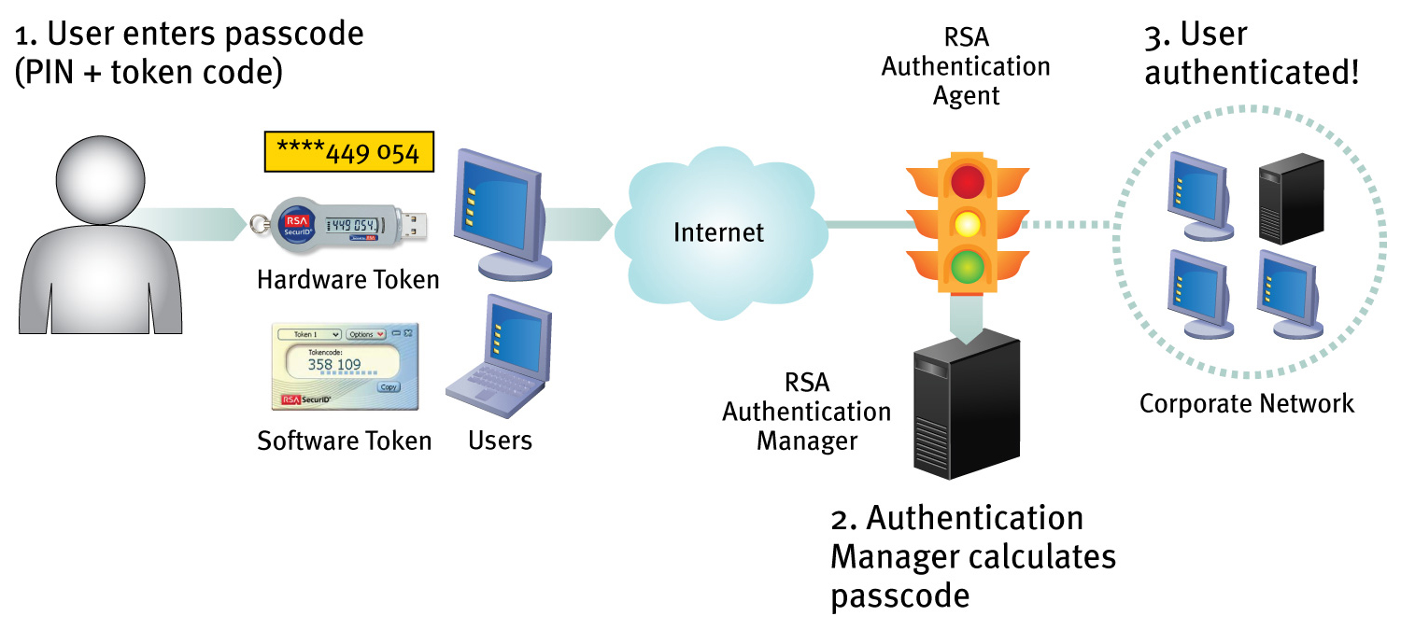

How does It works?
Notes:
RSA offers a full suite of products designed to secure your network through two factor authentication. RSA SecurID technology protects access to the network by using an RSA SecurID authenticator, RSA Authentication Agents, and RSA Authentication Manager software.
How it Works
Each user is assigned a unique authenticator (token) which generates a one-time password (OTP) every 60 seconds. The password is generated from a complex algorithm, virtually ensuring it cannot be guess.
Step 1: When the user attempts to access a protected resource, like a VPN or secure portal, they are prompted for their user ID and passcode. The passcode that the user presents is a combination of their secret PIN and the OTP code that is displayed on their token at that moment in time.
Step 2: The user ID and pass code are intercepted by the RSA Authentication Agent and presented to the RSA Authentication Manager software, the system’s authentication engine. The software checks the pass code to ensure it is correct before issuing instructions to the system to either allow or deny access.
Step 3: Once access is allowed, the user is authenticated and has access to their network resources.

Slide 17
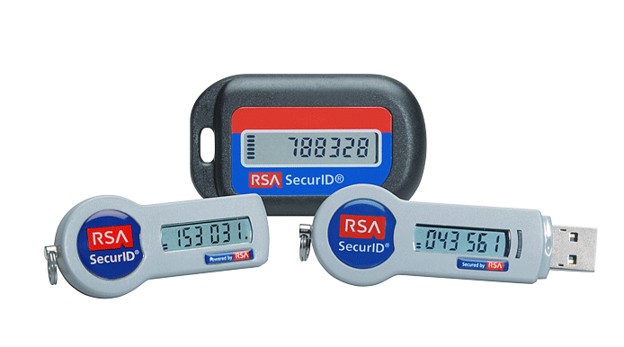
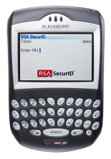
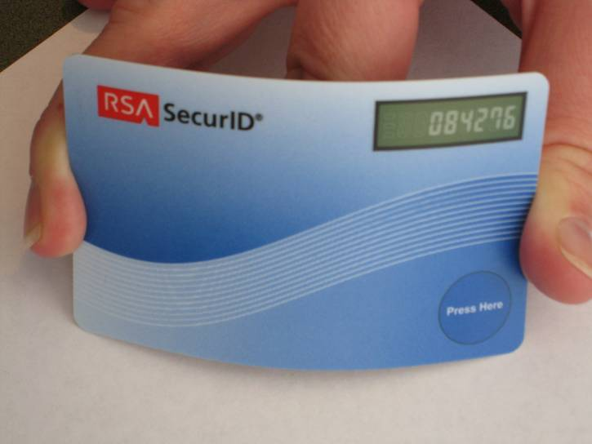
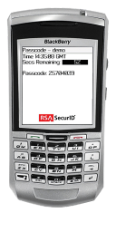
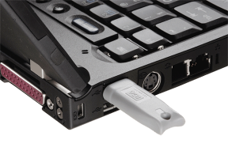
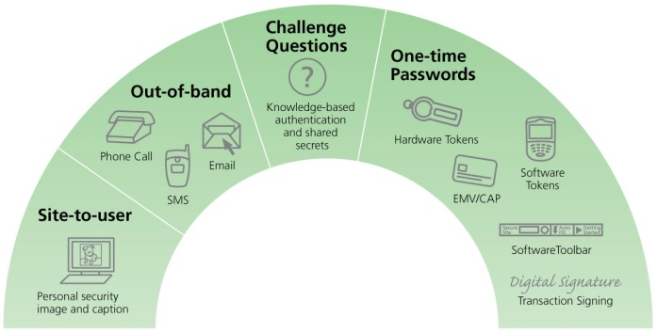
Two Factor Authentication Solution
17
Notes:
17
RSA SecurID® two-factor authentication is based on something you know (a password or PIN) and something you have (an authenticator)—providing a much more reliable level of user authentication than reusable passwords.

Slide 18



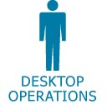



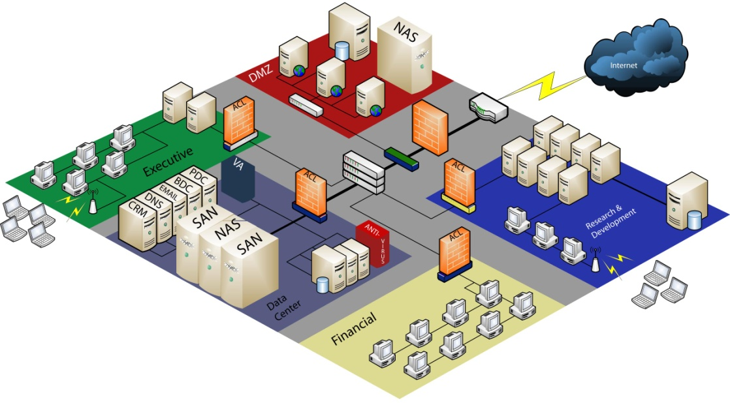

SIEM-The Enterprise Today
Mountains of data, many stakeholders
Access Control Enforcement
Privileged User Management
Malicious Code Detection
Spyware detection
Real-Time Monitoring
Troubleshooting
Configuration Control
Lockdown enforcement
Unauthorized
Service Detection
IP Leakage
False Positive
Reduction
Web server activity logs
Web cache & proxy logs
User Monitoring
Content management logs
SLA Monitoring
How to analyze and manage all the data to transform the information into actionable knowledge and intelligence
Switch logs
IDS/IDP logs
VA Scan logs
Router logs
Windows domain logins
Windows logs
VPN logs
Firewall logs
Wireless access logs
Oracle Financial Logs
Linux, Unix, Windows OS logs
Mainframe logs
DHCP logs
Client & file server logs
San File Access Logs
VLAN Access & Control logs
Database Logs

Slide 19








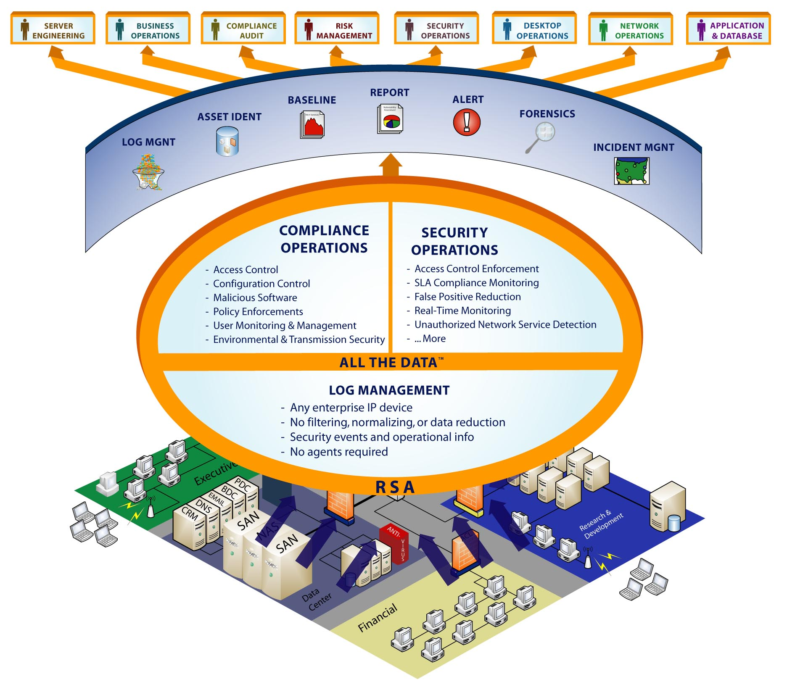
Solution: SIEM
An Information Management Platform…
Server Engineering
Business Ops.
Compliance Audit
Risk Mgmt..
Security Ops.
Desktop Ops.
Network Ops.
App & DB
Report
Baseline
Alert/Correlation
Asset Ident.
Compliance Operations
Security Operations
Forensics
Access Control
Configuration Control
Malicious Software
Policy Enforcements
User Monitoring & Management
Environmental & Transmission Security
Access Control Enforcement
SLA Compliance Monitoring
False Positive Reduction
Real-time Monitoring
Unauthorized Network Service Detection
More…
Log Mgmt.
Incident Mgmt.
All the Data
Log Management
Any enterprise IP device – Universal Device Support (UDS)
No filtering, normalizing, or data reduction
Security events & operational information
No agents required
…For
Compliance & Security Operations

Slide 20
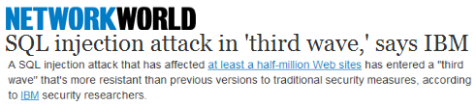



Why Protect Web Applications?
82% of Web applications have vulnerabilities¹
75% of all Internet attacks target applications²
Attacks are getting more sophisticated
  Increasing in scale due to automation, Google hacking
  Growing threats: L7 DDoS, CSRF, botnets, massive SQLi, scraping
¹ White Hat - statistic for initial examination; ² Gartner Research
Notes:
Sources for statistics:
White Hat. Note that this statistic is for web sites that had vulnerabilities.
A Gartner analyst provided the statistic “75% of all Internet attacks target web applications”
Regarding automation, more and more hackers are using pre-built tools or creating their own scripts to automate attacks processes. Hackers are also leveraging large numbers of bots or machines that have been compromised to execute distributed attacks.
Growing threats:
* L7 DDoS = Layer 7 or application layer distributed Denial of Services attacks
* CSRF = Cross-Site Request Forgery, an attack on authentication
* Botnets = networks of software agents or robots that run autonomously and automatically
* Massive SQLi = Massive, wide-scale SQL injection attacks
* Scraping = Screen scraping or stealing content and IP from other organizations’ websites.

Slide 21
Challenges with Legacy Security Solutions
Web Application Firewall - WAF
Application Threat | IPS/Network Firewall | Application Firewall
Cookie poisoning | Well known signatures only
Hidden field manipulation | Well known signatures only
Cross Site scripting | Well known signatures only
Injection Attacks | None
Stealth Commanding | None
Parameter Tampering | None
Buffer overflow | None
Google Hacks | None
Forceful Browsing | None
Identity Theft | None
Application DoS | None
Data Theft | None
Network Firewalls
  Blindly allow HTTP/S Web traffic
IPS/IDS
  Signature matching only, not application aware
  Cannot protect from zero-day attacks
  No protection for encrypted traffic
  Non deterministic protection
  Cannot “normalize” traffic to detect attacks
What is Missing?
More insight and control into application structure:
URLs, cookies, headers, FORMs, Session, SOAP actions, XML elements …
Notes:
THIS is the reason so many leading Fortune 500 companies and industry experts have concluded that application firewalls are now mandatory.
When you step back and consider the facts, the conclusion is pretty straightforward. They know that (summarize points from this section):
- Apps provide access to sensitive data…
- Firewalls don’t protect…
- IPS and patching…
- Just fixing code is difficult, expensive and slow (leaves holes open for far too long while you’re figuring out what to do)
CONCLUSION – Solution must be:
“Firewall” – Needs to be something at the perimeter that blocks attacks BEFORE they get to the app – extension of defense-in-depth
“Proactive” – Must block attacks before they are known, not reactively chase hackers by waiting for signatures, etc.
“Signature-Based” products will never be able to solve this problem. What’s needed is a

Slide 22
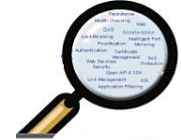



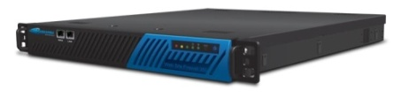



The solution: Layer 7 security
Firewall blocks only network attacks
Web Applications
Web Application Firewall
Port 80/443 traffic goes through
The solution: Web Application Firewall
Understands web traffic
Layer 4 and Layer 7 load balancing for Web servers
Accelerates application delivery
Protects against common web attacks
Mitigates broken access control

Slide 23

A New Type of Security is Needed
Traditional firewalls only detect network attacks
  Only inspect IP address, port/service number
IPS and NG firewalls only detect known signatures
  No application understanding; high rate of false positives/negatives
  No user/session tracking; No protection of SSL traffic
Web Application Firewalls alone detect application attacks!
Application Layer
Application
(Layer 7)
SecureSphere Web Application Firewall
Transport
Layer
Protocols
(OSI Layer 4 – 6)
IPS and Next Generation Firewall
Network
Layer
Network Access
(OSI Layer 1 – 3)
Network Firewall
Notes:
How do you protect your Web applications and data? Unfortunately, traditional security solutions are of little help against sophisticated application attacks. The first generation of network security, or network firewalls, really looked at the network level so they inspected IP address information, source and destination, and port and service number, and focused on trying to keep the bad guys outside of a protected perimeter. Unfortunately, any organization with Internet accessible servers—mail servers, FTP servers, Web servers—had to enabled external access to these resources. Then hackers began so was attacking these infrastructure servers at the protocol layer. The solution was that the Intrusion Prevention System that intended to protect all servers and users from system attacks.. What we found today is that the attackers have moved on and not only do they know port 80 is open but they know that specific applications are available like online commerce, online banking, and bill pay, and like any other application, there’s the potential for security vulnerabilities. So attacks not only focus on the protocol layer but they actually target the logic and the application itself. And the way to protect Web applications is by understanding the application logic, understanding user and session information and understanding the sophisticated Web attacks that hackers employ.
Only a Web Application Firewall can accurately stop Web application attacks.

Slide 24
Multiple Layers of Protection
Protocol Validation
Detects HTTP protocol violations
Identifies known attacks
  - 6,500+ signatures updated weekly
Detects abnormal application usage
Prevents sensitive data leaks
Stops malicious users before an attack is launched
Web Services
Attack Signatures
Application Profile
Data Leak Prevention
Web Worm Detection
ThreatRadar
Notes:
SecureSphere takes a defense in depth approach to securing Web applications. The first layer filters HTTP protocol violations and attacks that take advantage of the HTTP protocol itself. An example would be an attempt to make a buffer overflow with an abnormally large header of an HTTP request.
The next layer is the Signatures layer, that identifies known application, platform and network attacks. SecureSphere has a database of over 6500 signatures that’s updated weekly by the experts at the Application Defense Center.
The next layer is the layer is the Application Profile or white list. And this is where SecureSphere compares the actual usage of the application to the expected usage in the model to identify suspicious occurrences or suspicious user behavior. We will discuss Imperva Dynamic Profiling or ability to automatically learn and adapt to application changes later.
The next layer is the Data Leak Prevention layer, and this detects sensitive data- something like credit card data, or personally identifiable information, as it’s exiting the Web site. SecureSphere is able to see as sensitive data is exiting the application and administrators can ensure that that’s legitimate usage of that data.
And the final layer is ThreatRadar, or SecureSphere’s reputation-based security. ThreatRadar evaluates user and site reputation to make a more accurate and informed decision about web requests.

Slide 25
Let’s begin!

