Slide 1
Guidelines To Radware AppDirector Configuration

Slide 2
Contents:- 1.Acessing the Appdirector first time 2.Configuring IP Address using CLI 3.Accessing AppDirector through GUI 4.Configuring IP Address on Interfaces 5.Configuring FARMS on AppDirector 6. Configuring SERVERS on AppDirector 7. Configuring L4 Policies on AppDirector 8. Configuring Health Monitoring for Servers 9. NTP Server configuration on AppDirector 10.SNMP Server configuration on AppDirector

Slide 3
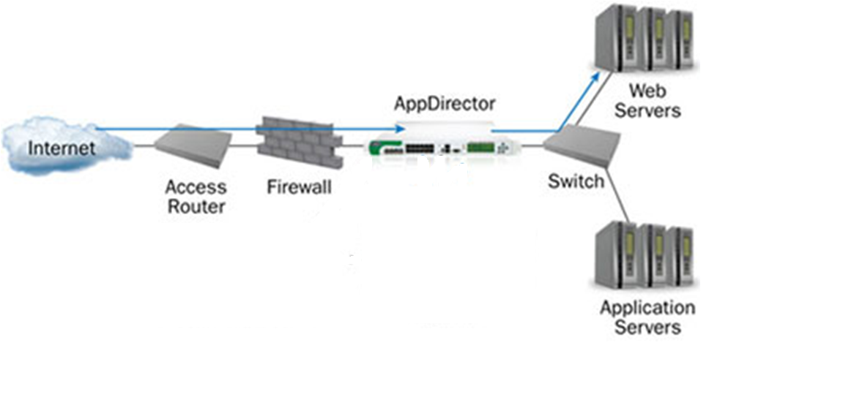
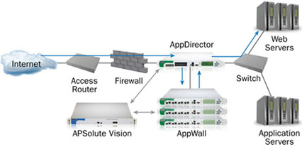
Radware AppDirector

Slide 4
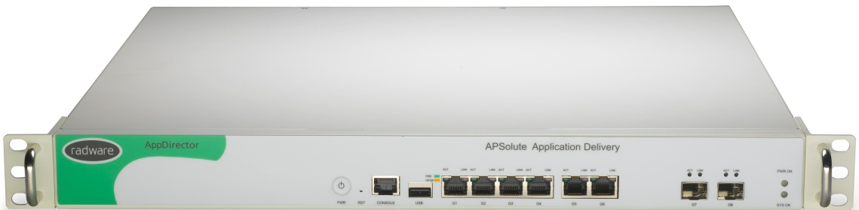
Front Panel View Of AppDirector
Sample device: Appdirector
HA: Dual Power Supplies
RJ-45 Standard console port
6 GE ports
2 SFP (1G) ports
USB Port

Slide 5
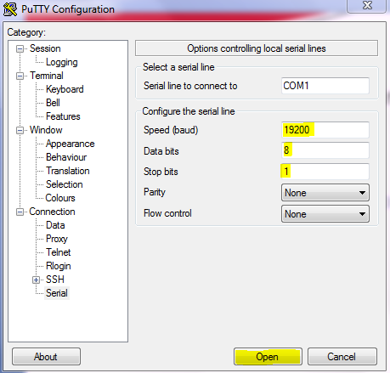
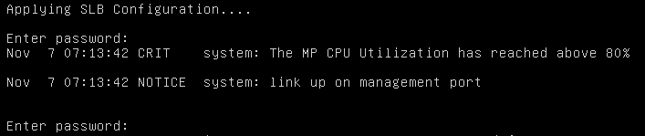
Accessing AppDirector First Time
Connect the console cable to the Device & PC
Set the putty setting as shown below & use Username/Password as radware/radware for login.

Slide 6

Assign the Ip Address through CLI
Assign IP Address, Subnet Mask & Gateway on the Ports
Configure a Default Route for Remote Access
Enable SSH, Telnet, HTTPS for Accessing the Device.

Slide 7
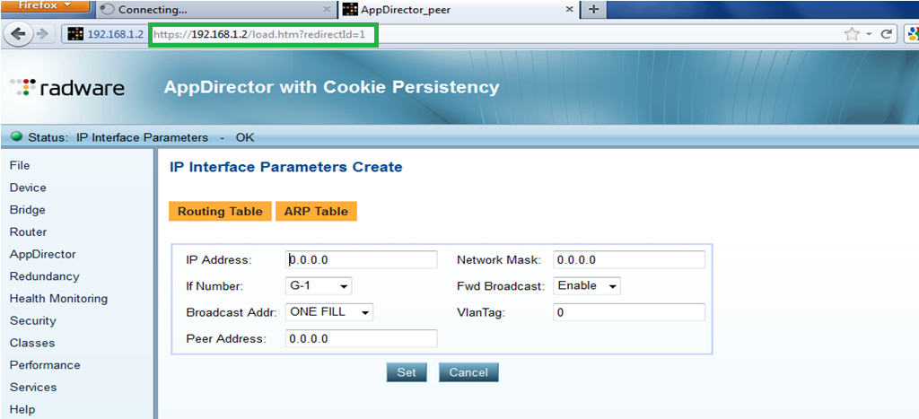
Access AppDirector using web browser

Slide 8
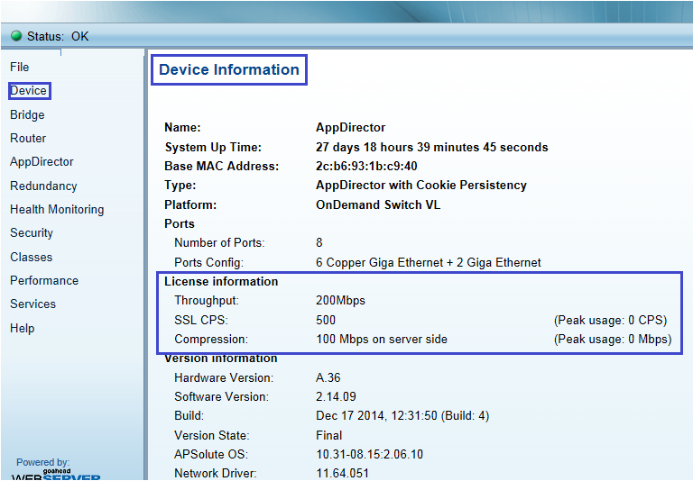
Checking Licensing Status
Goto Device → Device Information

Slide 9
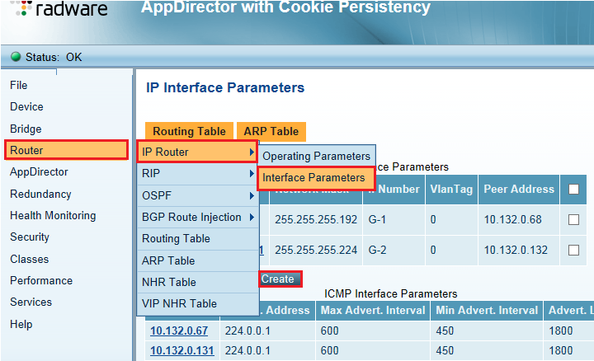
Configure IP Address on Interfaces
Go to Router → IP Router → Interface Parameters → Create
Now select the Interface & give it IP Address , Mask as per requirement

Slide 10
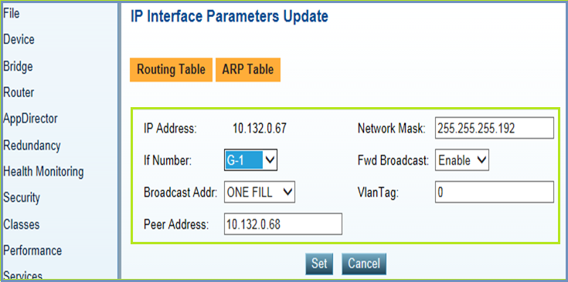
Configure IP Address on Interfaces
Now Give the IP Address , Network Mask, Interface Number, VLAN Tag (if any), Peer Address of Second Device (if Any)

Slide 11
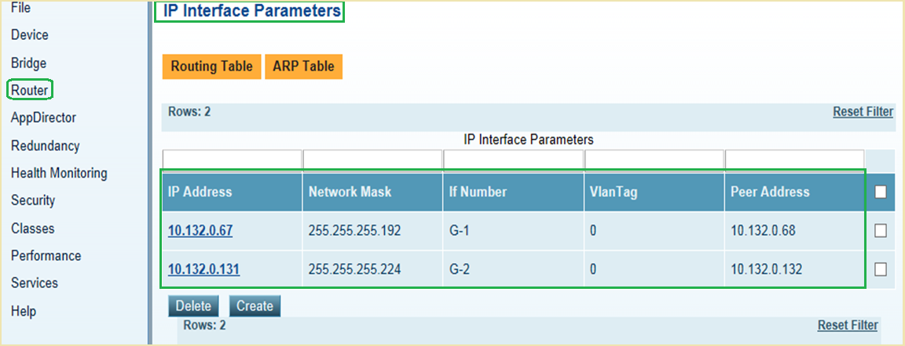
Quick View on Configured IPs

Slide 12
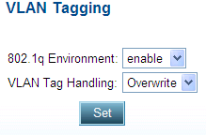
For AppDirector to support VLAN Tags you need to enable 802.1q environment support. After enabling you need to reboot the device. VLAN Tag Handling can be Retain VLAN Tags: preserves VLAN Tags on incoming traffic passing through the device (used only with Segmentation per VLAN, but is Default) Overwrite VLAN Tags: rewrites VLAN Tags based on the local subnet to which the traffic is sent or on the destination MAC of the packet. CLI: net vlan-tag-environment set enable Web Based Management Device → VLAN Tagging
Configuring VLANs on AppDirector

Slide 13
Steps to configure an AppDirector
Create a Farm
Add Servers to the Farm
Create a Layer 4 Policy
Configure Health Monitoring
Configure client persistency
Configure Layer 7 Policies
Configure Client NAT
Configure Redundancy

Slide 14
What is FARM
Farms contain servers
Farm defines the server dispatch (Dispatch Method)
On the Farm level it’s defined what triggers a new load balancing decision and how the device is doing the basic persistency (Farm Session Mode)
Defines basic health monitoring of the servers
Virtual IP bind the client request towards the farm
Virtual IP addresses are bound to one or more farms by defining multiple Layer 4 policies for the traffic flow
A single Layer 4 Policy can contain only a single farm
Multiple Layer 4 policies can be associated to one VIP

Slide 15


VIPs and Farms
AppDirector
VIP-A
VIP-B
VIP-C
Farm-1
Farm-2
Farm-3
Farm-4
slide 15

Slide 16
There are three major components to a Farm that will significantly affect traffic directed to that farm:
Dispatch Method
Client Ageing time (More details in lab 7)
Client Session Mode (More details in Lab 7)
When creating a new farm it is important to understand these values and decide what they should be
Many support issues of traffic not behaving as expected revolve around these parameters.
These values can be modified at anytime if they need to be adjusted however only new sessions will be classified by the changes, any existing sessions will still be treated based on the old values.
Therefore it might take some time to see the results

Slide 17

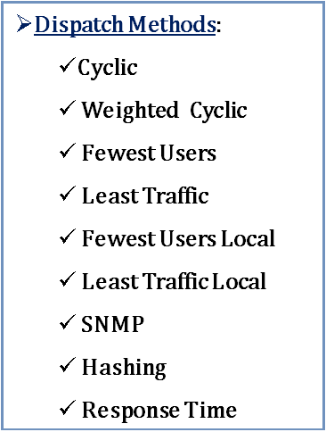

VIP
AppDirector
Server 1
Server 2

Slide 18
Dispatch Methods:
Cyclic – Round Robin
Weighted Cyclic – Round Robin but uses Server Weights when applied
Fewest Users – These are counted as source IPs or sessions (depending on “Session Mode”)
Least Traffic – Measured in Packets
SNMP – AD can query SNMP-enabled servers for Object Identifiers and make load balancing decisions accordingly. NT-1 and NT-2 are preconfigured traffic measurements. Private-1 and -2 allow customers to enter their own SNMP Identifiers as needed (CPU, Available Memory, etc.)
Hashing – uses mathematical formula based on source IP
Response Time – measures amount of time each server takes to respond to Health Monitoring checks. Fastest responding server gets more traffic

Slide 19
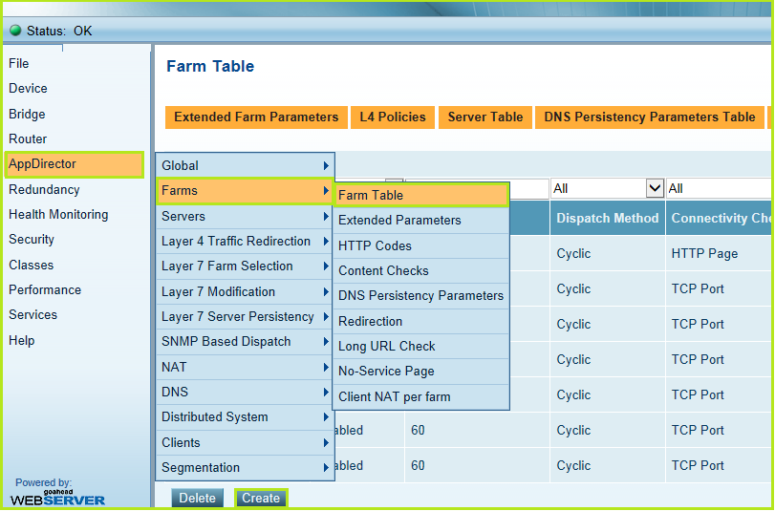
Farm Configuration
Click on AppDirector → Goto Farms → Farm Table → Click Create

Slide 20
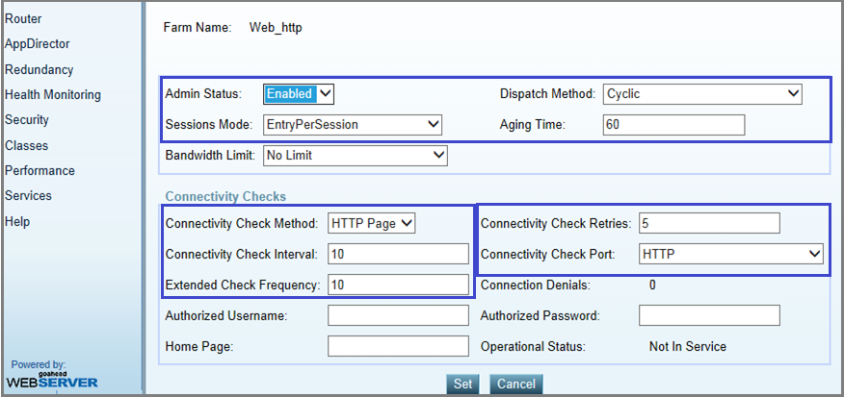
Farm Configuration
Enable Admin Status
Choose Dispatch Method
Choose Session Mode
Set Aging Time
Configure Connectivity Check

Slide 21
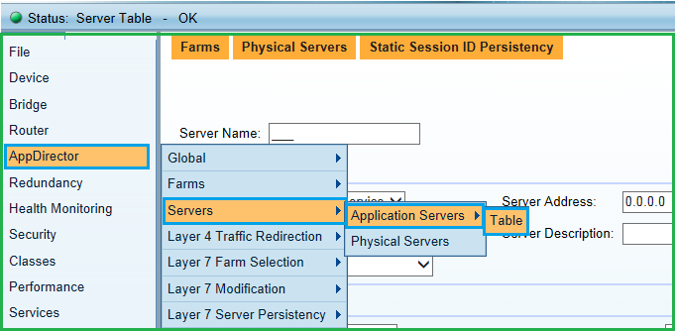
Server Configuration
Go To AppDirector → Servers →Application Server → Table

Slide 22
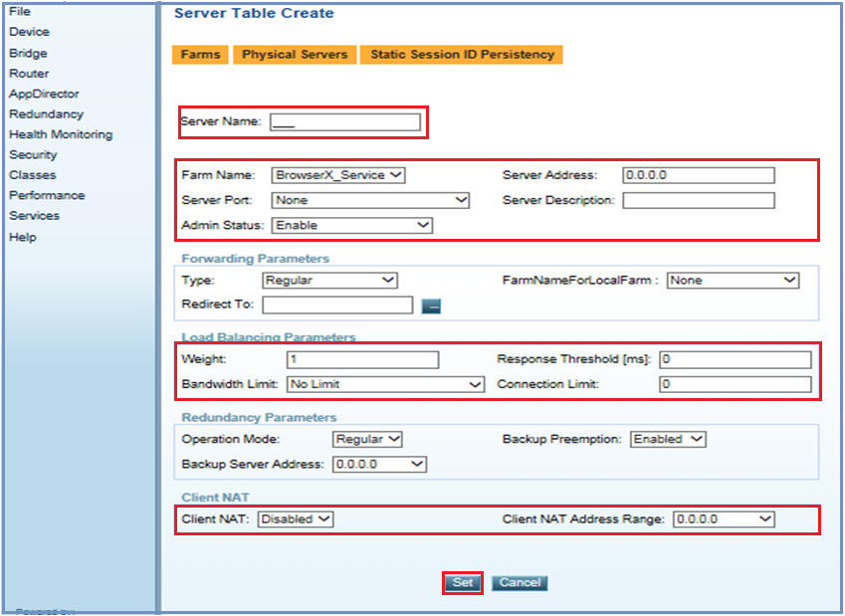
Server Configuration
Give a name to the Server & FARM
Give IP Address to the Server
Select Service Port for the Server
Choose Admin Status for the Server
Select Load Balancing Parameters

Slide 23
There are three main limiting factors for servers
Weights
Connection Limit
Bandwidth Limit
1.Weights
This value is a ratio, the higher the number the more traffic will be sent to that server
Note: of the Dispatch Method is cyclic this value is ignored
2.Connection Limit
Will limit the number of connections based on the session Mode (layer 3 or Layer 4)
3.Bandwidth Limit
Will cap the server at a specific bandwidth limit. If the server reaches the limit no new session will be established
Note: It will not traffic shape or provide QoS, traffic can exceed the bandwidth limit however no new sessions will be established to the server until it drops below the limit.

Slide 24
Layer 4 Policies
Virtual IP address
Layer 4 Policies – farm selection based on network level parameters
Layer 7 Policies – farm selection based on application level parameters
Farm – a group of servers that provide a service

Slide 25

A Layer 4 policy connects the VIP to a Farm
Multiple Layer 4 Policies can share the same VIP
Sometimes a customer has to use a single IP on the outside for multiple farms running different applications:
They want to conserve IP
The DNS name is the same (As in HTTP and HTTPS)
Destination IP = VIP
Destination port = 21
Destination IP = VIP
Destination port = 53
VIP-10.1.1.50
Destination IP = Selected server
Destination port = 21
Destination IP = Selected server
Destination port = 53
FTP
WWW
DNS

Slide 26
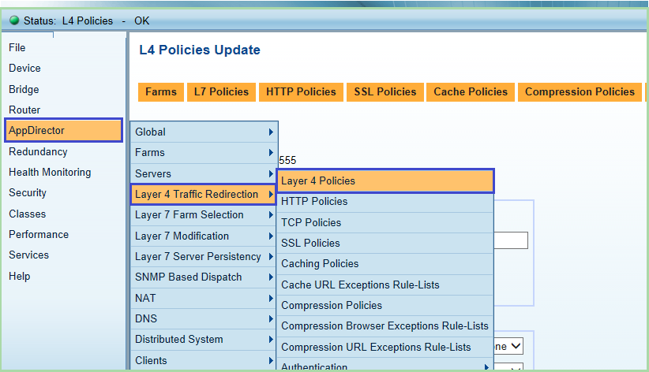
Configure Layer 4 Policies
Goto AppDirector → Layer 4 Traffic Redirection → Layer 4 Policies

Slide 27
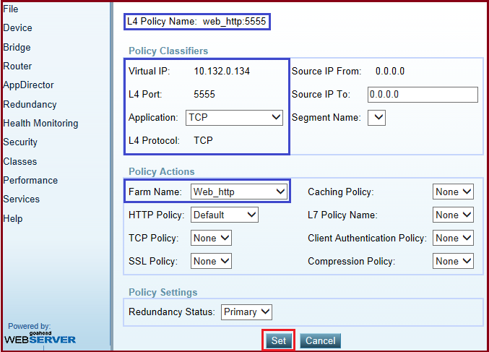
Configure Layer 4 Policies
Add the following information then click Set button

Slide 28

Health Monitoring
The default method for checking the availability of servers is called Connectivity Checks (Health Monitoring).
Each farm can have a different Check method, but every server within that farm has to be able to respond to the check in the same way
If a server fails to respond to consecutive checks, the AppDirector will disable it in that farm and not send traffic to it
The AppDirector will continue to send checks to the failed server in order to reintroduce it back into the farm when it has recovered
AppDirector
Ping
Ping
Server 1
Server 2

Slide 29
Health Monitoring
Connectivity Checks:
Ping
TCP or UDP Port
HTTP page
page Content
Ping Check
HTTP Page Check
HTML Code “Server Up”
HTML Code “Server Down”
AppDirector
AppDirector
Ping
Ping
test.htm ?
test.htm ?
Server 1
Server 2
Server 1
Server 2

Slide 30
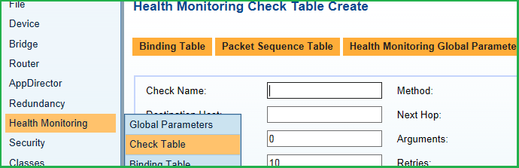
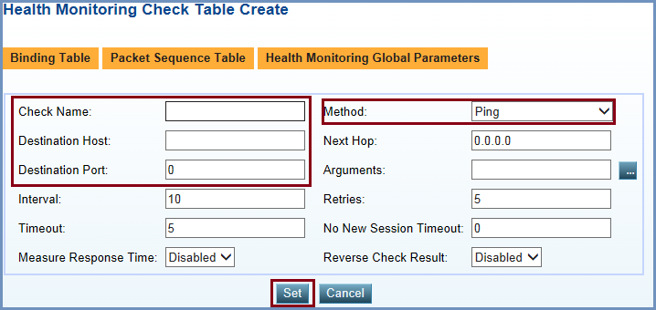
Configuring Health Monitoring
Goto Health Monitoring → Check Table → Create
Then fill the Check Name, Method used,
Destination Host, Destination Port
Then Click Set

Slide 31
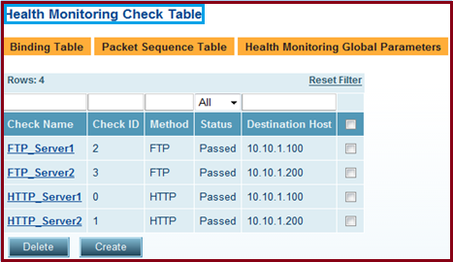
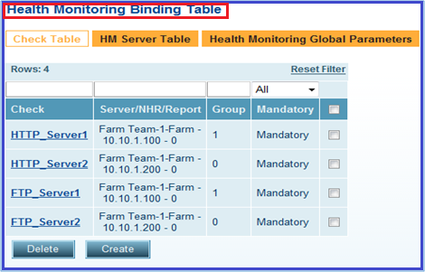
Health Monitoring contains two parts:
Health Check DB
The DB of all the health checks being performed by the AppDirector
Binding Table
Binding the health checks to the servers in the AppDirector.

Slide 32
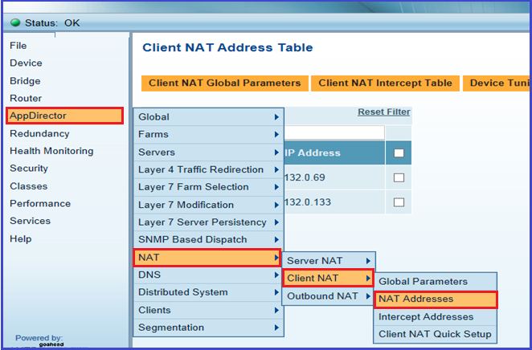

Configuring Client NAT
Goto AppDirector → NAT → Client NAT → NAT Address → Click Create
Set the IP Address/Range For Client NAT

Slide 33
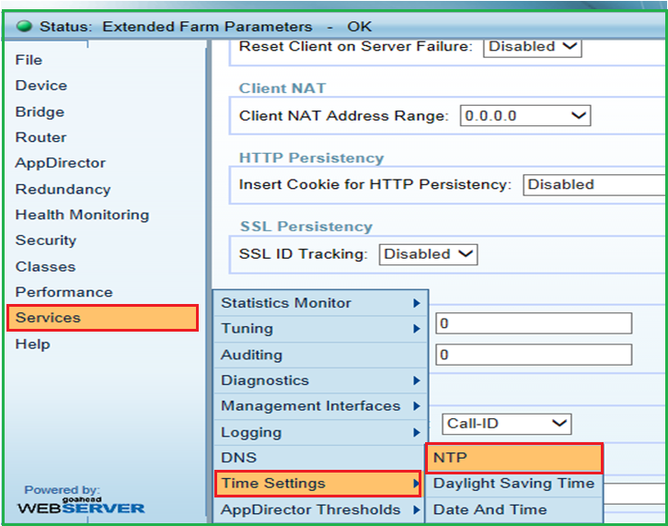
NTP Configuration
Go to Services→ Time Settings → Click NTP

Slide 34
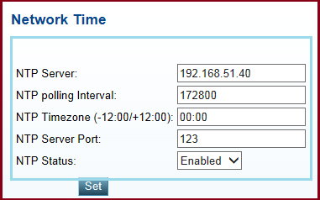
NTP Configuration
Configure NTP Server IP Add, Polling Interval, Time zone,
NTP Port, NTP Status & Click Set

Slide 35
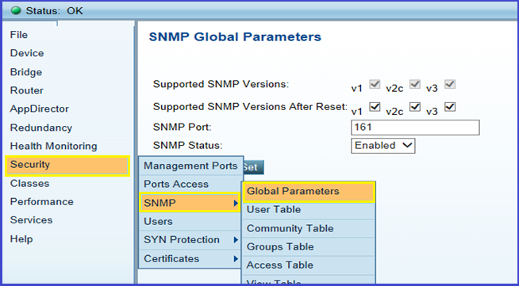
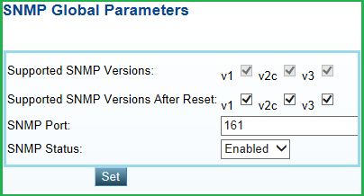
SNMP Configuration
Goto Security → SNMP → Global Parameters
Select SNMP Version , SNMP Port, Enable SNMP &
then Click Set

Slide 36
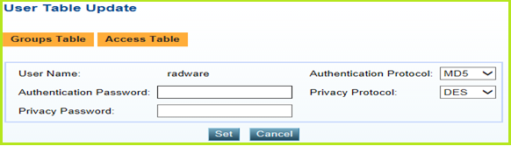
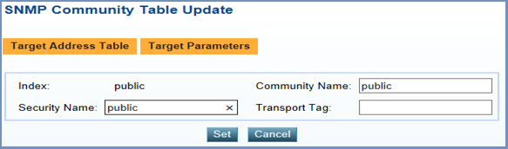
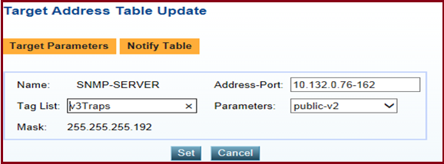
SNMP Configuration
In User Update Table Create the User Name.
Choose Authentication Protocol and Password,
Privacy Protocol and Password.
Put Community String details in SNMP Community Table
In Target Address Table put SNMP server address details.

Slide 37
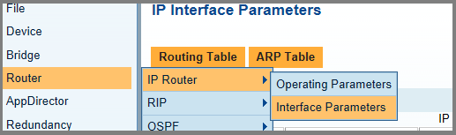
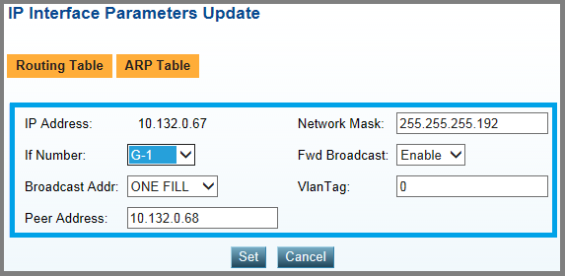
HA Configuration
Goto Router → IP Router → Interface Parameters
Set the Peer IP Address and Click Set Button

Slide 38
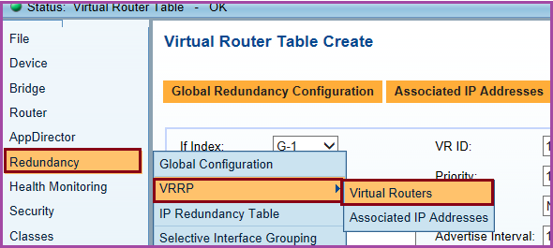
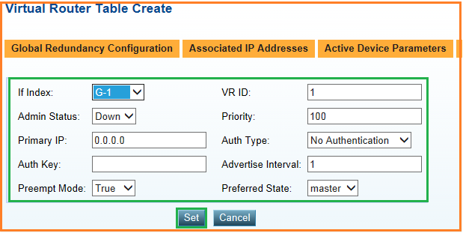
HA Configuration
Go to Redundancy→ VRRP → Virtual Routers
Choose Interface Number, Set VRRP ID, Priority
Choose Preempt Mode & other required parameters

Slide 39
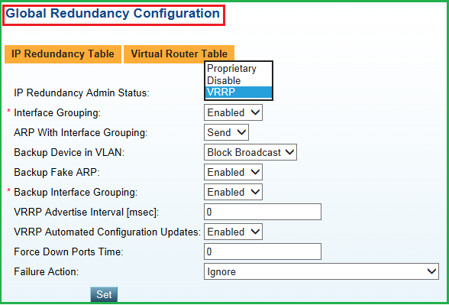
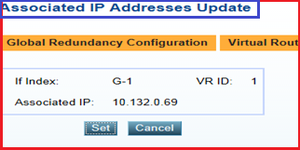
HA Configuration
Goto Global Redundancy Configuration →
Choose IP Redundancy Admin Status as VRRP & click Set
In Associated IP Address, put Client NAT IP
address & click set

Slide 40
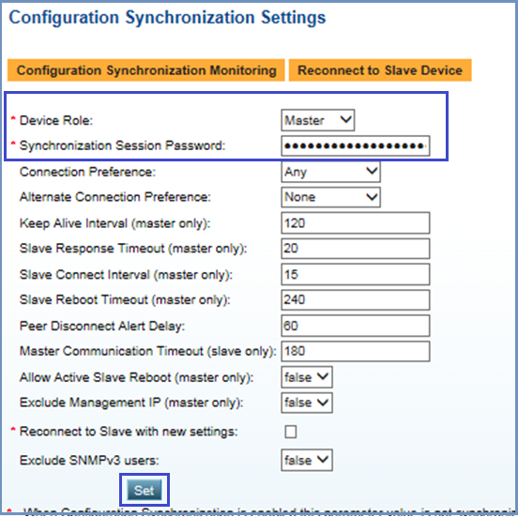
HA Configuration
Put Device Role as Master/Slave based on Box.
Put Sync Session Password.
Click Set

Slide 41
Thanks

