Slide 1
Guidelines To Radware Alteon Configuration

Slide 2
Contents:-
1.Accessing the Radware Alteon first time
2. Access Through Web-Browser
3.Activating License
4.Configuring VLANs
5.Assigning IP Address/VLAN To Interface
6.Configuring Real Servers
7.Configuring Server Group & Add Servers to Group
8.Configuring Health Check For Server Group
9.Configuring Virtual Server
10.Taking Backup of the Configuration
11.Restoring The Backup Configuration on Alteon

Slide 3
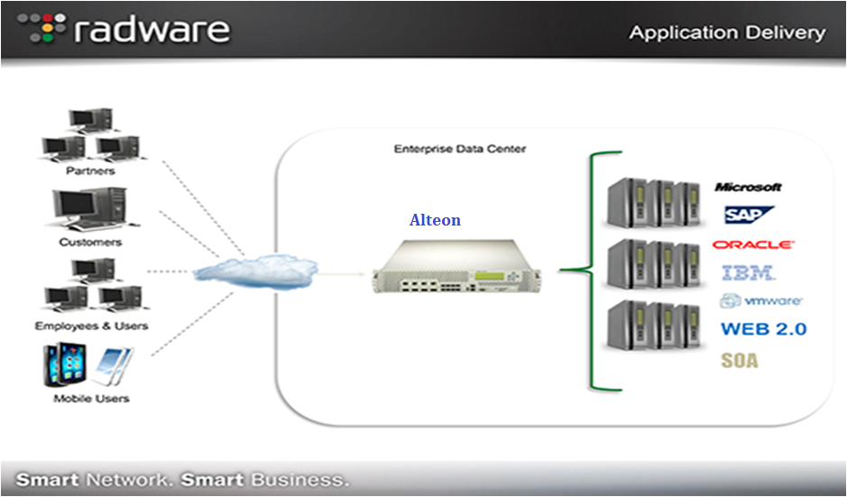
Radware Alteon

Slide 4
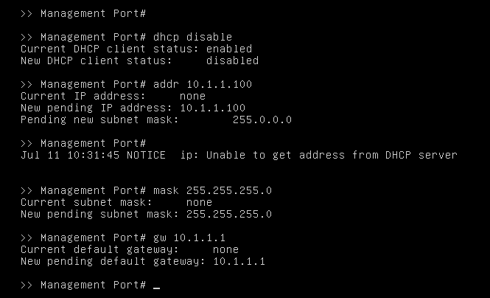
Accessing Radware Alteon First Time with Console
Connect the console cable to the console port & other end to the PC.
Password: admin
Now Assign IP Address to MGMT interface through cli.
Main# /cfg/sys/mmgmt
Management Port# dhcp disable
Management Port# addr 10.1.1.100
Management Port# mask 255.255.255.0
Management Port# gw 10.1.1.1
Management Port# apply
Main# /cfg/sys/access/sshd on
Main# /cfg/sys/access/ssh enable

Slide 5
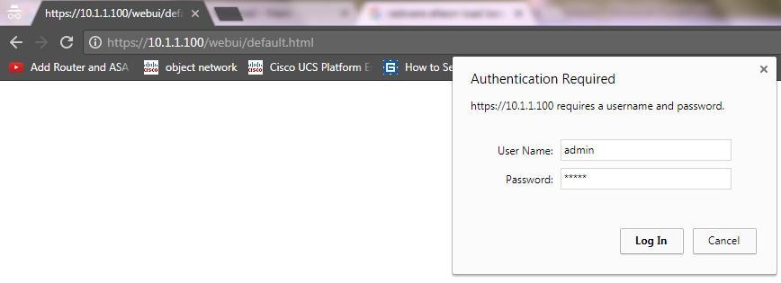
Access Through Web-Browser
Type https://10.1.1.100 in the URL Bar in browser. Use admin for User Name & Password

Slide 6
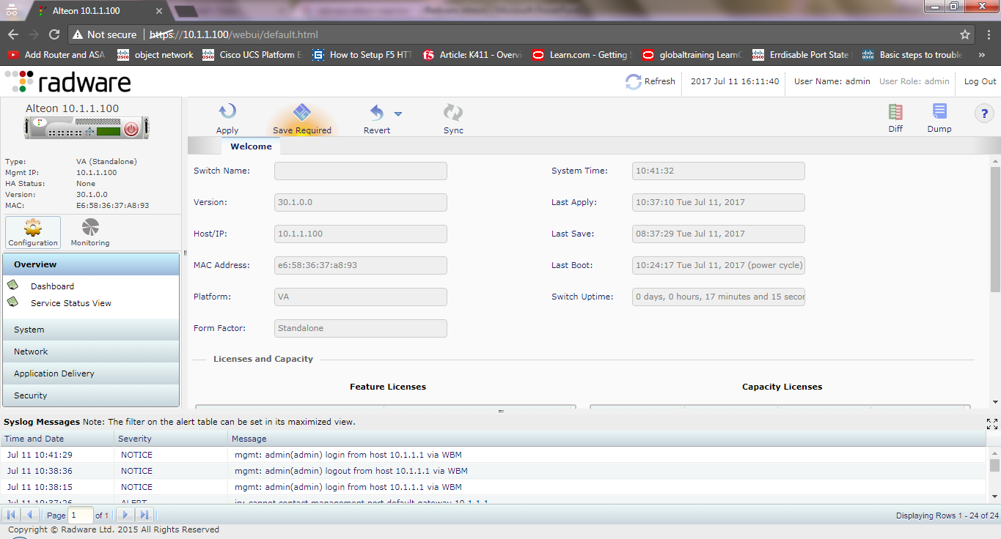
Access Through Web-Browser

Slide 7
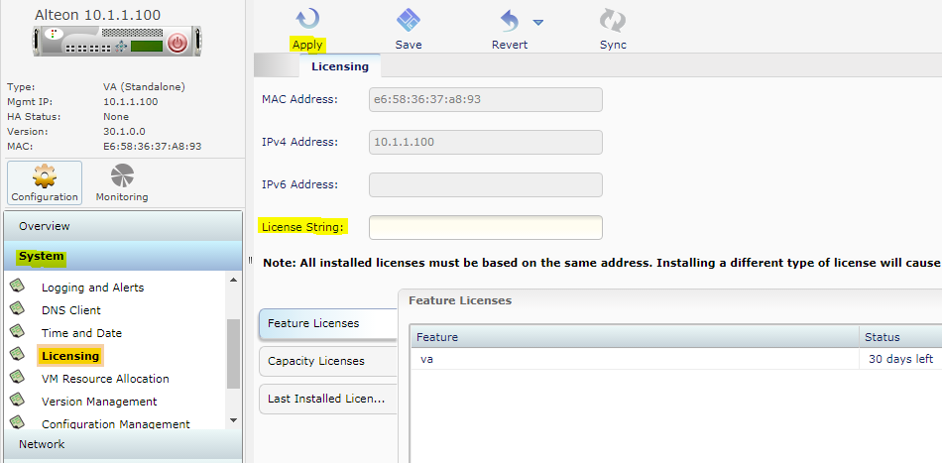
Activating License
Goto System→ Licensing→ Then type the License key in the License String Box.
After that click the Apply Button & License will be activated.

Slide 8
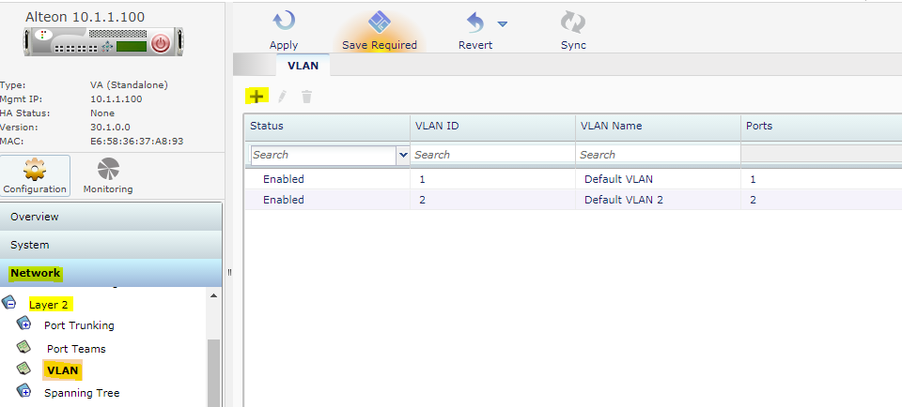
Configuring VLANs
Goto Network→ Layer 2→VLAN & click add

Slide 9
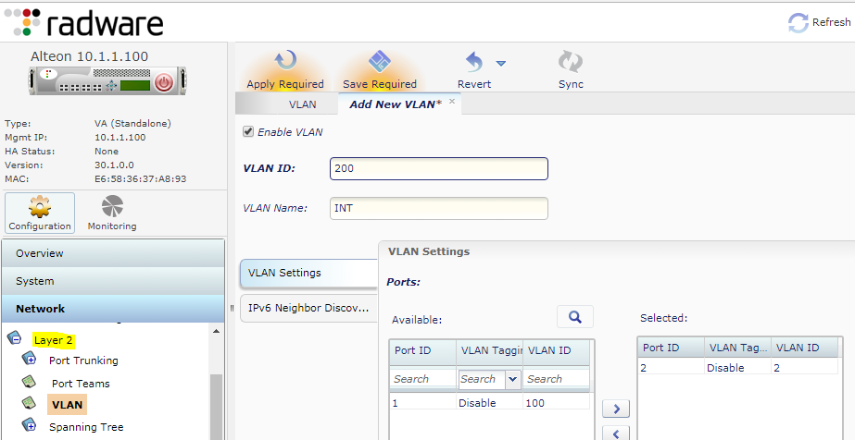
Configuring VLANs
Enter the necessary information & click submit

Slide 10
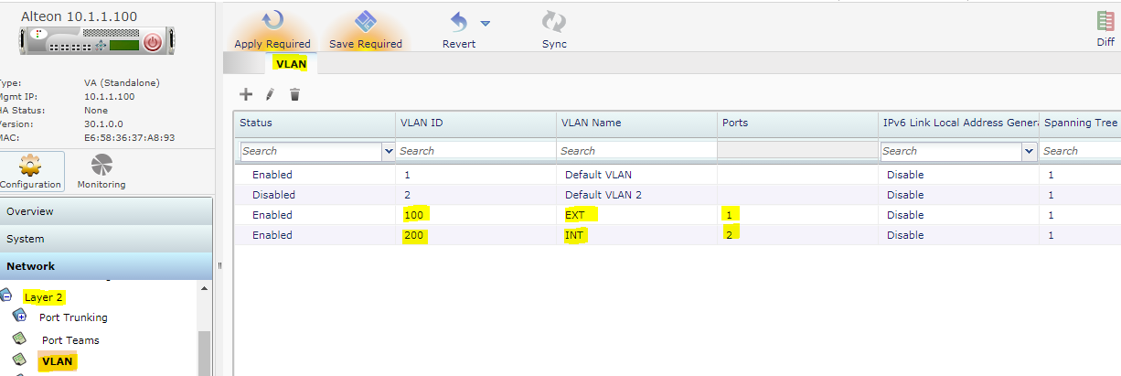
Configuring VLANs

Slide 11
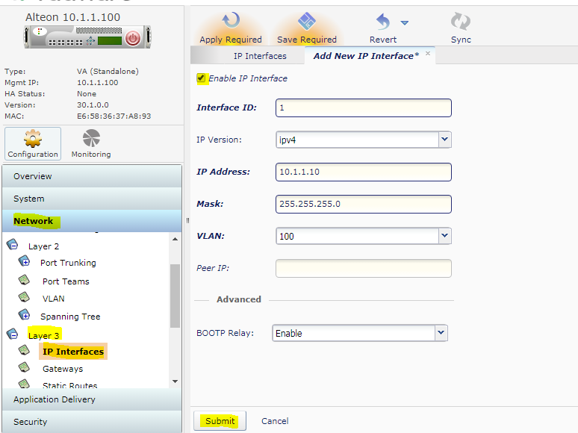
Assigning IP Address/VLAN To Interface
Goto Network → Layer 3→IP Interface and click add.
After that fill the information as below

Slide 12
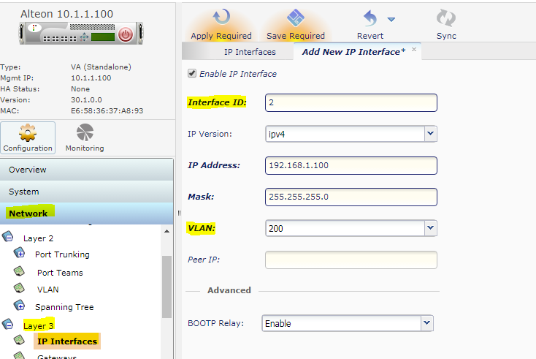
Assigning IP Address/VLAN To Interface

Slide 13
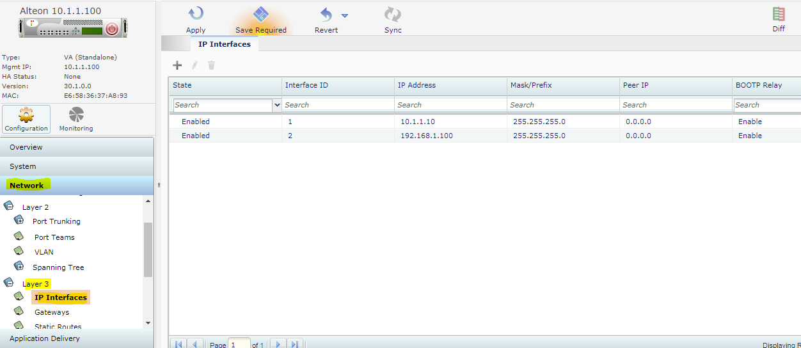
Assigning IP Address/VLAN To Interface
View the Interfaces IP Address & VLAN we have added

Slide 14
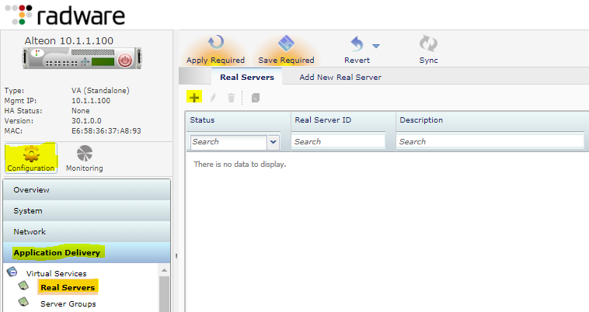
Configuring Real Servers
Goto Configuration→ Application Delivery→Real Servers then click on + button to add Real Server.

Slide 15
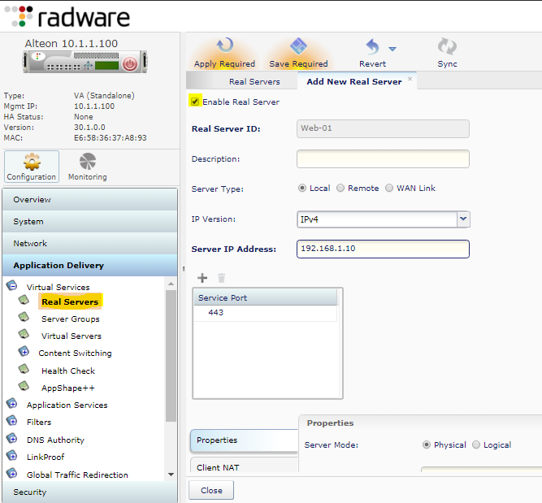
Configuring Real Servers
Configure the Real Server as shown
Add all the Real Servers by this process.

Slide 16
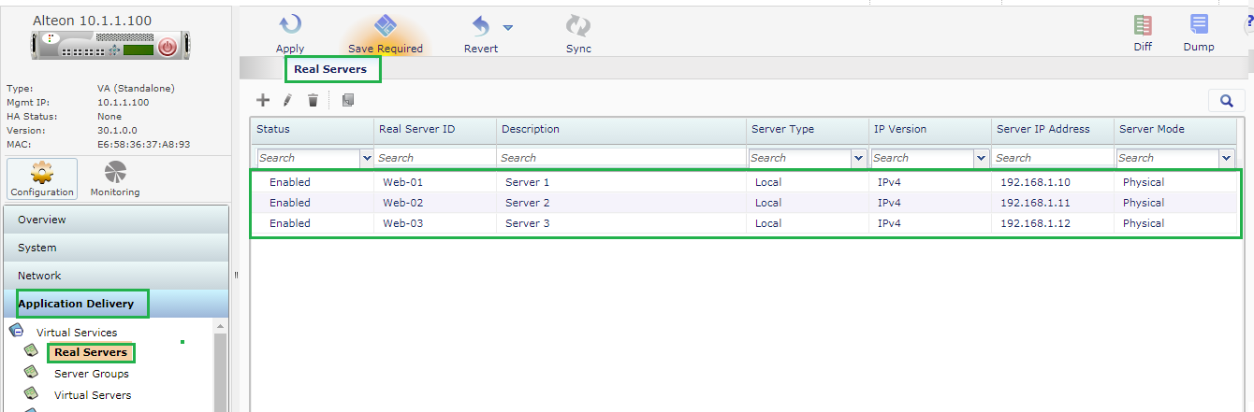
Quick View on Configured Real Servers

Slide 17
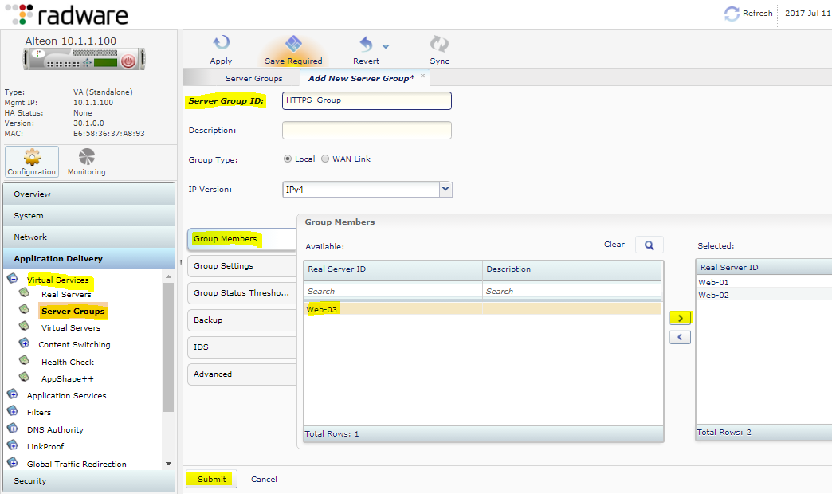
Configuring Server Group & Add Servers to Group
Goto Server Groups & click
+ symbol to add new server
Group.
Then give a name to Server
Group & Add Real Servers
To this group as shown .
Then click submit button on
Bottom.

Slide 18
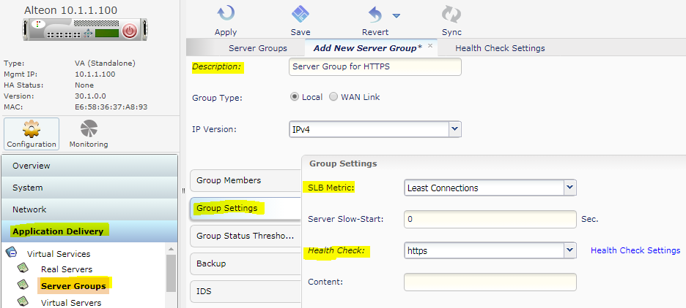
Configuring Health Check For Server Group
Goto Application Delivery→ Server Groups→ Group Setting & Select SLB Metrics (Load Balancing Method)
Then Select Health Monitor in this case we are using https service check & Submit.

Slide 19
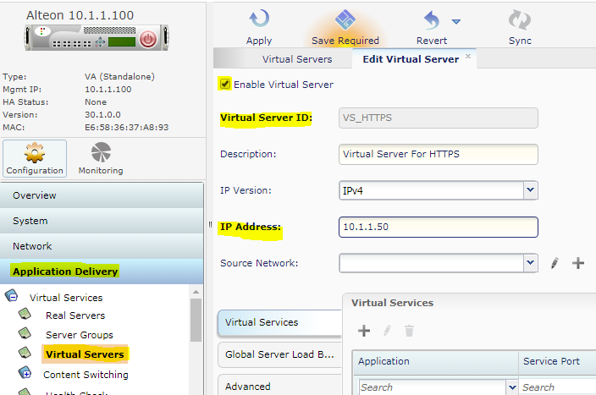
Configuring Virtual Server
Go to the Application Delivery→ Virtual Servers →Click + button.

Slide 20
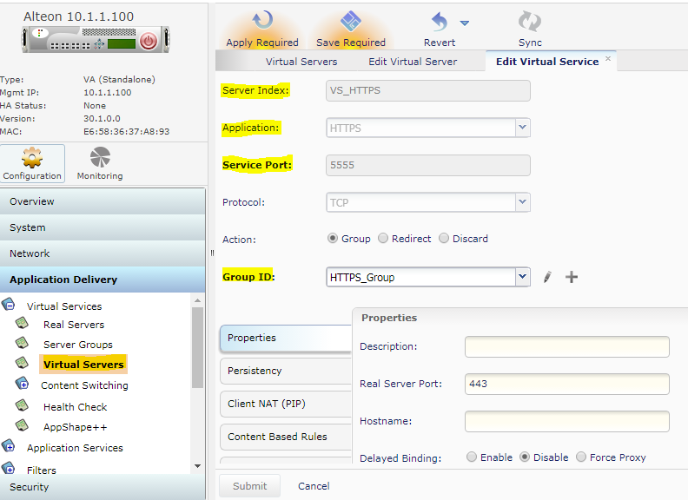
Configuring Virtual Server
Now add Virtual Service to this Virtual Server. When client will hit VIP 10.1.1.50 at Port 5555 then Alteon will forward this request to Real Servers based on selected Load Balancing Method

Slide 21
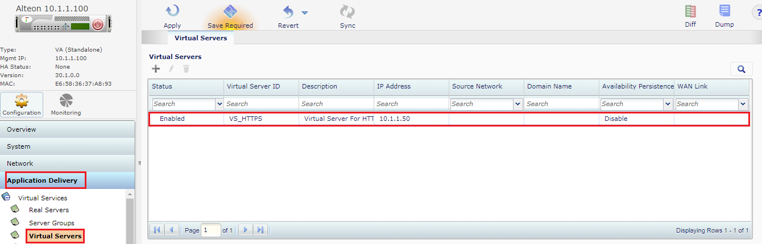
Quick View on Configured Virtual Servers

Slide 22
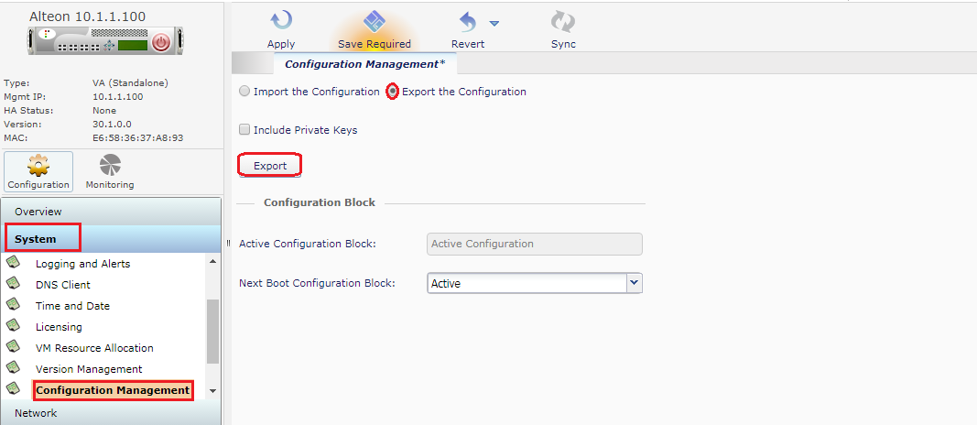
Taking Backup of the Configuration
Goto System → Configuration Management → Check Export The Configuration Then Click Export button & Configuration will be downloaded.

Slide 23
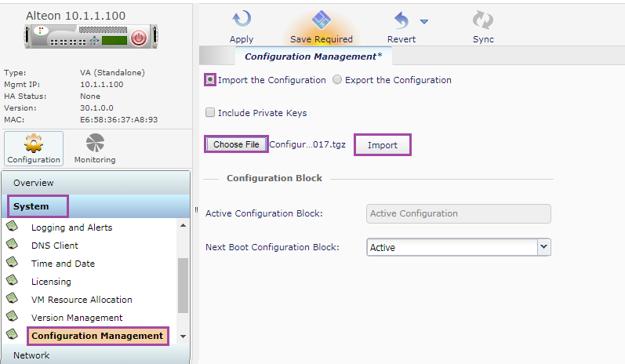
Restoring The Backup Configuration on Alteon
Goto System → Configuration Management → Check Import The Configuration Then Click Choose File button & click Import button.

Slide 24
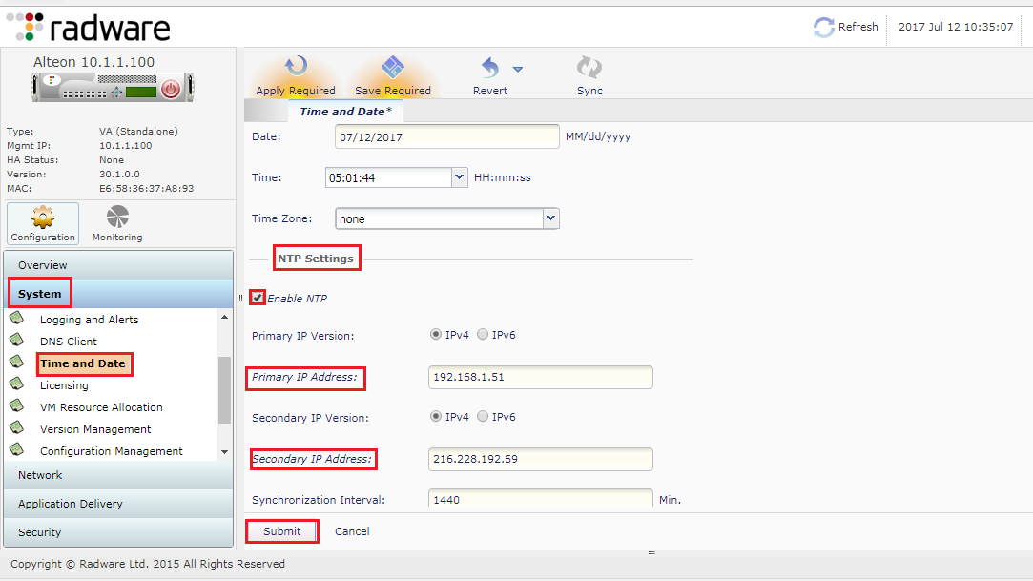
Configuring NTP Server
Go to System → Time & Date→ Enable NTP & Give IP Address of NTP Servers then click submit

Slide 25
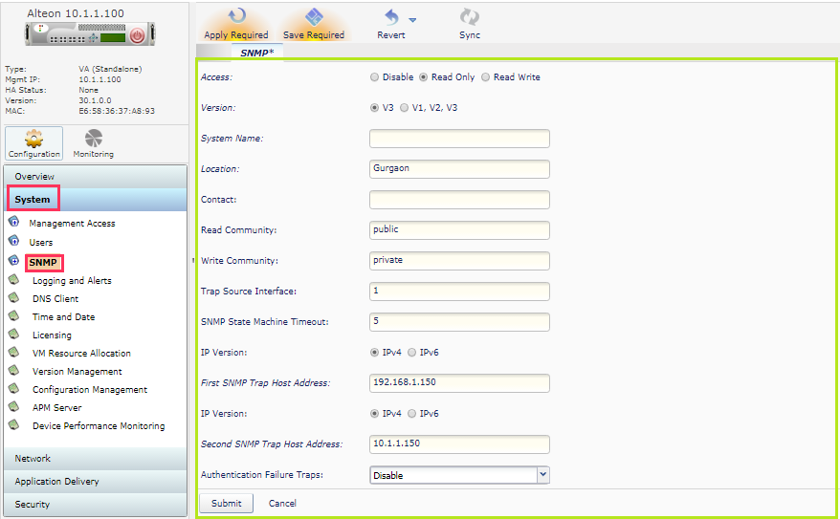
Configuring SNMP Server
Goto System → SNMP Then fill all the necessary information.

Slide 26
Thanks

