Slide 1
F5 Configuration document

Slide 2
1. F5 Integrated Solution 2.Setup Utility a. License Activation b. Management Settings 3. Network Configuration a. Vlan configuration b. Self IP configuration 4. Local Traffic a. Node configuration b. Pool configuration c. Virtual server configuration d. Profiles e. SSL Offloading e. iRule 5. System a. Configure NTP b. Configure SNMP c. Authentication using Remote Server 6. Packet Capture a. via CLI b. via GUI

Slide 3
LTM Introduction
LTM delivers applications to users in a reliable, secure, and optimized way.
LTM is used to Load Balances the client request among the servers in a pool.
It uses multiple load balancing algorithm for distributing the client request.
LTM provides extensibility and flexibility of application services with the
programmability we need to manage your physical, virtual, and cloud
infrastructure.
It monitors the health & performance of the servers.

Slide 4







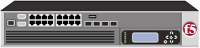

F5’s Integrated Solution
Users
The F5 Solution
Applications
Application Delivery Network
CRM Database Siebel BEA Legacy .NET SAP PeopleSoft IBM ERP SFA Custom
Mobile Phone
PDA
Laptop
Desktop
TMOS
Co-location

Slide 5

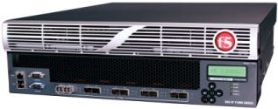

The Full Application Proxy
Client Data
SYN ACK
TCP Express
SYN
ACK
Internet
Client Side Profile
Full Application Proxy – No More Relays
Client Data
Server Side Profile
SYN
ACK
SYN ACK
Server Response

Slide 6
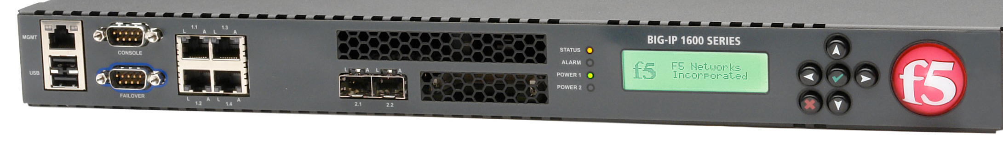
Front Panel on most platforms
Sample device: BIG-IP 1600
Management Interface (10/100) - Default IP 192.168.1.245/24
10/100/1000 Copper Interfaces
Number varies based on platform
LCD and LCD Control Buttons
You can configure the management interface IP from the LCD
Console Port
Default 19200/8/1/N
2 USB Ports
Status LEDs
Gbics
Fiber interfaces, multi-mode (default) and single mode available, number varies by platform:
Type and Number depend on platform
Hard-Wired Failover Port (blue outline)
Console cables and failover cable are pinned differently

Slide 7
Setup Utility

Slide 8
BIG-IP web-based configuration
1. Access using default IP
2. License the BIG-IP
3. Run the Setup Utility
BIG-IP LTM Basic Configuration
4. Configure BIG-IP objects( Nodes, Pools and Virtual Servers)

Slide 9
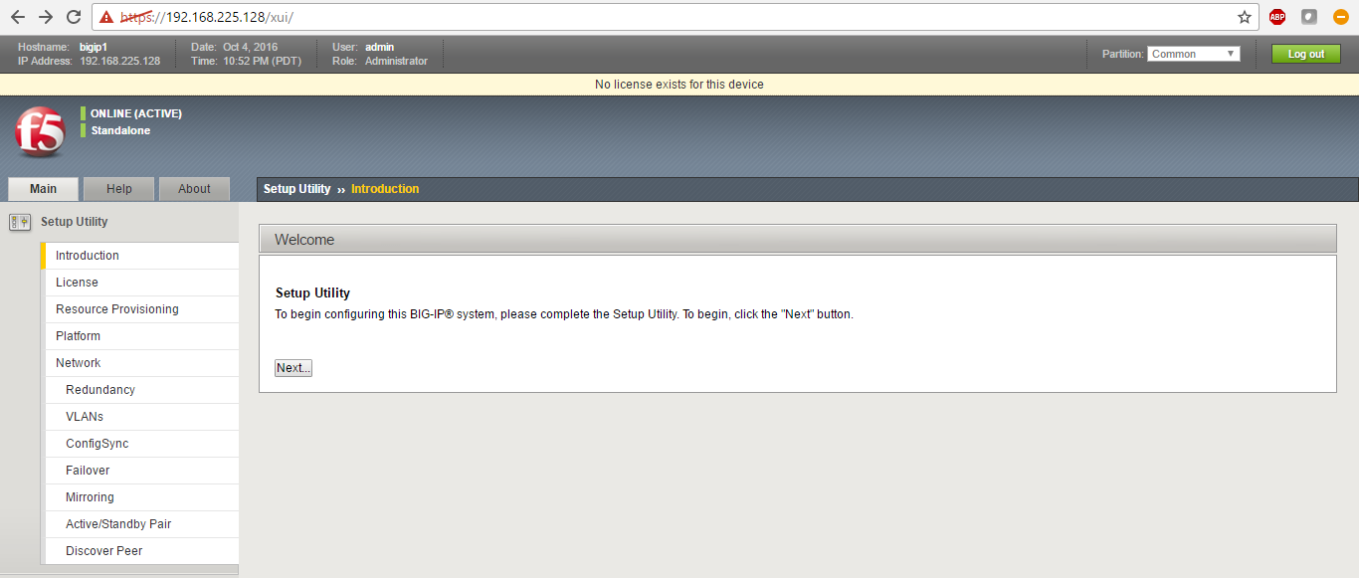
Accessing LB For The First Time
Use 192.168.225.128 or 192.168.1.245 default IP depending on the model
Click next for Setup Utility

Slide 10
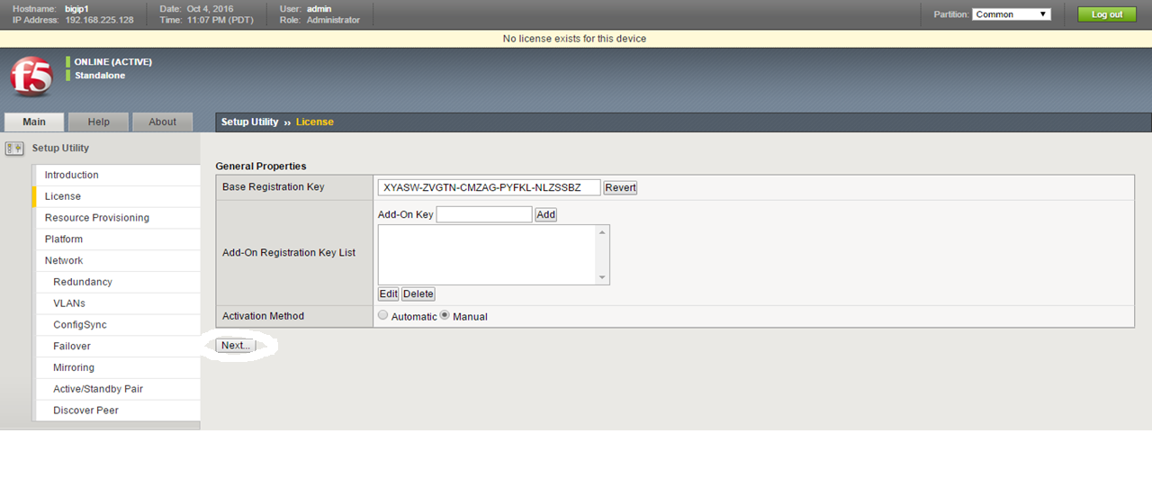
License Activation
Click on Next

Slide 11
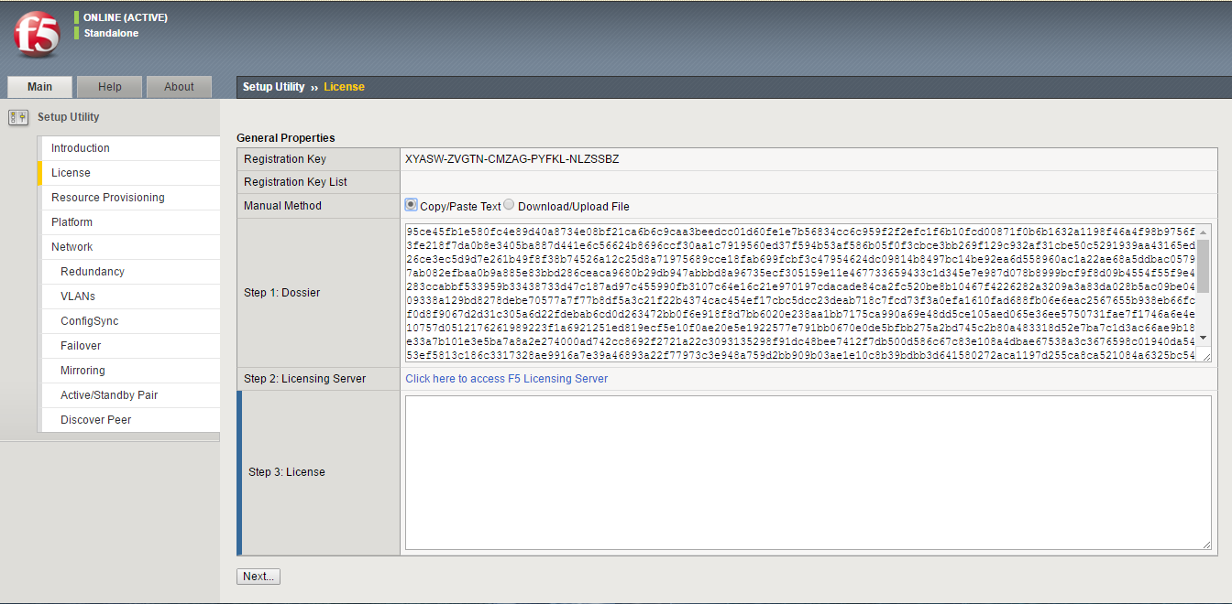
Copy the Dossier in Notepad

Slide 12
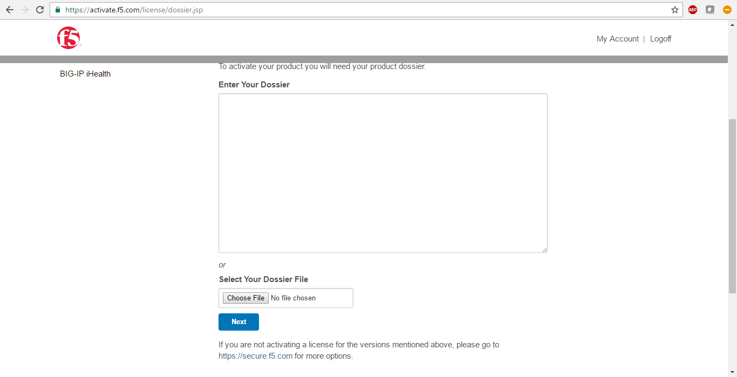
Open https://activate.f5.com/license/dossier.jsp

Slide 13
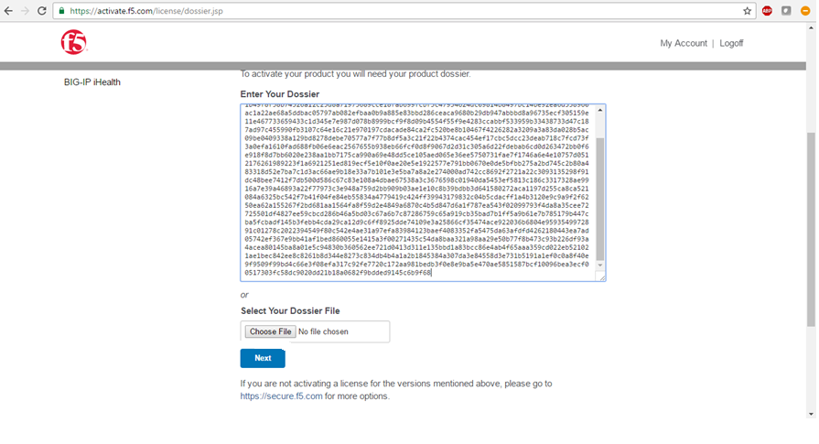
Paste the copied Dossier
Click on Next

Slide 14
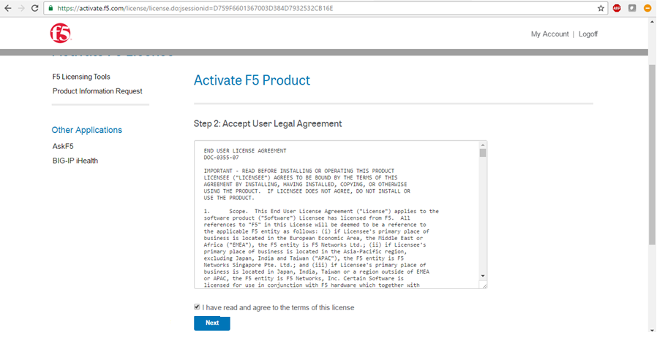
Click on next

Slide 15
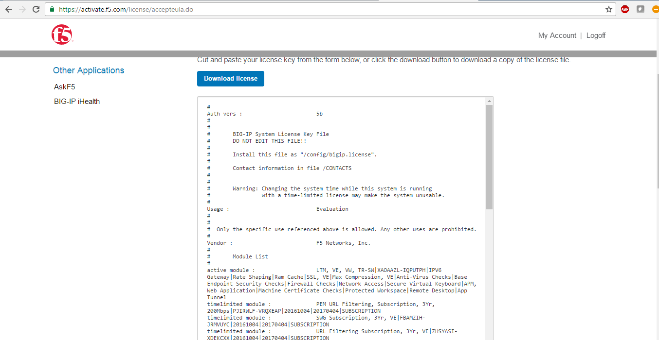
Copy the Licence

Slide 16
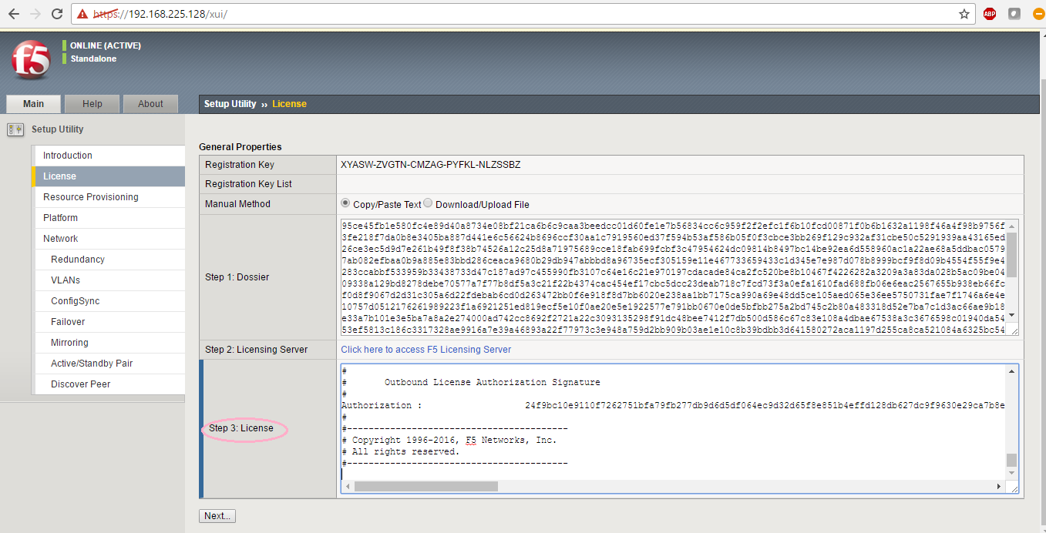
Paste the copied Licence
Click on Next

Slide 17
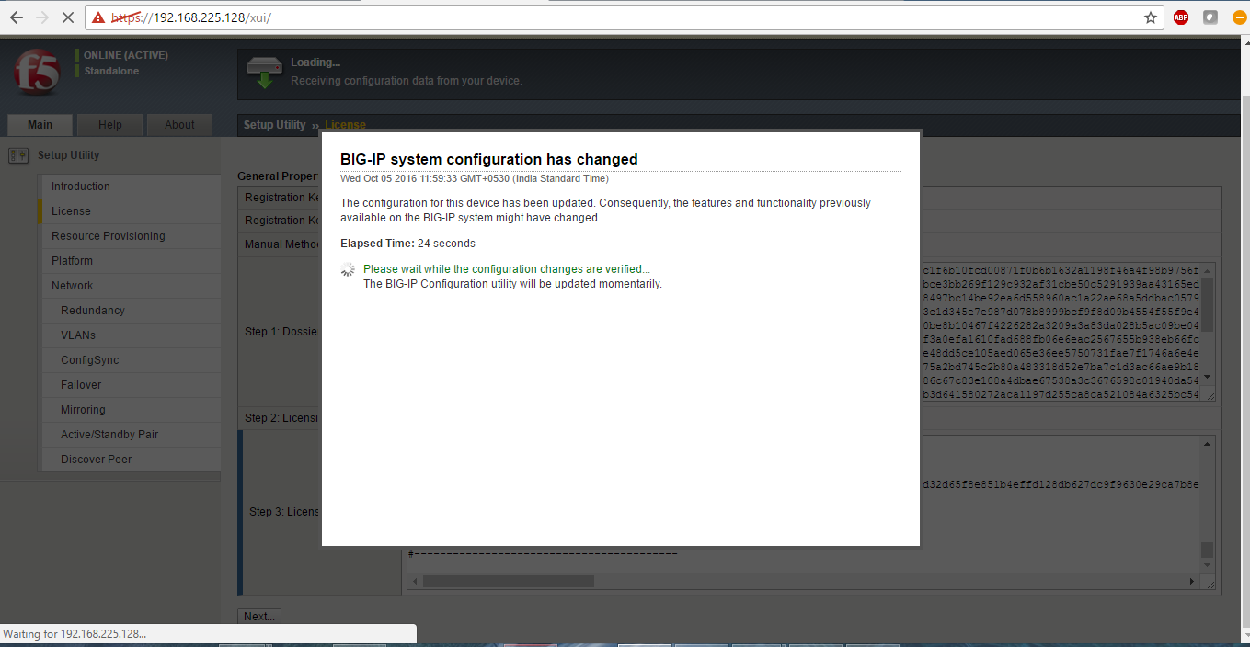
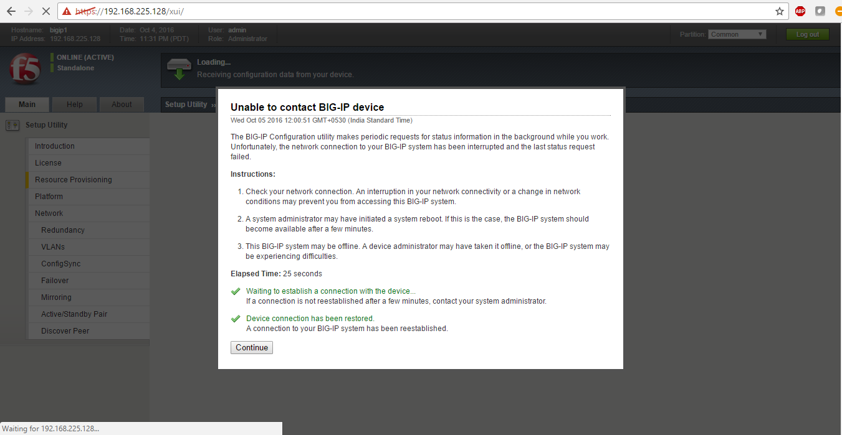
Device Rebooted Need Reconnection

Slide 18
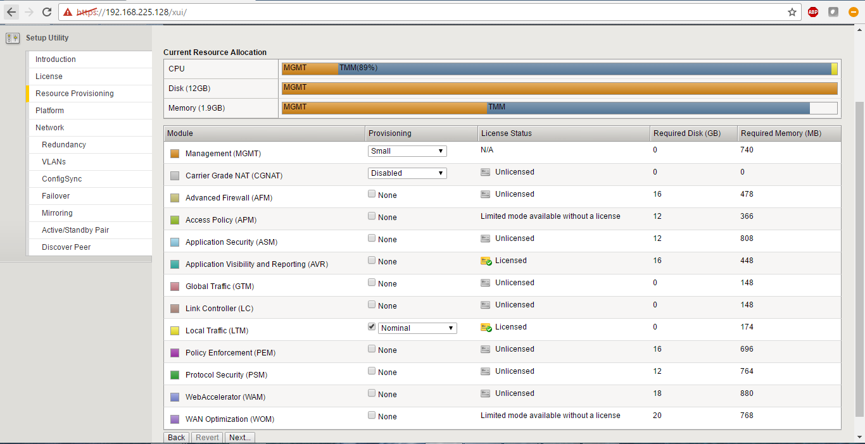
Licence Status
Click on Next

Slide 19
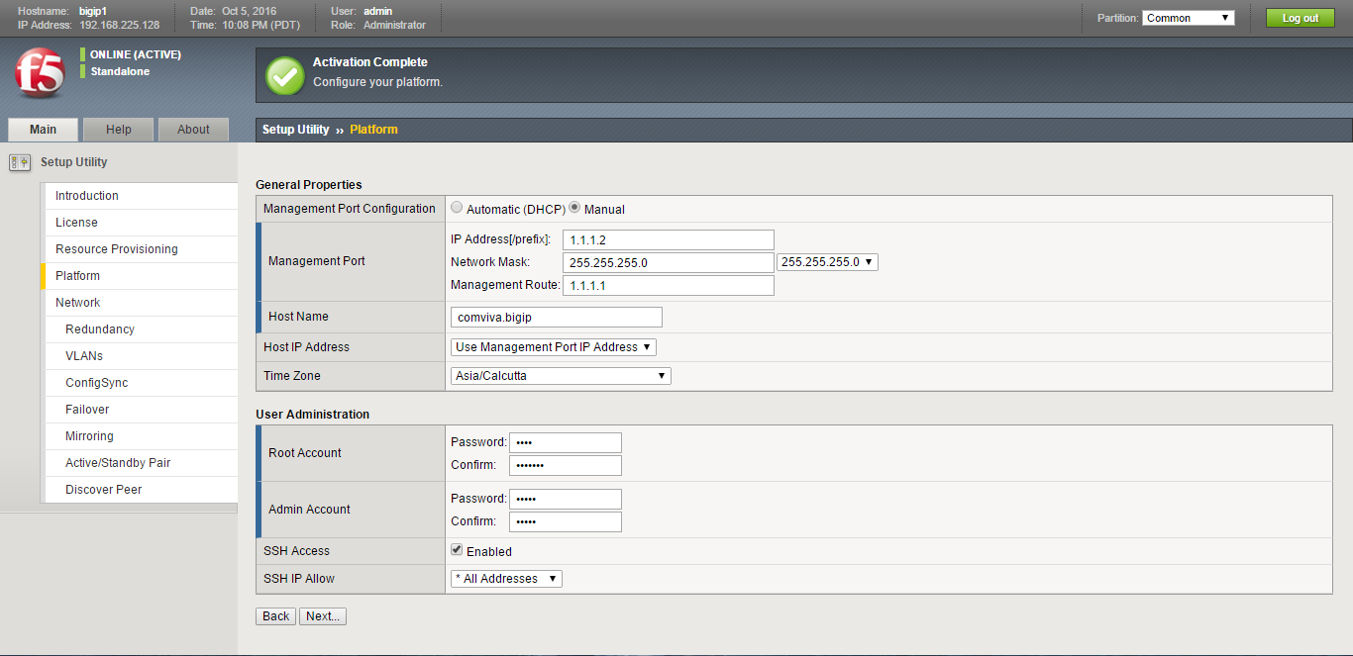
Management Configuration
Configure MGMT IP, Mask, Gateway and Host name accordingly
Change CLI and GUI password
Enable SSH, Allow ssh for all IPs
Click Next

Slide 20
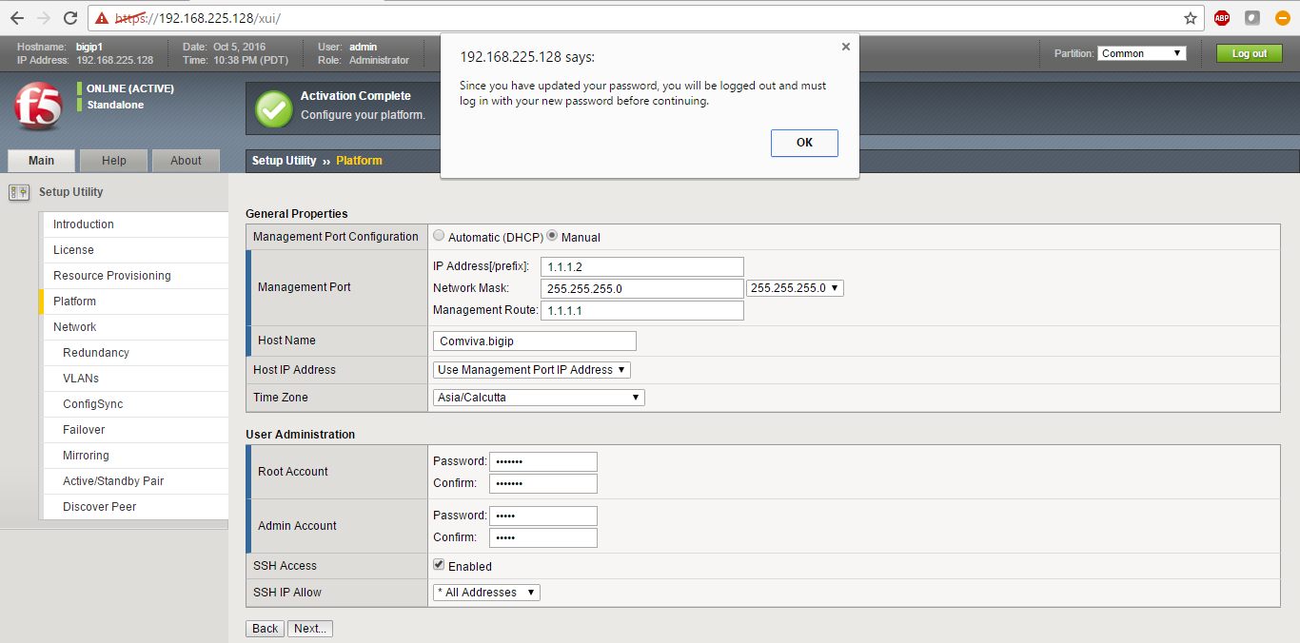
After Click Next Click OK

Slide 21
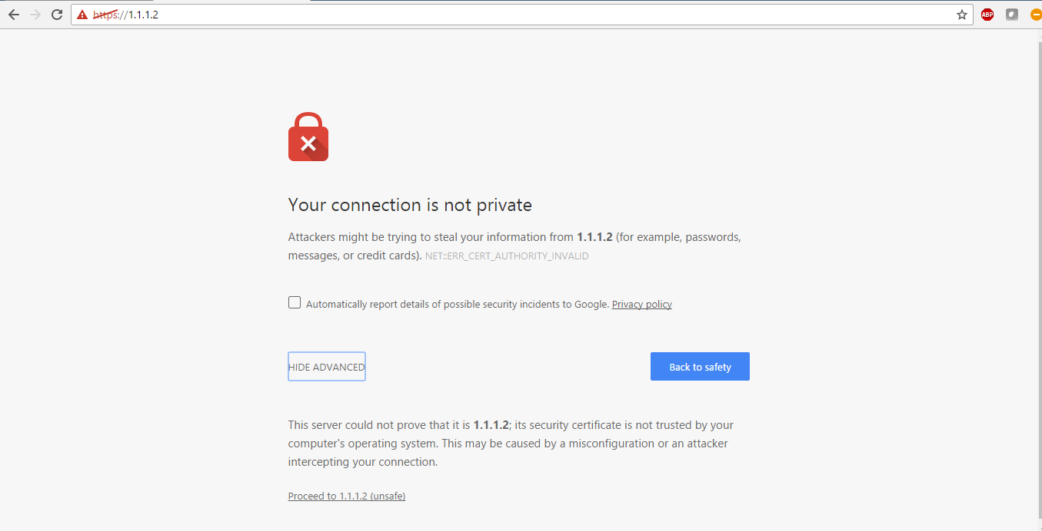
Access with new IP
Click to proceed

Slide 22
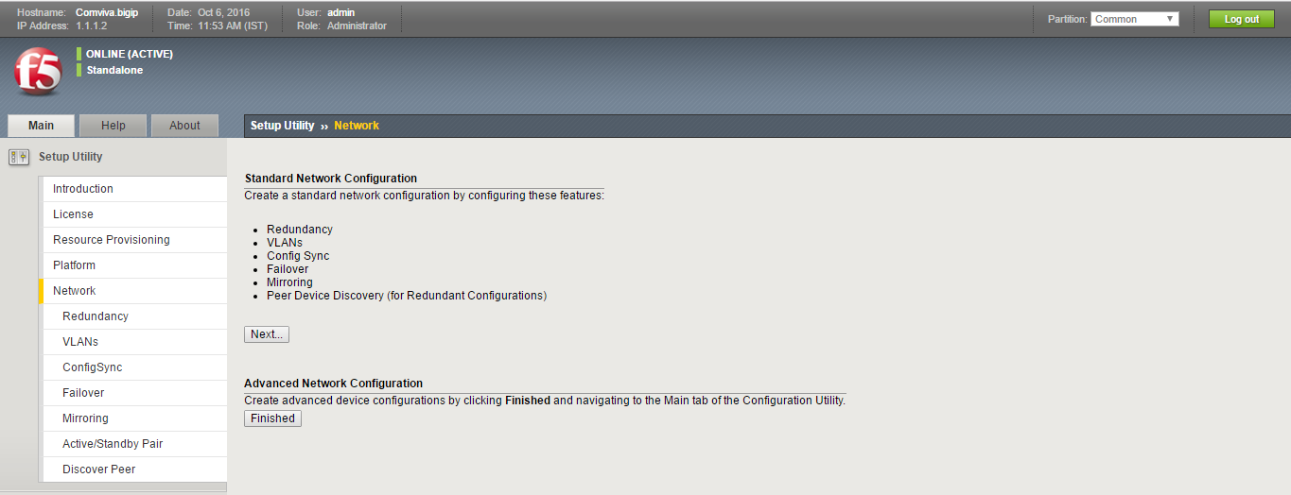
Click Finished, as we want to configure advanced network setting
Now will jump from setup utility to configuration utility

Slide 23
Configuration Utility
Vlan Configuration

Slide 24
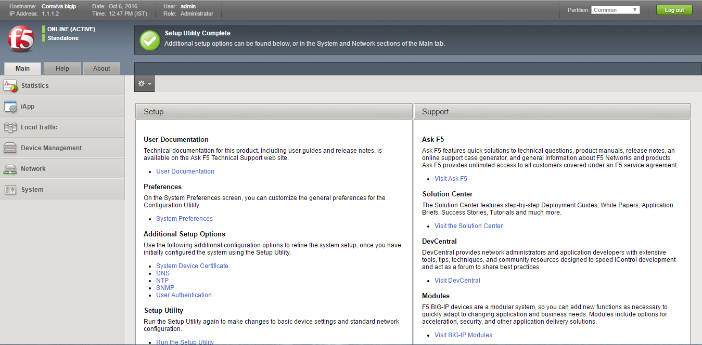
Click on Network

Slide 25
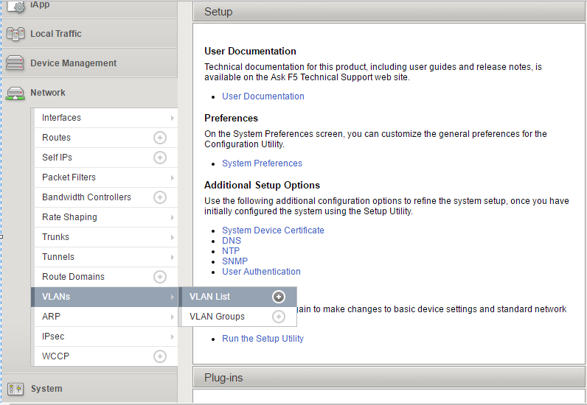
Click on VLAN List

Slide 26
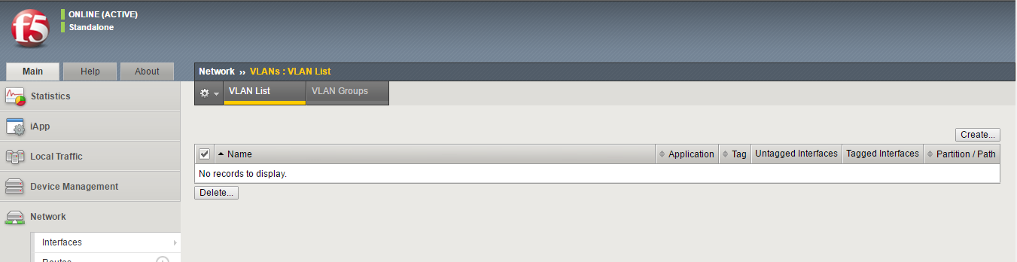
Click to create vlan

Slide 27
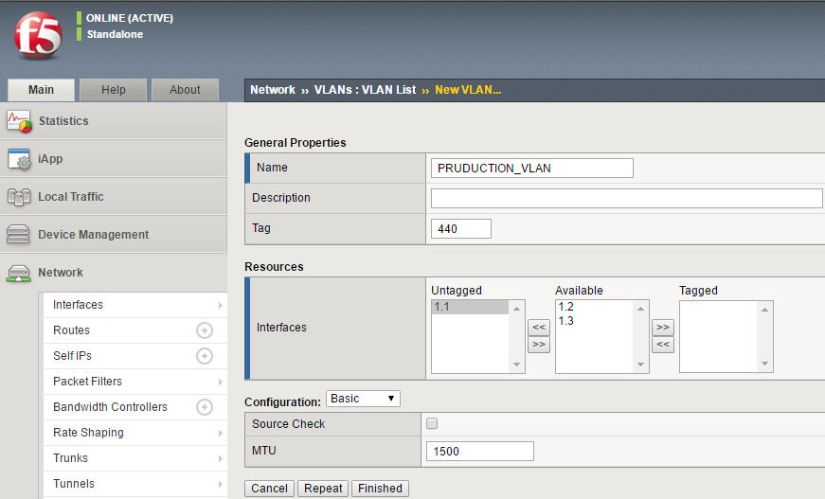
Type vlan name and vlan id
Interface can be tagged or untagged as per requirement
Click Finished

Slide 28
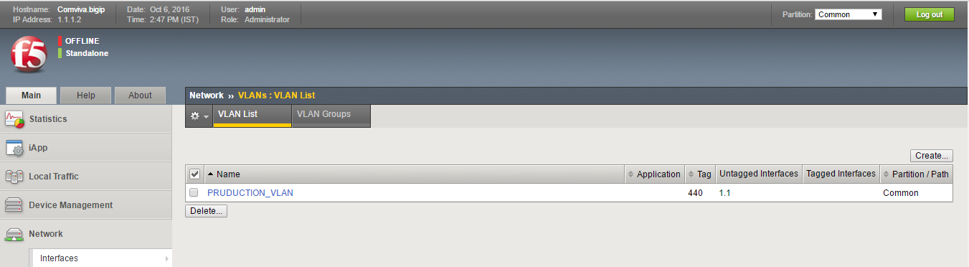
Quick View on Configured Vlan

Slide 29
Self IP and Floating IP Configuration

Slide 30
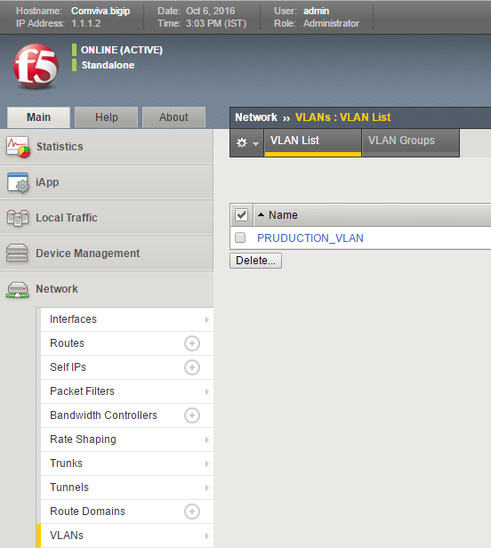
Click on Self IPs

Slide 31
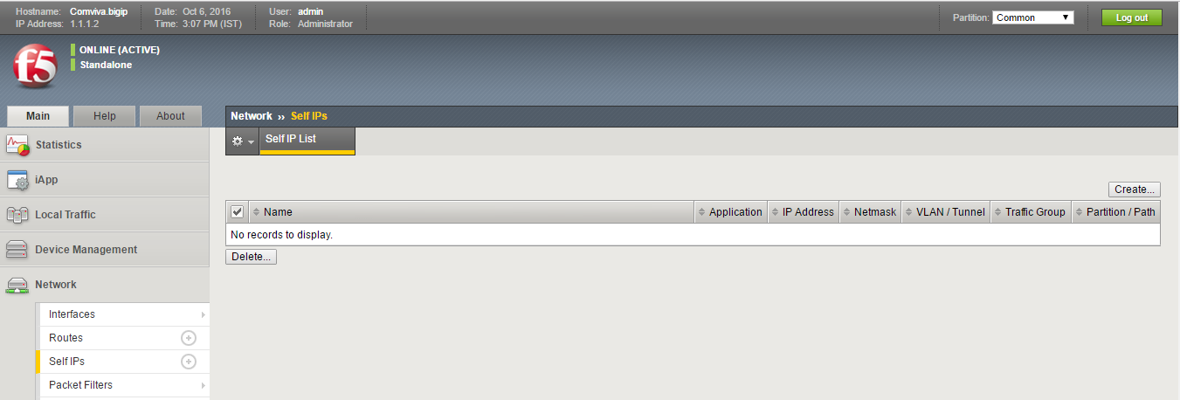
Click create to configure self ip

Slide 32
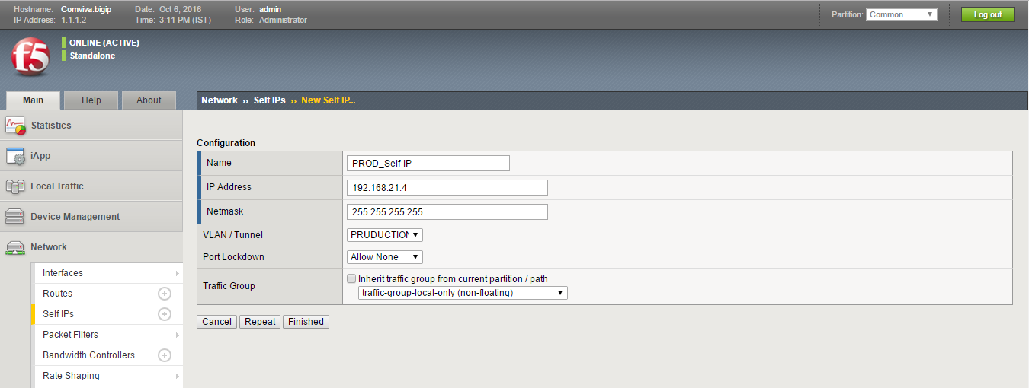
Name the self IP
Type IP address and mask as per requirement
Select vlan
Select non-floating as it is physical IP
Click repeat to configure floating

Slide 33
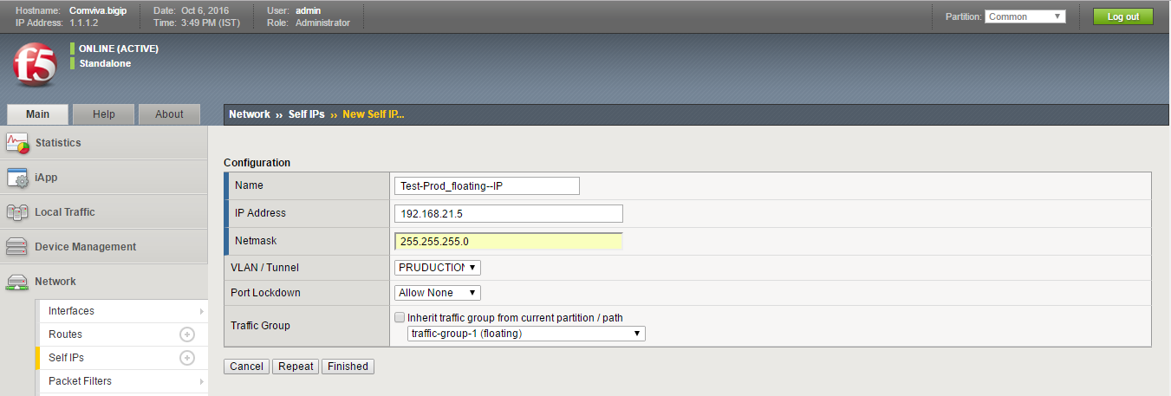
Name the self IP
Type IP address and mask as per requirement
Select vlan
Select floating
Click to finish

Slide 34
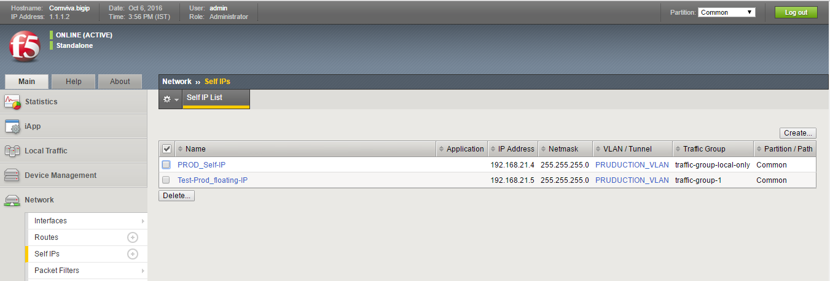
Quick View on Configured IPs

Slide 35
Node Definition

Slide 36

Node-: A node is a logical object on the BIG-IP® system that identifies the IP address of a physical resource on the network.
Gateway
F5
Web 1 192.168.21.4
Web 2 192.168.21.5
Web 2 192.168.21.6
TXN 1 192.168.21.7
TXN 2 192.168.21.8
TXN 3 192.168.21.9
TXN 4 192.168.21.10
Web Nodes
TXN Nodes

Slide 37
How to configure Node

Slide 38
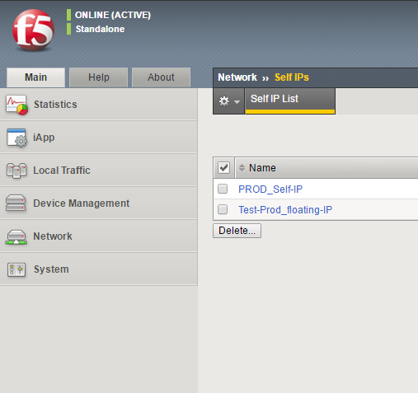
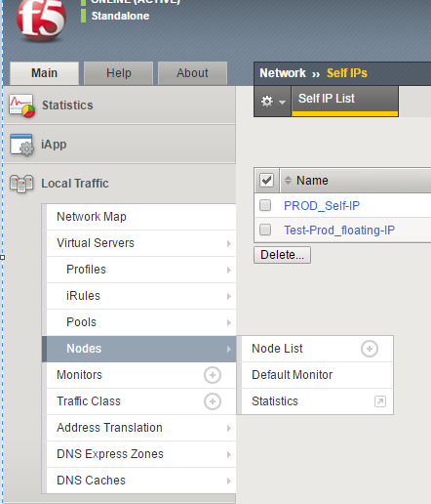
Click on Local Traffic
Click on Node list

Slide 39
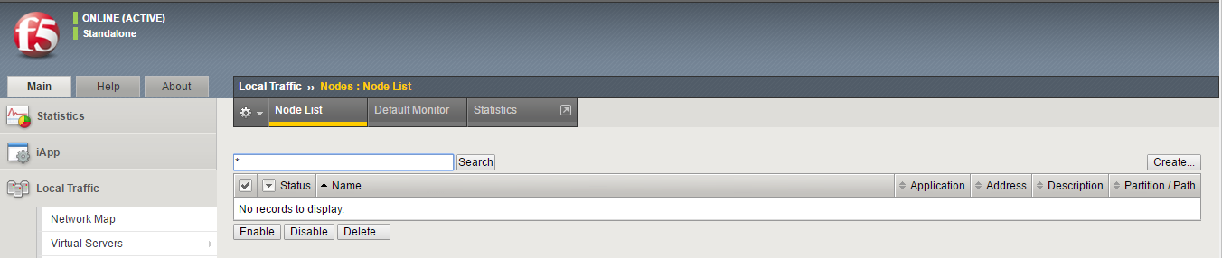
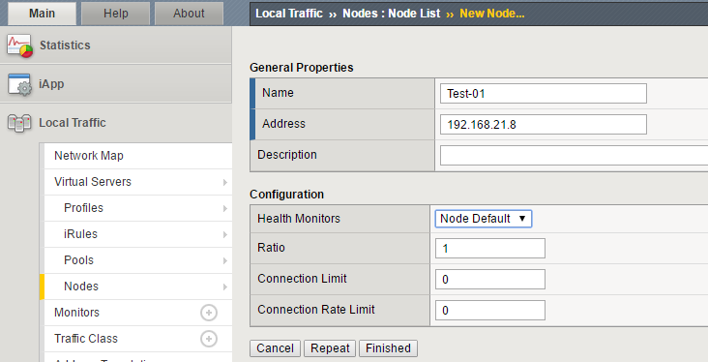
Click on Create
Type Name, Node IP and leave rest of the details default
Click to Finish

Slide 40
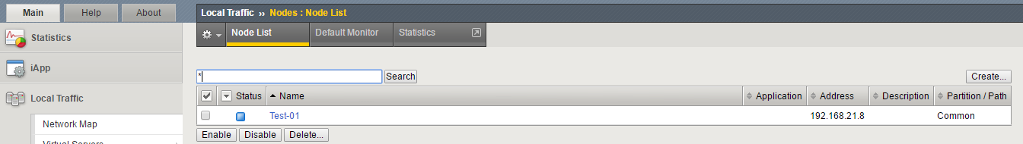
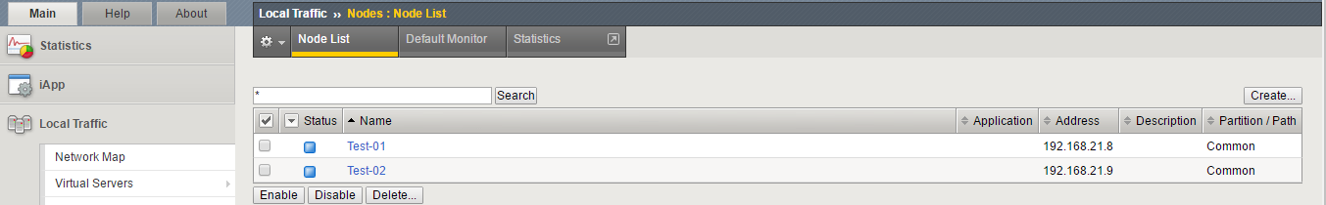
Quick View on Configured interfaces
Similarly Create another node

Slide 41
Pool Definition

Slide 42
Pool:- A load balancing pool is a logical set of devices, such as web servers, that you group together to receive and process traffic.
Gateway
F5
Application 1
Application 2
Web 1 192.168.21.4 :9990
Web 2 192.168.21.5:9999
Web 2 192.168.21.6:9999
TXN 1 192.168.21.7:9898
TXN 2 192.168.21.8:9898
TXN 3 192.168.21.9:9898
TXN 4 192.168.21.10:9898
Web application pool
TXN application pool

Slide 43
How to configure Pool

Slide 44
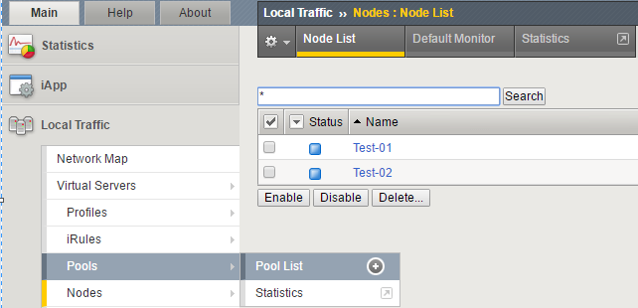
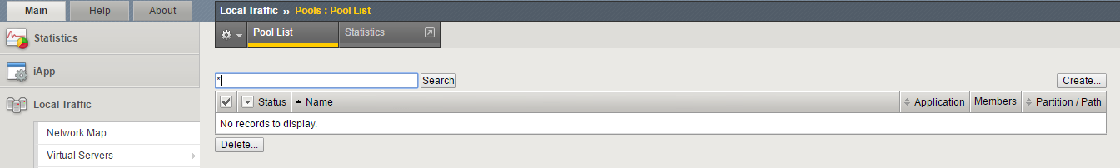
Click on Pool List
Click to create Pool

Slide 45
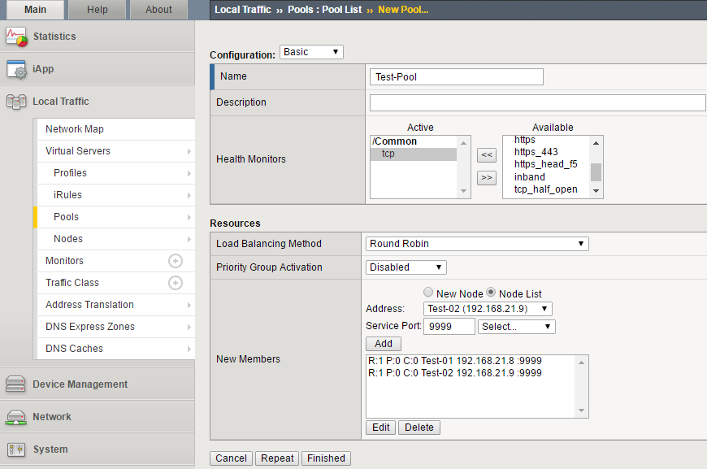
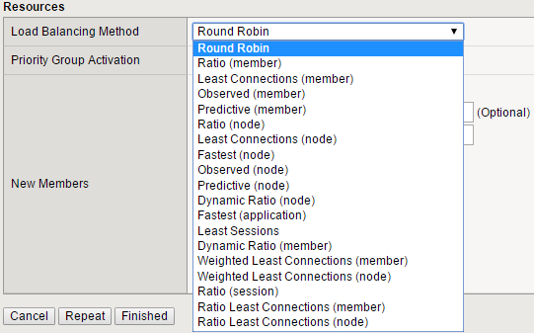

Type name and select health monitor according to requirement
1. Select node from node list 2. Fill service port 3. Click on to add
Click on Finish

Slide 46
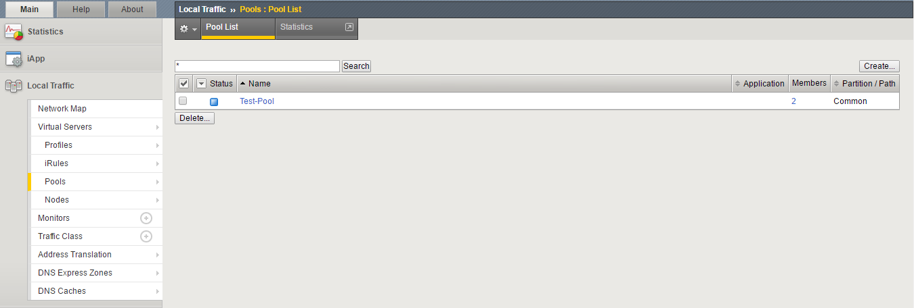
Quick View on Configured Pools

Slide 47
Virtual Server Definition
A virtual server is a traffic-management object on the BIG-IP system that is represented by an IP address and a service. Clients on an external network can send application traffic to a virtual server, which then directs the traffic according to your configuration instructions. The main purpose of a virtual server is often to balance traffic load across a pool of servers on an internal network. Virtual servers increase the availability of resources for processing client requests

Slide 48
Users
Gateway
F5
VIP 192.168.21.11 :9999
VIP 192.168.21.11 :9898
Application 1
Application 2
Web 1 192.168.21.4 :9990
Web 2 192.168.21.5:9999
Web 2 192.168.21.6:9999
TXN 1 192.168.21.7:9898
TXN 2 192.168.21.8:9898
TXN 3 192.168.21.9:9898
TXN 4 192.168.21.10:9898
Web application pool
TXN application pool

Slide 49
Configure Virtual Server

Slide 50
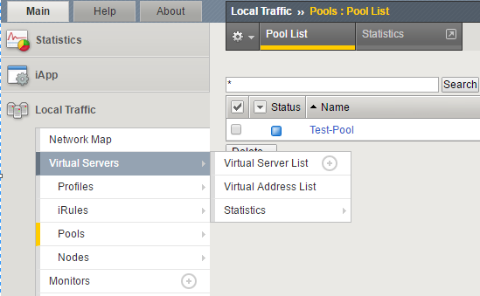
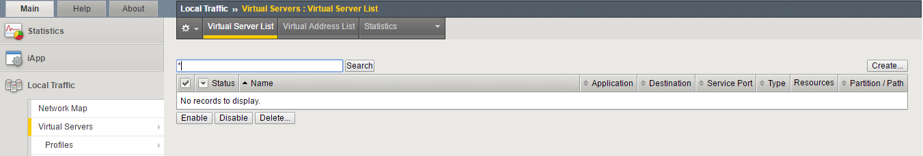
Click on Virtual Server List
Click on Create

Slide 51
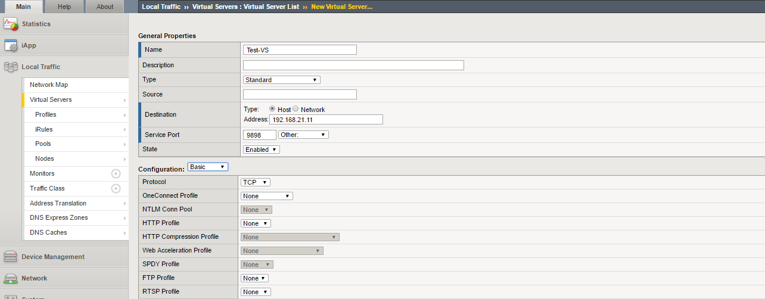
Type name of virtual server
Type VIP IP and service port(listening port)
Leave other setting default
To be continued

Slide 52
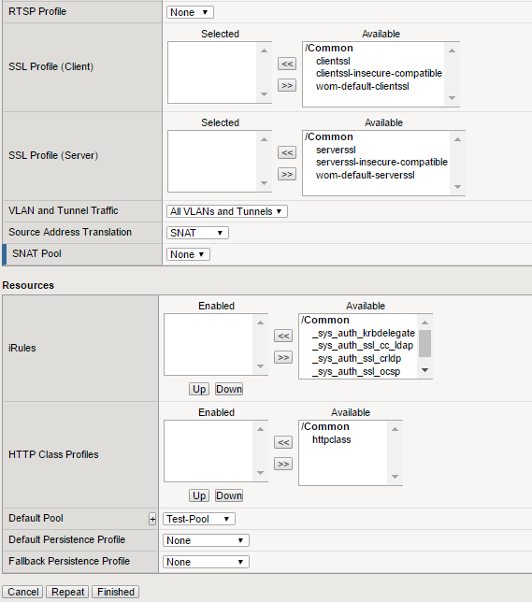


Select Auto map from dropdown
Select Pool that need to load balanced
Click to finish

Slide 53
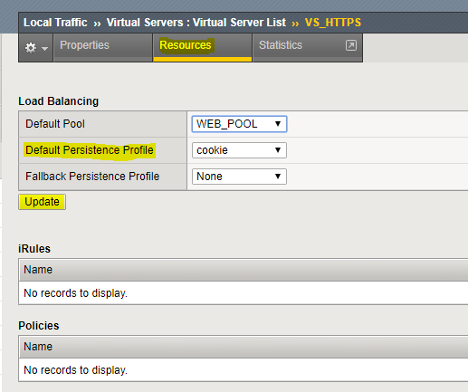
Session Persistence
Goto Virtual Server → Resources tab
Choose Persistence Profile

Slide 54
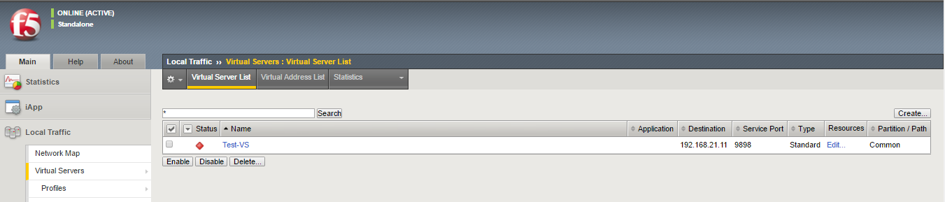
Quick View on Configured Virtual Servers

Slide 55
Profiles Definition
Profiles are a configuration tool that you can use to affect the behaviour of certain types of network traffic. More specifically, a profile is an object that contains settings with values, for controlling the behaviour of a particular type of network traffic, such as HTTP connections. Profiles also provide a way for you to enable connection and session persistence, and to manage client application authentication.

Slide 56
How to Configure Profiles

Slide 57
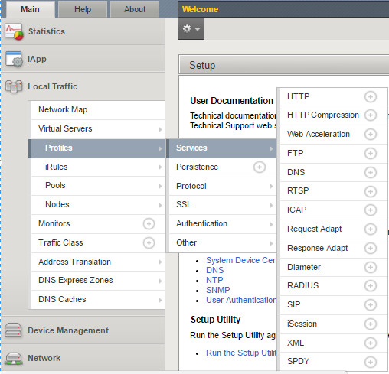
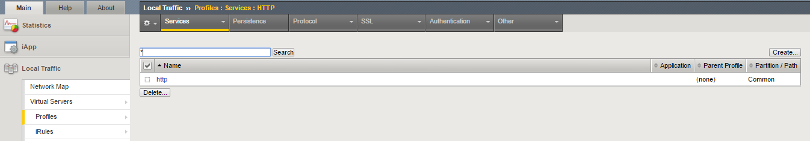
Click on HTTP
Click to Create for new Profile

Slide 58
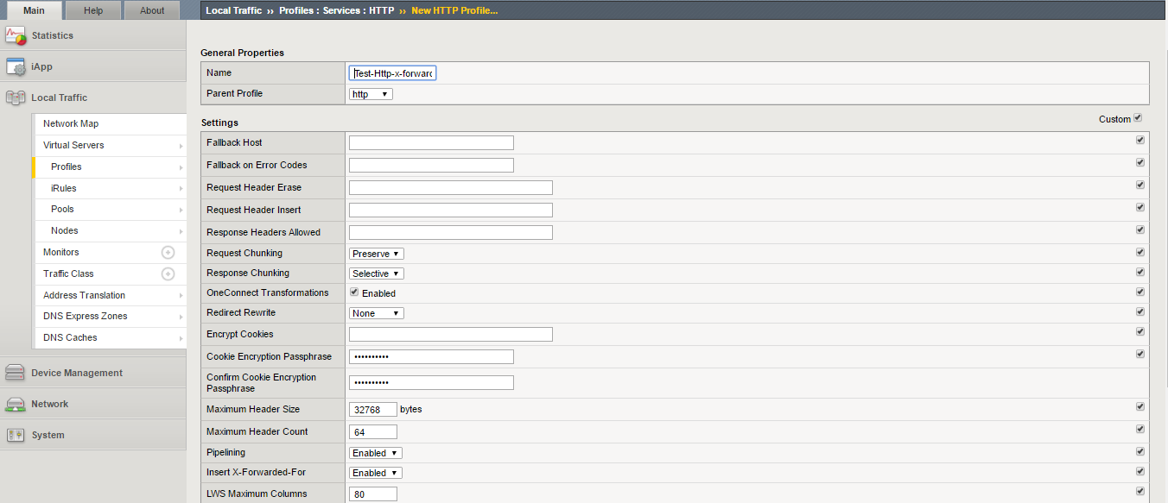
Name the profile
Select parent profile http
Select custom
Select Insert X-Forwarded-For Enabled
To be continued

Slide 59
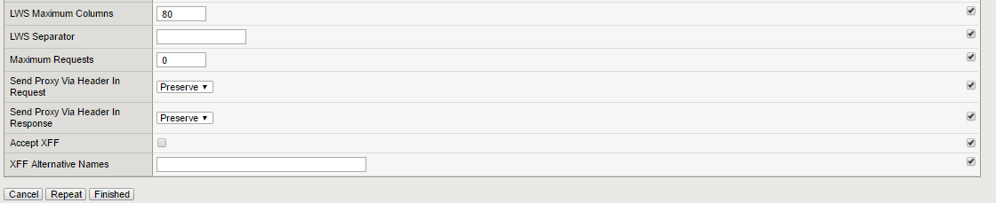
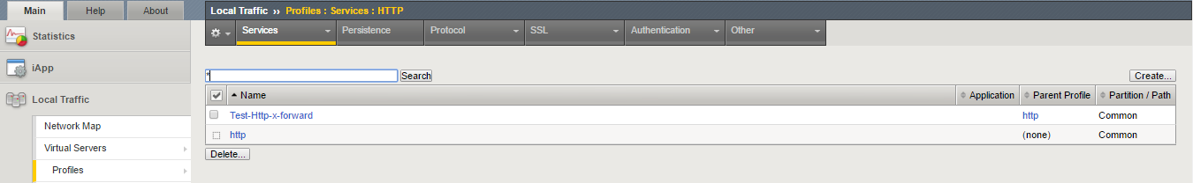
Click on Finished

Slide 60

Attach Profile to Test-VS
Select profile
Click on Update

Slide 61
SSL Offloading
It is a feature of F5 in which request from client to f5 in encrypted (i.e HTTPS) then F5 offload the SSL data from
HTTPS request & then forward the client request to Server in HTTP format.
After that Server response back in HTTP to F5 then F5 encrypt response to HTTPS format & send to client
So in this way Servers Resources are saved that were previously used in SSL (Handshaking, encryption, Decryption) & in this way server performance Increases.
According to a research Server Takes 10 times the time to process HTTPS request as compare to the HTTP Request.
Requirement
Before we configure it we must have SSL certificates & Key for our Website.
There are Two Method for Creating Certificates & Key
1. Self signed by F5 Device 2. By Certificate Authority

Slide 62

Generating Self Signed Certificates
Self signed by F5 Device
Go to System →File Management
→ SSL_Certificate_List then create new.
Now add the information as shown
In diagram.
So we have created self-signed SSL
Certificates & Key.
Now we will create a Client SSL Profile.

Slide 63

CA Certificates
2.Add Certificates Provided by CA
Go to System →File Management
→ SSL_Certificate_List →Import
Now select Import type as Certificate.
Give a name to it.
Browse the Certificates Provided by CA.
Then Click import.

Slide 64

Import Key to F5
Add Key Provided by CA
Go to System →File Management
→ SSL_Certificate_List →Import
Now select Import type as Key.
Give a name to it.
Browse the Key Provided by CA.
Then Click import.

Slide 65

Client SSL Profile
Open the Local Traffic > Profiles > SSL > Client page, and then click Create
Now fill the required information as shown. Click Custom then Add for Certificate Key Chain then select Certificate & key we created & click Finished.

Slide 66

Go to Local Traffic→ Virtual Servers & select the virtual server.
Now assign the Client SSL profile that we created to Virtual Server in the configuration field & click update at bottom.
Now when client make HTTPS request to this VS ip then F5 will offload SSL & will send request in HTTP to node.
In response F5 will encrypt the response to HTTPS & will forward to client.

Slide 67
iRULES
An iRule, in its most simple terminology, is a script that executes against network traffic passing through an F5 device
iRules can route, re-route, redirect, inspect, modify, delay, discard or reject, log or do just about anything else with network traffic passing through a BIG-IP
iRule allows us to use the advance feature of F5 which we can’t use via CLI or GUI

Slide 68


Click on iRule list
Click on Create

Slide 69


Paste the iRule
Click on Finish

Slide 70


Attach iRule to Virtual Server
Click on Virtual Server
Click on Test-VS

Slide 71

Click on Resources
Click on Manage

Slide 72


Select Test-iRule
Click on Finished

Slide 73

Authentication using Remote Server
We will use tacacs+ for authenticating user traffic
Goto System → Users → Authentication
Fill the following details

Slide 74

Authentication using Remote Server
Assigning access control properties to user groups
Goto System → Users → Remote Role Groups
Click create
Fill the following details

Slide 75
NTP Configuration

Slide 76


Add NTP IP
Click on NTP
Click for Update

Slide 77
SNMP Configuration

Slide 78


Insert SNMP server IP and Add
Click on Configuration
Click to Update

Slide 79


Select SNMP version According to requirement
Click on Create

Slide 80



Slide 81
Packet Capturing on F5 LB

Slide 82


Capturing Packets from CLI
Packet Capture from Command Line on F5 LB-
Use the command tcpdump –D to see all available interfaces.
To See list of all available Interfaces
We selected interface no. 1 i.e eth0
Tcpdump try to resolve IP to Name from DNS

Slide 83


Use the command tcpdump –h for Help.
Filter traffic to/from host 10.1.1.1
-n used to stop IP to name resolution

Slide 84


Packets only form source 10.1.1.1
Using IP, Port based filters-
Filtering packets on Port 22

Slide 85


Packets with only ACK flag set
TCP Flags based filters-
Packets with ACK & RESET flags only

Slide 86


Only Packets that match src 10.1.1.1 & flag push as set
Using Combined Filters-

Slide 87

Only Packets matching dst IP 10.1.1.1, src port 23 & tcp flag reset
Using Combined Filters-

Slide 88


Stop Capture after 5 packets
Saving Packet Captured from Host 10.1.1.1 to a test.pcap file

Slide 89

Capturing Packets via GUI
Goto System → Support, then tick TCP Dump box. Select VLAN, No. of packets to Capture. Apply filter in options field.
Then Click Add. Select Timeout & click Start

Slide 90



Now Download the Snapshot File. The file will be downloaded as .tar.gz, now extract this file.
We will find a file with .dmp extension, now rename it as .pcap so we can analyze it in wireshark.

Slide 91

Copy Capture File from Server to PC
As we have save the captured packets to a file on server, now we will copy this file from server to our pc on which
Wireshark is installed to analyze the packets.
We will use WinSCP App to achieve this. First open the WinSCP app that is installed on our pc. After that it will ask to login, type IP or Hostname in Hostname field, Port no., Username & Password & click login.
Remember to copy file from server we must have connectivity to the server.

Slide 92

Now we will get a Window as shown below. On left side is our PC & on Right side is Server Directories.

Slide 93

Now drag & drop the captured file from server directory to our PC.
Now we have the captured file on our pc & we can analyze it using Wireshark GUI.

Slide 94
Thank You

