Slide 1

CISCO ASA Firewall configuration document

Slide 2
What is Firewall?
A firewall is a security device which is configured to permit, deny or proxy data connections set by the organization's security policy.
A firewall's basic task is to control traffic between computer networks with different zones of trust

Slide 3





Simple Internet Firewall Design
Internet
ASA
UNTRUSTED NETWORK
Usually blocks all inbound access from untrusted network
TRUSTED NETWORK
Allows all access outbound from trusted network

Slide 4

Internet Firewall Design with DMZ
Firewall DMZ interface allows traffic from trusted and unstrusted networks
INTERNET SERVER
Internet
ASA
UNTRUSTED NETWORK
TRUSTED NETWORK

Slide 5
Firewall Modes of Operation
Routed Mode : is the traditional mode of the firewall. Two or more interfaces that separate L3 domains
Transparent Mode : is where the firewall acts as a bridge functioning mostly at L2

Slide 6
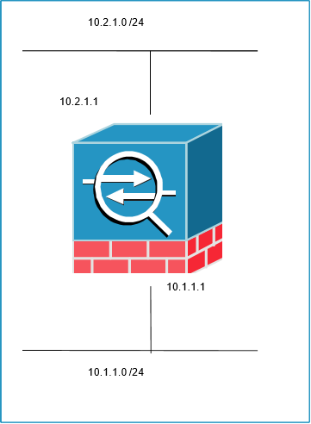
Routed Mode
Traditional mode of the firewall
Separates two L3 domains
Policy is applied to flows as the transit the firewall

Slide 7
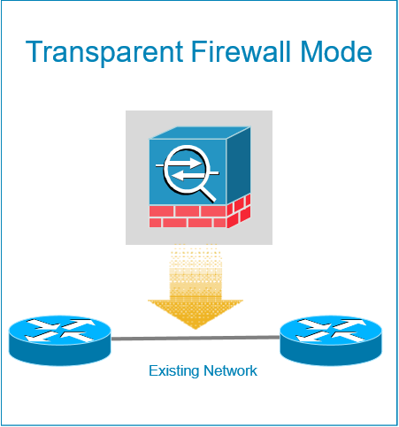
Transparent Mode
Operates at layer 2, transparent
to the network
Drops into existing networks without
re-addressing
Simplifies internal firewalling & network segmentation

Slide 8
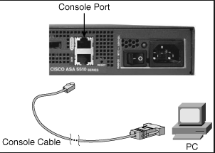
Accessing the ASA
Connect the ASA with the PC via Console
port
Open up Putty on the PC and connect to
ASA

Slide 9
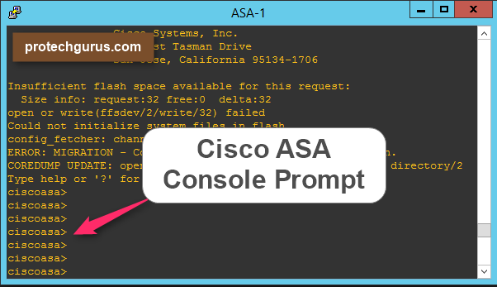
When you connect to the ASA, you login to User Exec mode , this gives you very little access of the ASA
Ciscoasa>

Slide 10

Entering the enable mode and configuration mode
To access the privileged access mode type en
To enter the configuration mode ,type
conf t in the Privileged mode
It gives you access to all of the show commands and some commands like reload etc
In this mode you configure the ASA

Slide 11

Configure the hostname and assign an Ip address
Nameif is used to Assign a name to the Interface
By default , Inside interface has
Security level of 100
And outside interface has 0
Policy is automatically open from Higher security level to Lower security level

Slide 12
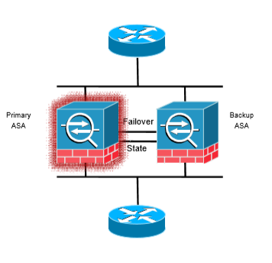
Firewall HA(Failover) -Active/Standby
Failover is used for Active to Standby switchover
In the Active/Standby mode ,Active firewall carries all the traffic
Configuration and session information should synched between them.
If the Active member goes down , Secondary firewall takes the role of Active firewall.
Both platforms must be identical in software, licensing, memory and interfaces

Slide 13
How Failover Works
A dedicated Failover link is created on which traffic related to High availability passes through.
Failover link passes Hellos between active and standby units every 15 seconds (tunable from 3-15 seconds)
After three missed hellos, primary unit sends hellos over all interfaces to check health of its peer.
If the standby unit doesn’t receive 3 hellos it presumes the role of Active unit.

Slide 14

HA Feature –Interface Redundancy
Up to 8 redundant interface pairs are allowed
When the active physical interface fails, traffic switches to the standby physical interface and routing adjacencies, connection etc won’t need to be relearned.
Adding members as a part of Redundant interface

Slide 15
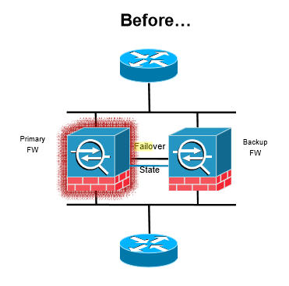
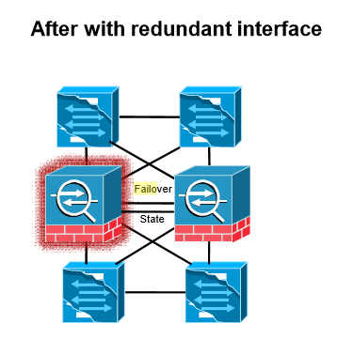
HA Feature –Interface Redundancy

Slide 16
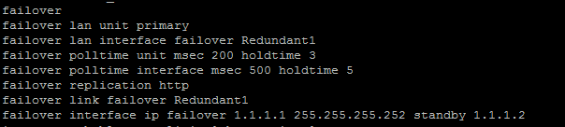
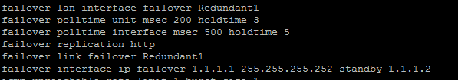
Configuring Failover
Primary Device
Secondary Device

Slide 17
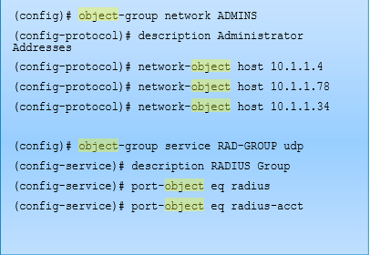
Adding Object Groups
Object groups allow grouping of similar items for easing configuration and operational maintenance of the ASA firewall
Can be grouped by protocol, network or service

Slide 18
Network Address Translation (NAT)
NAT (Network Address Translation) uses a pool of public addresses that are mapped one-to-one to the private (or "inside") addresses, keeping the port number intact
PAT (Port Address Translation) uses a single outside public address and maps multiple inside addresses to it using different port numbers.

Slide 19


Network Address Translation (NAT)
Configure PAT to Allow Hosts to Go Out to the Internet
In order to configure PAT, A network create a network object that represents the inside subnet and configure a dynamic Nat rule(PAT)
192.168.0.10
PAT
Internet
Inside Interface
Outside Interface
192.168.0.1
198.51.100.10
192.168.0.20

Slide 20


Network Address Translation (NAT)
Configure NAT to Access the Web Server from the Internet (Static Nat)
Users on the internet will hit the public Ip 198.51.100.101 and firewall will translate it to the private ip 192.168.1.100 of the web server ,Through this way Users will think as the Public ip is the real server
1.1.1.1
STATIC NAT
Internet
Dmz Interface
Outside Interface
Public User
192.168.1.99
198.51.100.10
Web Server
192.168.1.100

Slide 21
Firewall configuration and HA document

Slide 22
Thank You
192.168.1.100

